Slide 1
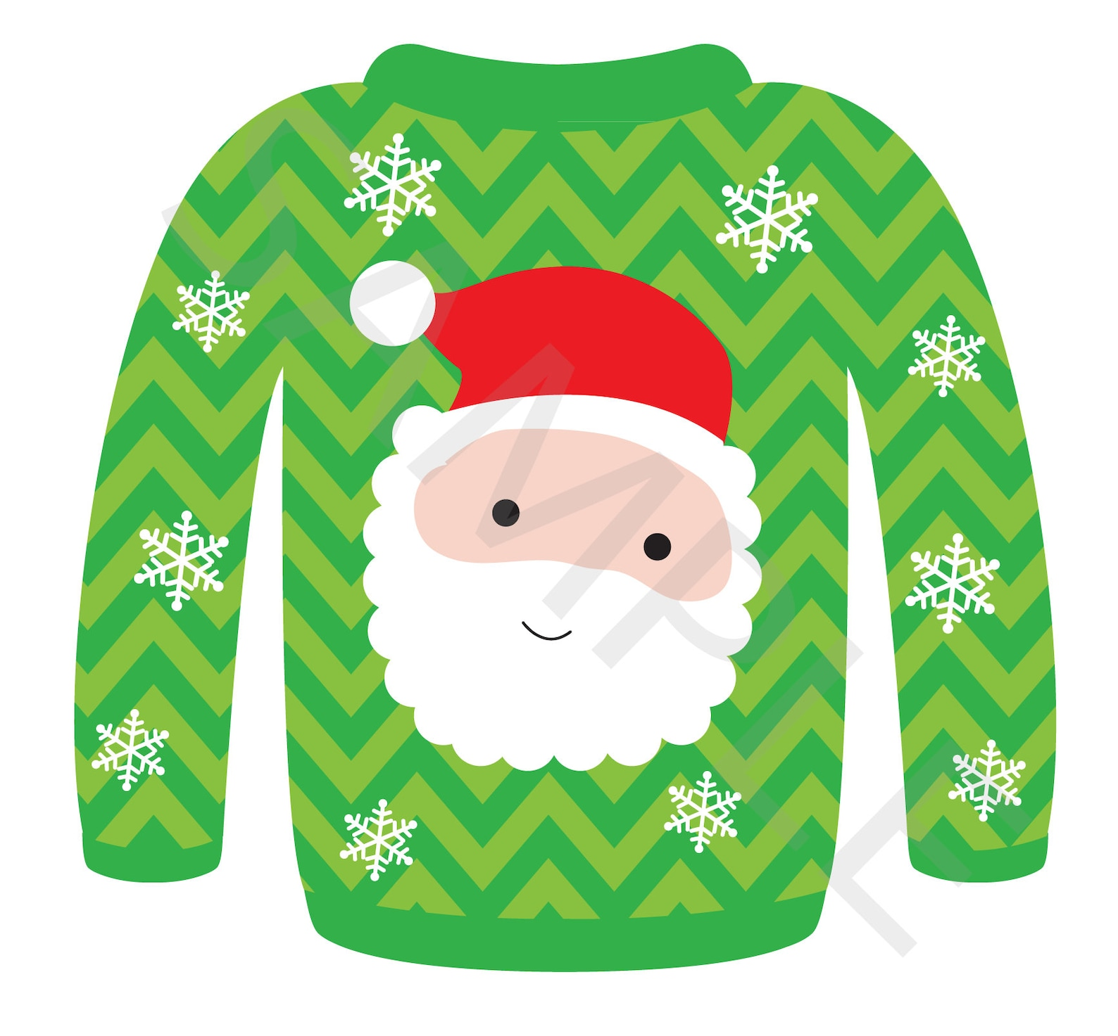
Ugly Sweater- Design

Slide 2
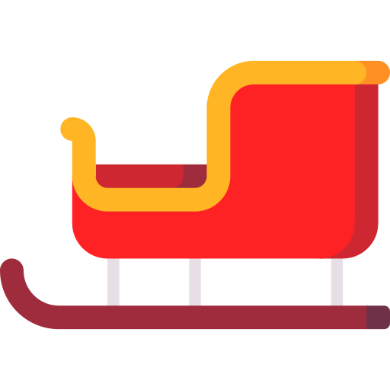
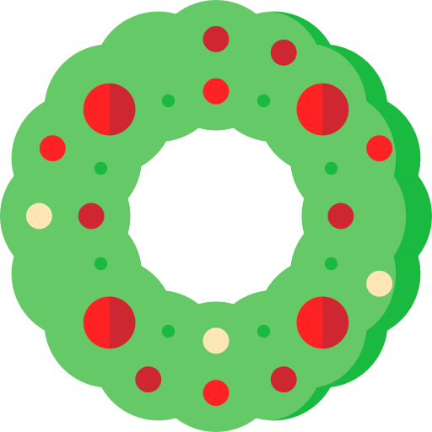
4. Shapes options 1

Slide 3
4. Shapes options 1

Slide 4
4. Shapes options 1

Slide 5
4. Shapes options 1

Slide 6
Type your name:
Name:

