Slide 1
Planets Guided Research © Brittany Washburn
Fill in the information for the planet you’re assigned
Site for research: https://www.ducksters.com/science/astronomy.php
Question | Answer
Planet Name
How many moons does this planet have?
Distance to sun?
Distance and time of one orbit
Polar diameter and equatorial diameter
Surface temperature
Rings?
Time of one rotation
Any other interesting facts?

Slide 2
Solar System Stop Motion Animation

Slide 3
These planet icons can be recolored, resized, and fully customized because each one is a layered group of shapes. Play around with them to see what they can do.
Your Task:
1. Create an animation that includes at least 40 slides.
2. Create an animation of a space scene. It must include at least two facts from your first slide. *Remember to keep it school appropriate.

Slide 4
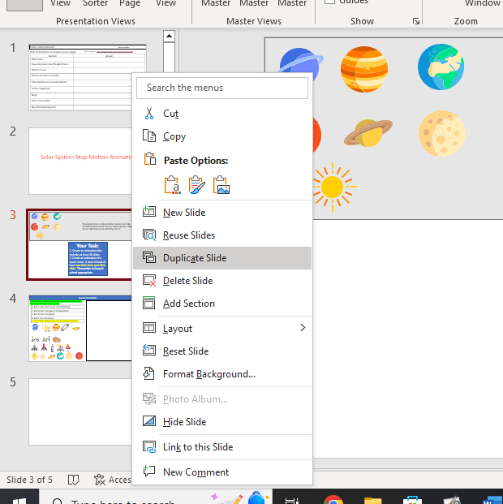
*Remember to right click and Duplicate Slide to make new slides

Slide 5
Space Scene Builder
© Brittany Washburn
Build the scene on the next slide. You may need to resize, rotate, and change the layers of the objects.
1. Add a dark color square as the backdrop.
2. Add at least one type of transportation.
3. Add at least one planet.
4. Add a star and meteor.
5. Add at least two facts from your Solar System Research.

