Slide 1
Online Research Review

Slide 3
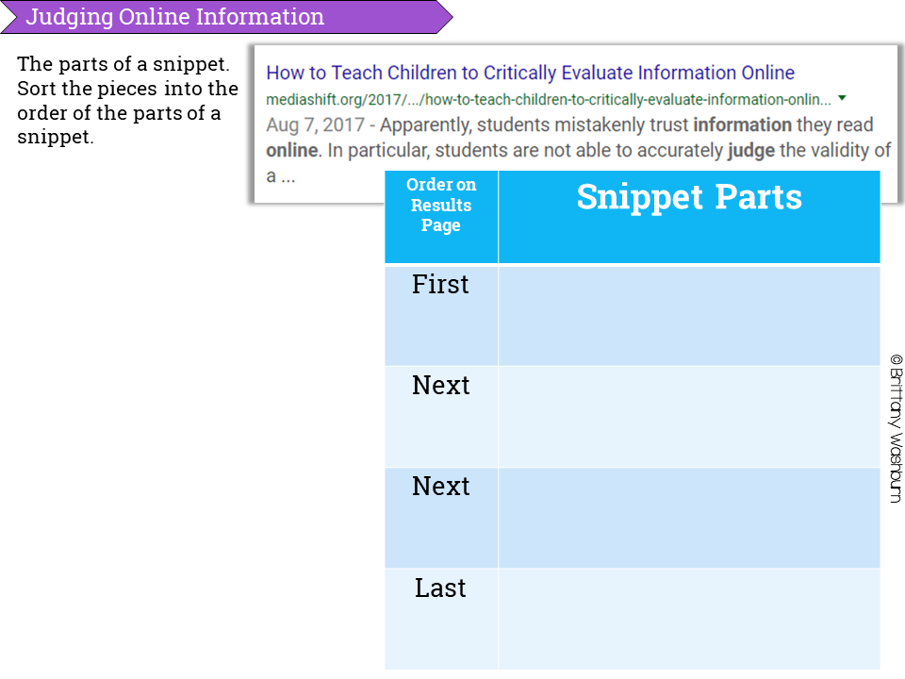

Slide 4
Search Engine Links: (Hold down your control key and click on the link to open.)
https://plovich.weebly.com/search-engines.html

Slide 5
Question: Why is October the 10th month instead of 8th? Oct=8
Source 1: | URL | Website Publisher or Author
Confirmed by: | URL | Website Publisher or Author
Answer:

Slide 6
Question: Search for a Kindness Quote for Kids
Source 1: | URL | Website Publisher or Author
Confirmed by: | URL | Website Publisher or Author
Answer:

