Slide 1
HOW TO COPY AND PASTE
THE SNAP CUBES

Slide 2
HOW TO COPY AND PASTE
THE SNAP CUBES

Slide 3
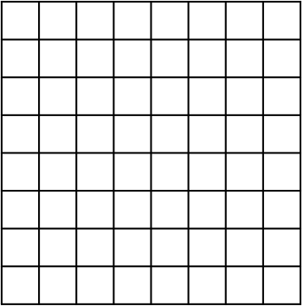
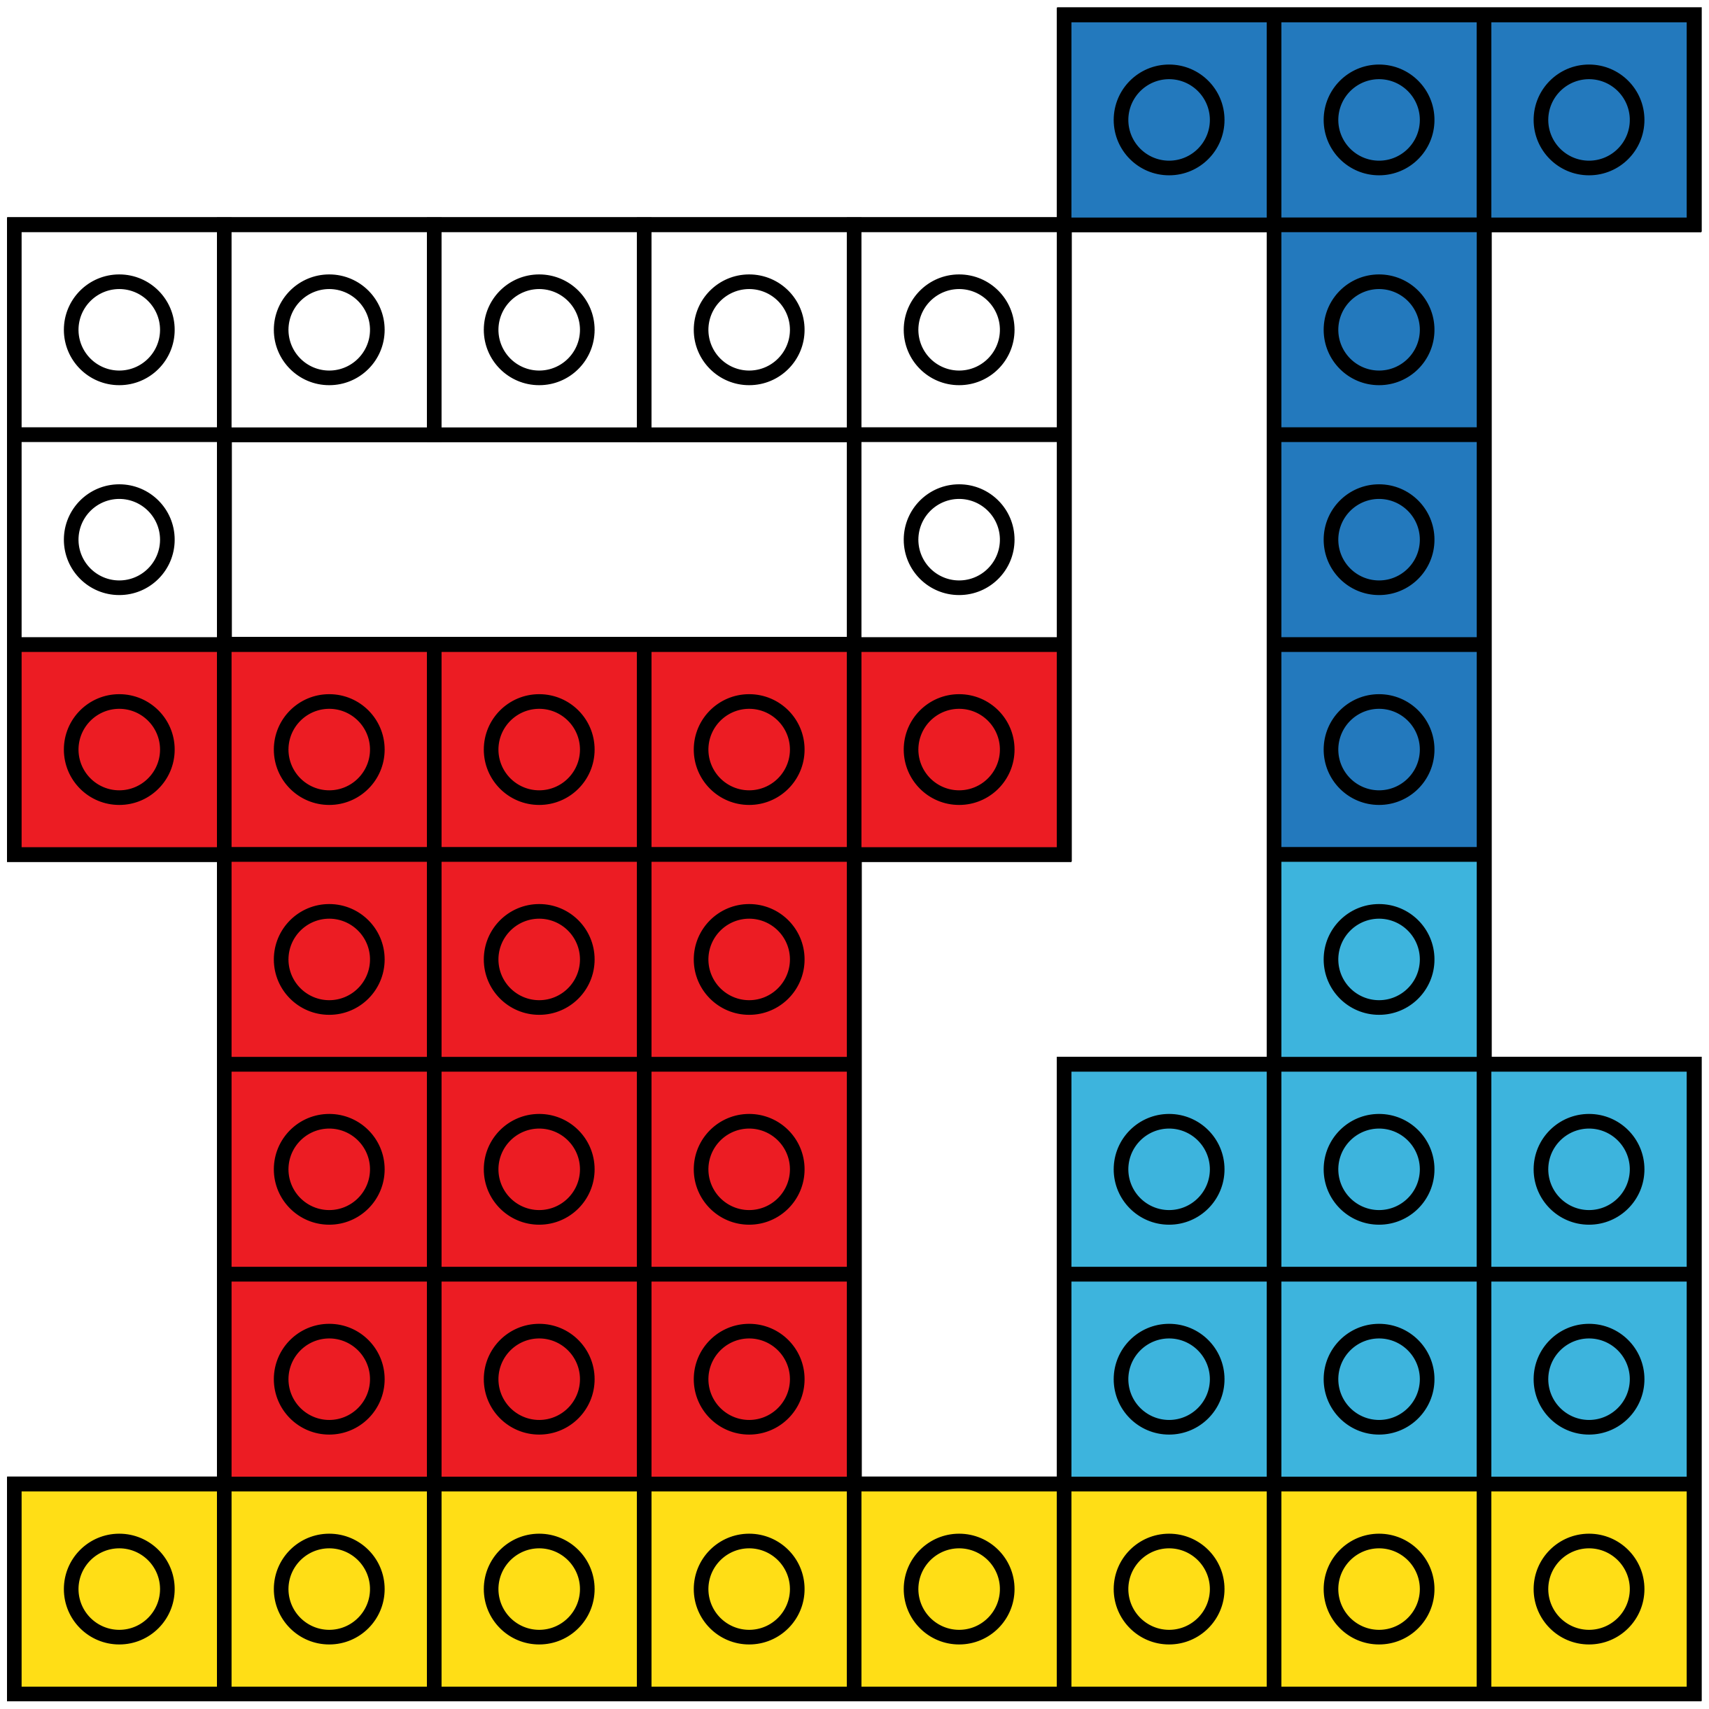
DIRECTIONS
On the following slides your job is to create the design by filling in the grid.
Each grid is 8x8, which means there are 8 rows and 8 columns.
There is just one of each color snap cube so you will have to duplicate each color many times.
You can copy and paste this grid over the design on each slide if it helps you.
*Match the grid up to one corner of the design so that it fits.
This helps me to see where the blank boxes are on the grid. It is optional.
RIGHT
WRONG

