Slide 1


Slide 2
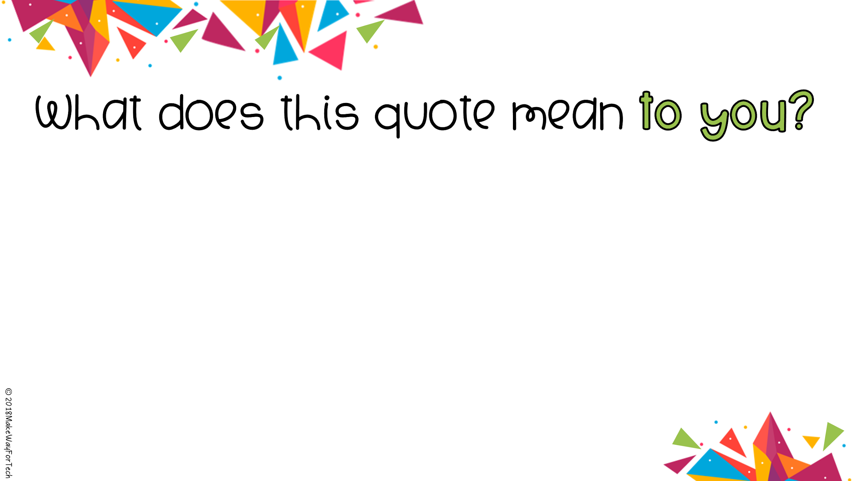
No act of kindness, no matter how small, is ever wasted.
- Aesop
Type here
Notes:
Quote is editable. Teacher records class discussion responses.

Slide 3
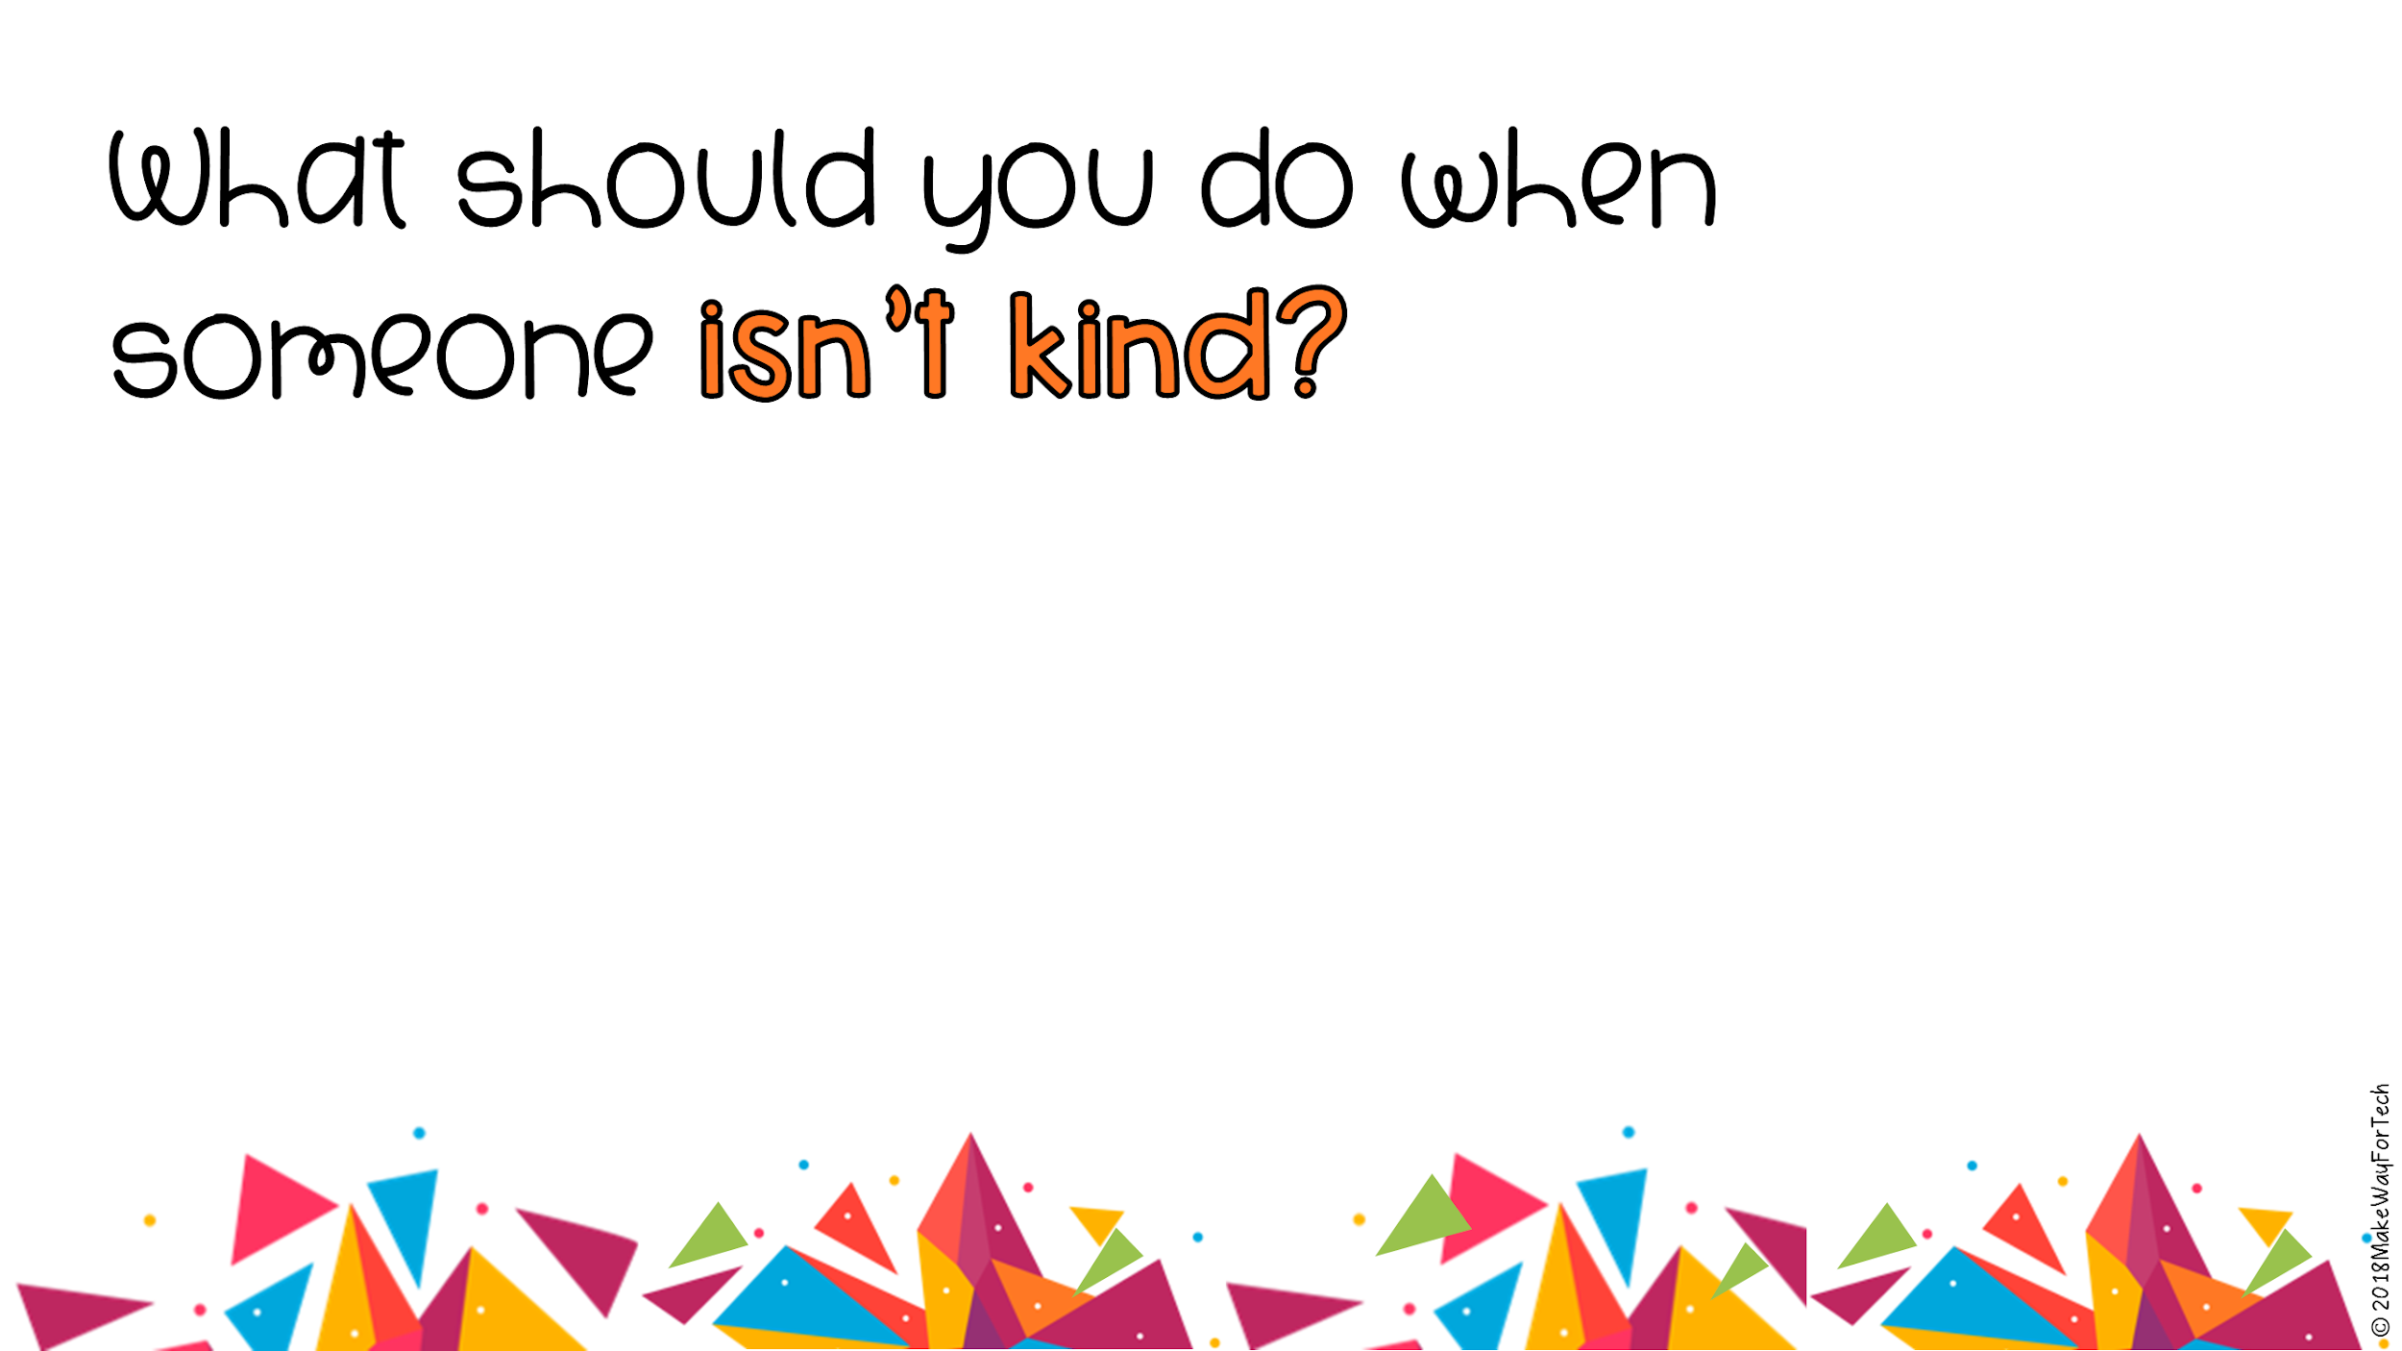
Type here
Notes:
Teacher records class discussion responses.

Slide 4
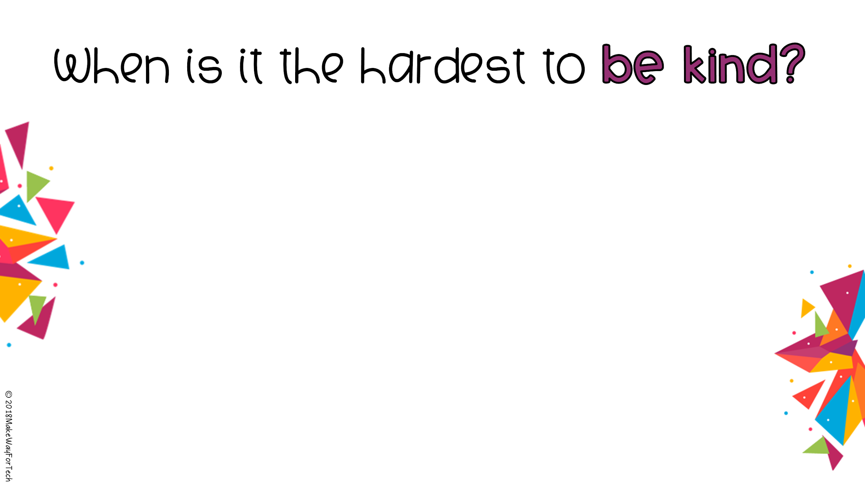
Type here
Notes:
Teacher records class discussion responses.

Slide 5

Type here
Type here
Type here
Type here
Type here
Type here
Type here
Type here
Type here
Type here
Type here
Type here
Type here
Type here
Type here
Notes:
DIRECTIONS: Each student types a response into ONE text box. Change the font size if more space is needed to type. Include your name at the end.

Slide 6

Notes:
DIRECTIONS: Each student inserts an image that represents or shows kindness.

Slide 7
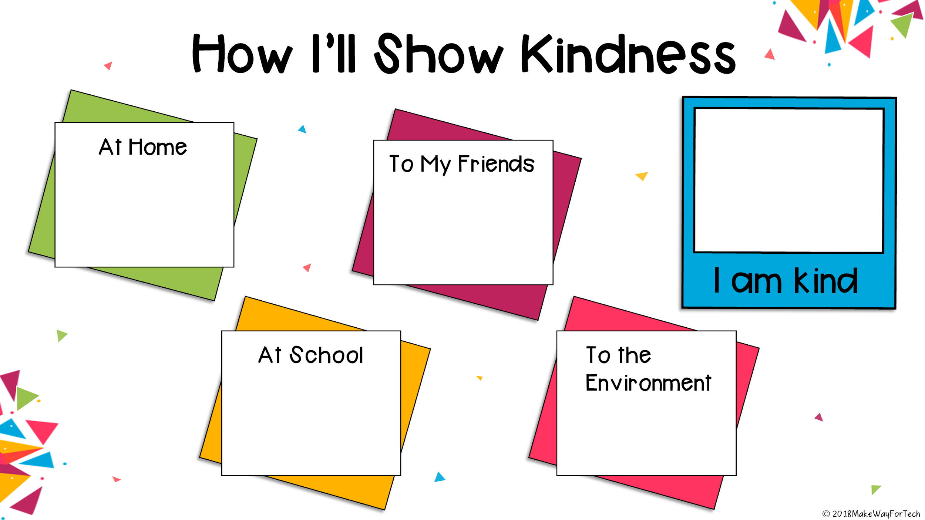
Type here
Type here
Type here
Type here
Notes:
DIRECTIONS: 1. Type your responses into the text boxes.
2. Take a photo of yourself with the camera on your computer. (Insert--Image--Camera) Then insert the photo into the box that says “I am kind.”

