Slide 1
Holiday Parade Stop Motion Animation

Slide 2
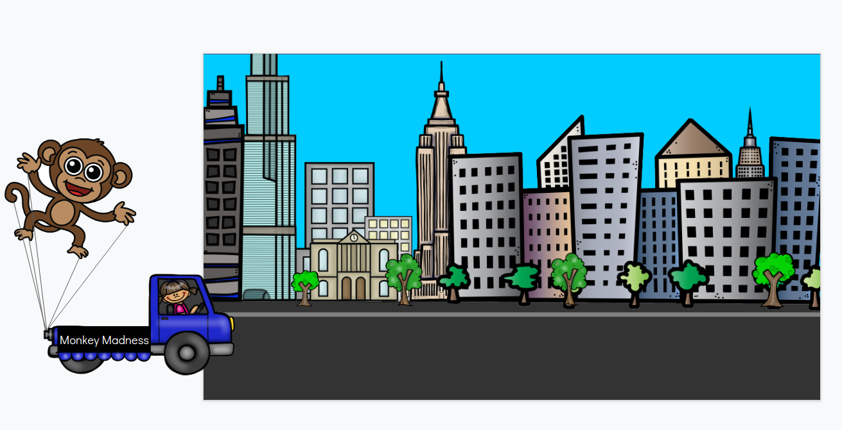
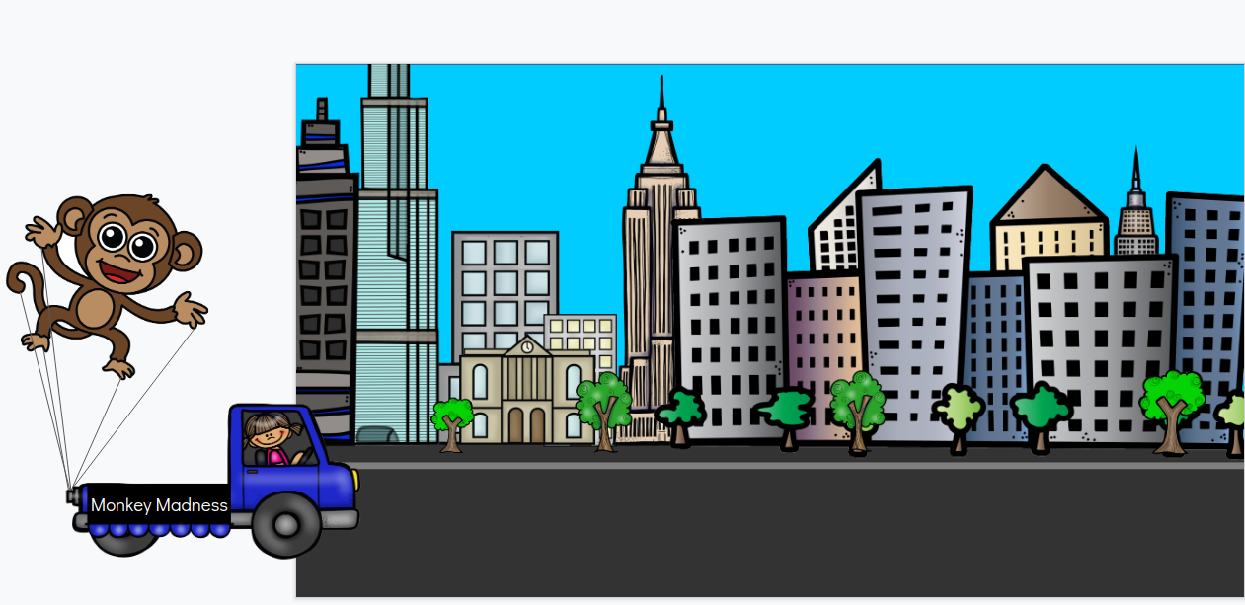
How to Animate in Google Slides
First, pick your background slide. Move the background slide to the end of this presentation. This will be the first slide in the animation. Create a vehicle and balloon, then copy and paste your truck and balloon mostly off the slide to the left:
Duplicate the current slide, then select all of the images and move them to the right (use the arrow key once or twice). The white vertical line below shows that the images have moved.

Slide 3
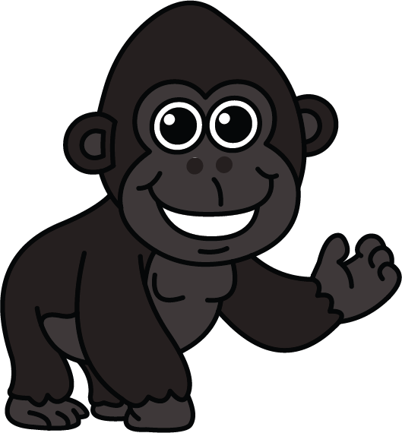
How to Animate
Duplicate the slide again, and move your images to the right. You will keep duplicating and moving the images to the right each time, until the balloon and truck are off the slide to the right.
How to Make the Balloon “Float” Around
You can make the balloon appear to float around in several ways:
Changing the size of the balloon (this makes it look closer to the viewer or father away)
Rotating the balloon to the left or right (make sure all of the cables are attached to both the balloon and the truck)
Changing the aspect ratio of the balloon (stretching it or shrinking it in one dimension).
Make the balloon larger or smaller.
Rotate the balloon a few degrees to the right or left.
Increase or decrease either the height or the width.

Slide 4
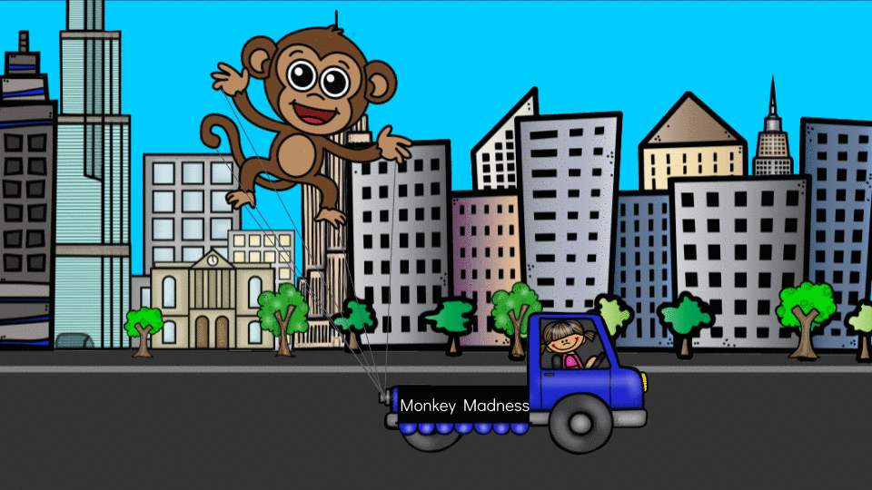
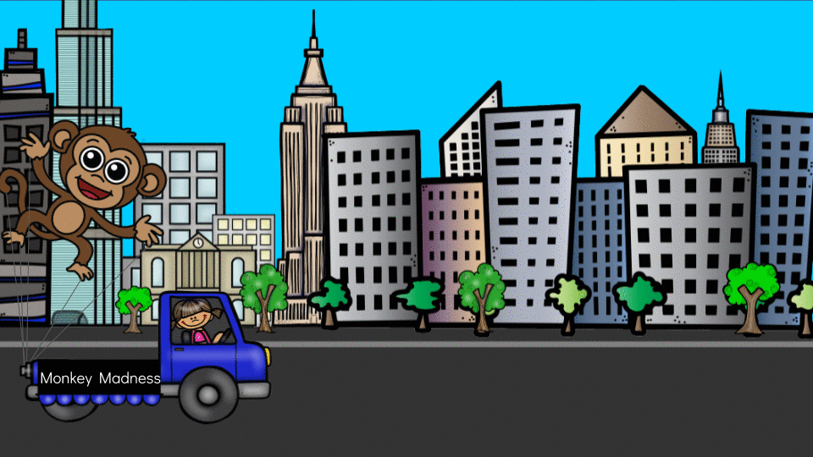
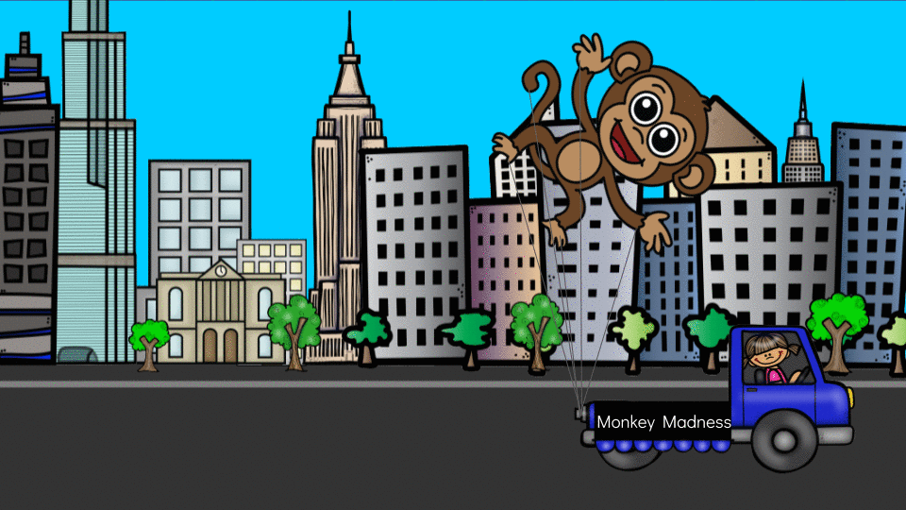
Examples
size
rotation
aspect ratio
In some cases, you may want to change size and rotation, or even all three (size, rotation, and aspect ratio)!
When you are making changes, you may need to ungroup the balloon from cables to adjust them.
Always make sure the cables are attached to both the balloon and the truck!

Slide 5
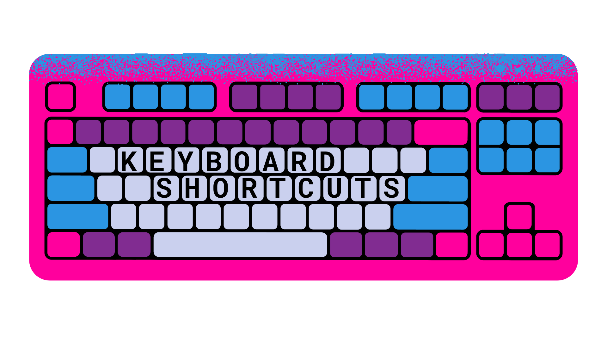
Duplicate Ctrl +d
Group Ctrl + Alt + g
Ungroup Ctrl + Alt + Shift + g
Resizing
Resize larger Ctrl + Alt + k
Resize smaller Ctrl + Alt + j
Rotating
Rotate clockwise by 1° Alt + Shift + Right Arrow
Rotate counterclockwise by 1° Alt + Shift + Left Arrow
Rotate clockwise by 15° Alt + Right Arrow
Rotate counterclockwise by 15° Alt + Left Arrow
Positioning
Bring to front Ctrl + Shift + Up Arrow
Send to back Ctrl + Shift + Down Arrow

Slide 6
Vehicles and Balloon Options

Slide 7
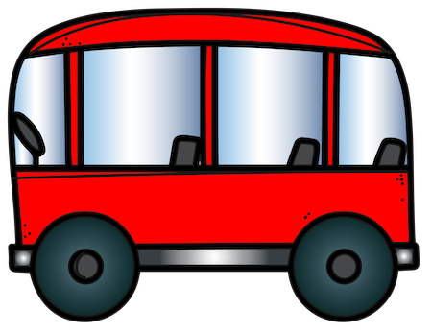
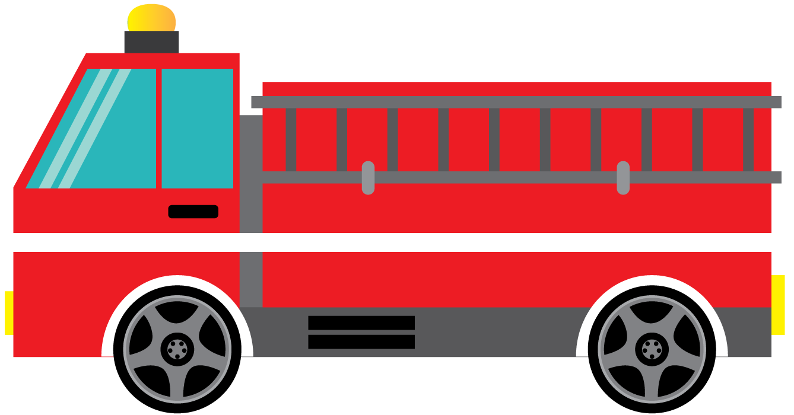
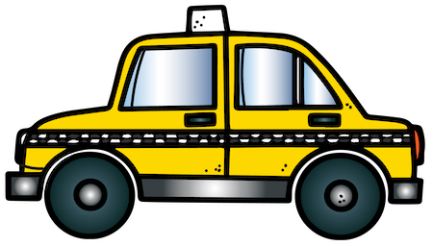
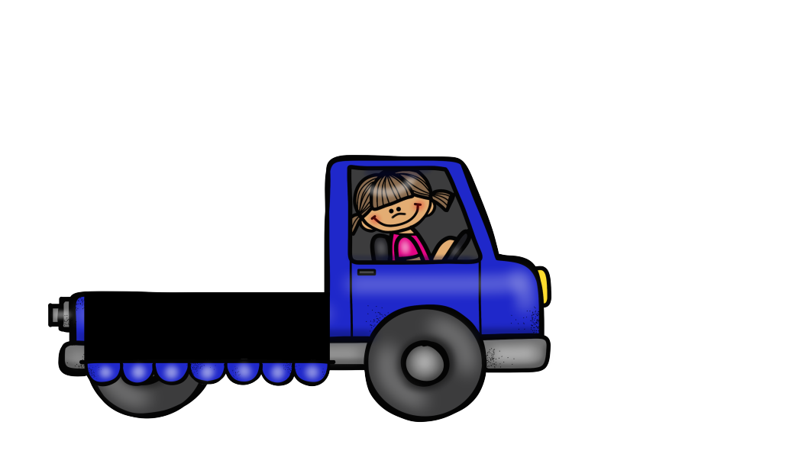
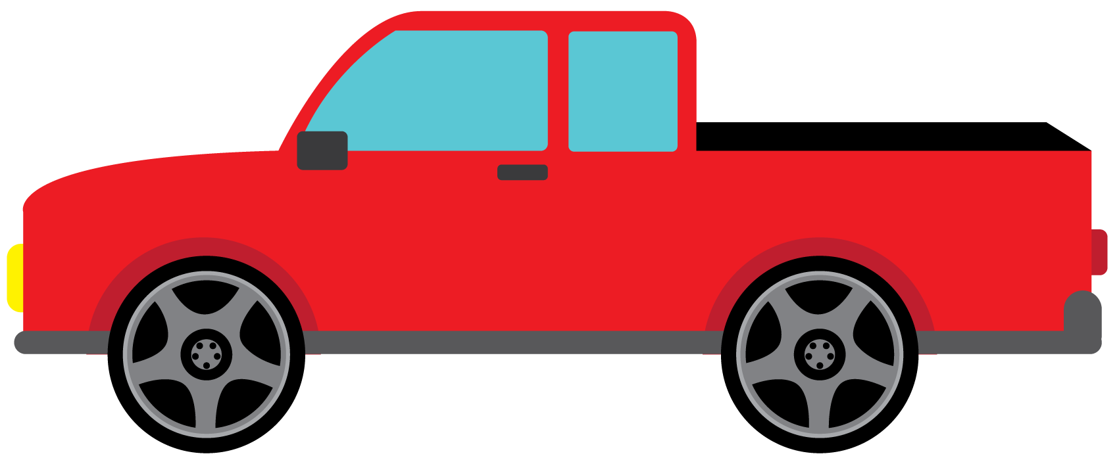
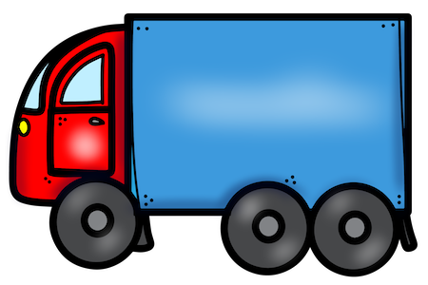
Pick your vehicle from the ones below (or search “pickup png” or “car png” in Insert→ Image → Search the web). Make sure it is facing to the right.

Slide 8
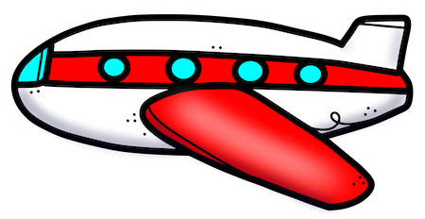
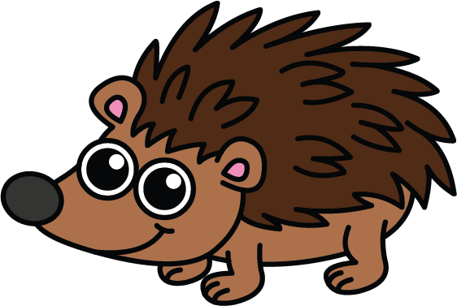
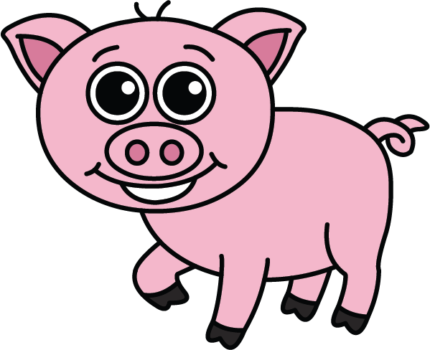
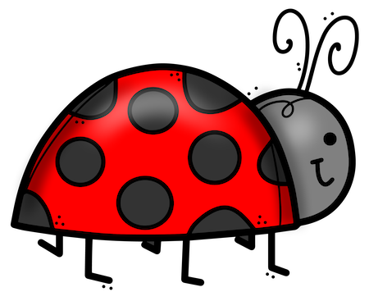
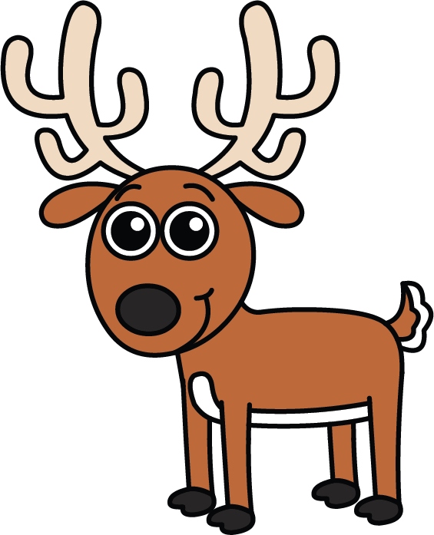
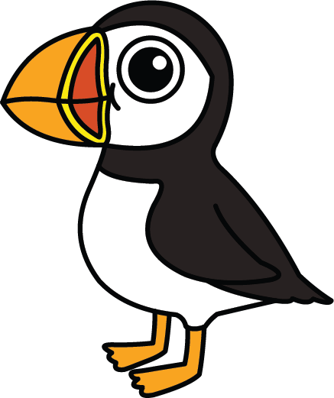
Pick your balloon from the ones below (or search for a character you like in Insert→ Image → Search the web).
This Photo by Unknown Author is licensed under CC BY-NC

Slide 9
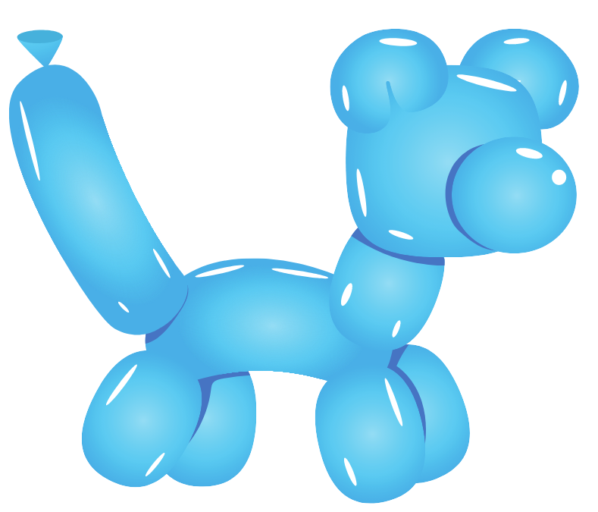
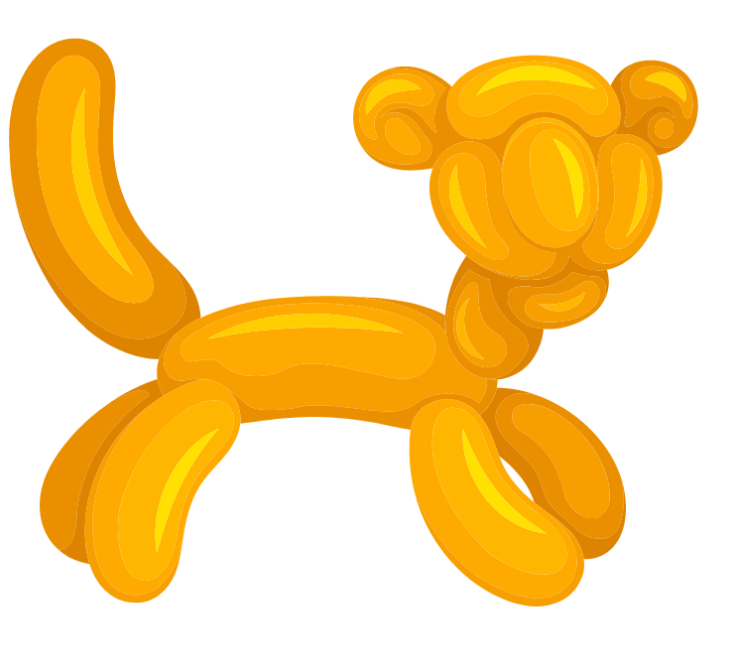
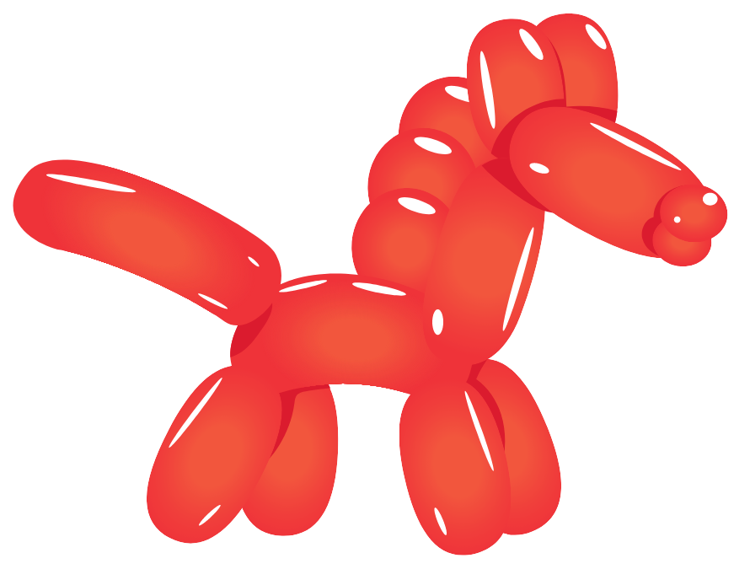
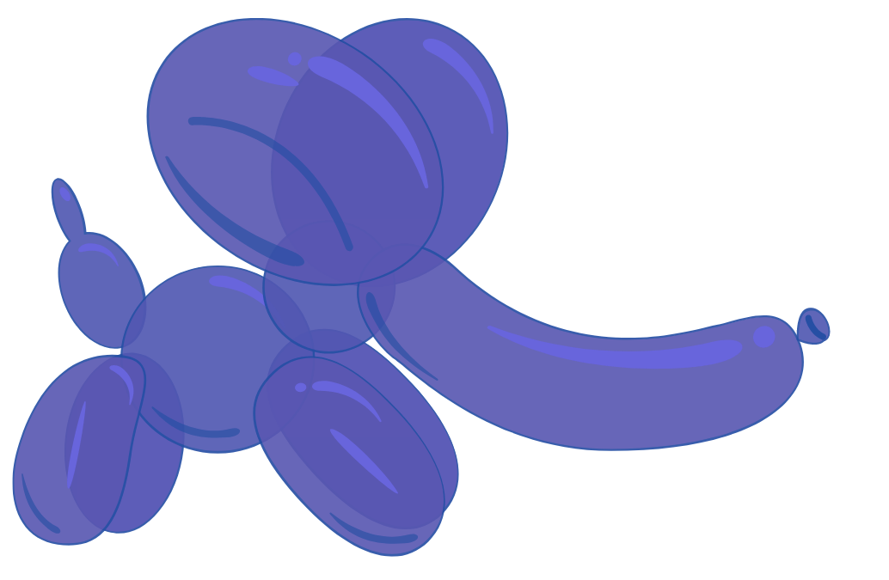
Pick your balloon from the ones below (or search for a character you like in Insert→ Image → Search the web).

Slide 10
Build your truck and float. Add cables (lines). When it is complete copy and paste it to the city slide background you chose to begin your animation.
Example:
After adding lines, group the float and lines.
Monkey Madness
Use a text box to add a name to your float and group it with the truck.

Slide 11
Optional enhancements to the stop motion animation:
Add more than one parade float.
Add other static (not moving) or animated components to the slide, such as spectators, animals, an airplane flying by, etc.
Add an animated GIF to the slide! Go to Insert → Image → Search the web and search for a “gif” such as “bird gif,” “car gif,” etc.
Add text to the animation. To make the text animated, add just one letter at a time (one per slide):
Enhance Your Stop Motion Animation
T
Tr
Tru
Truc
Truck

Slide 12
Background Slides

Slide 16
Describe Your Animation!
Your
Name:
Name of Animation:
Number of Slides/Frames:
Animated Object(s):
Setting
Add text here
Add text here
Add text here
Add text here
Add text here
Describe the stop motion animation:
Add text here

