Slide 1
HOW TO COPY AND PASTE
THE PIECES

Slide 2
STEPS TO BUILD YOUR HALLOWEEN SCENE
Copy and Paste Between Slides
To resize clip art, use the corner handles so that you don’t stretch the image
Pick Background
2. Add a Haunted House
3. Add Characters & Accents
4. Add Spooky Cats
5. Optional - Add Candy
6. Write Story

Slide 4
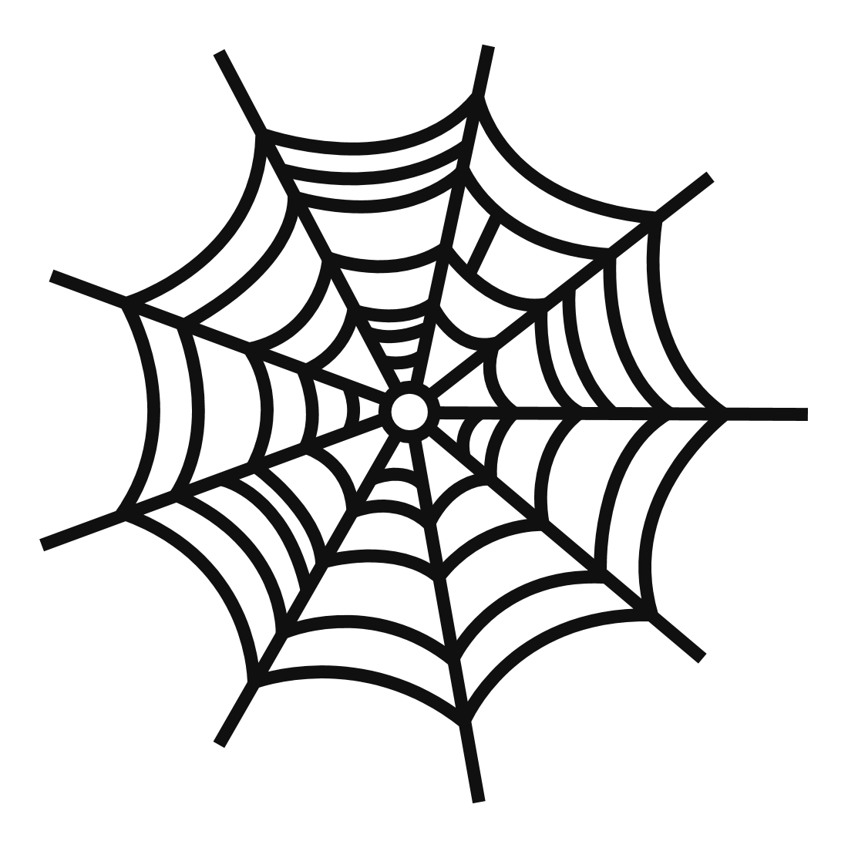
Background Elements
Choose from this column if you celebrate Halloween
Choose from this column if you do not celebrate Halloween

Slide 5
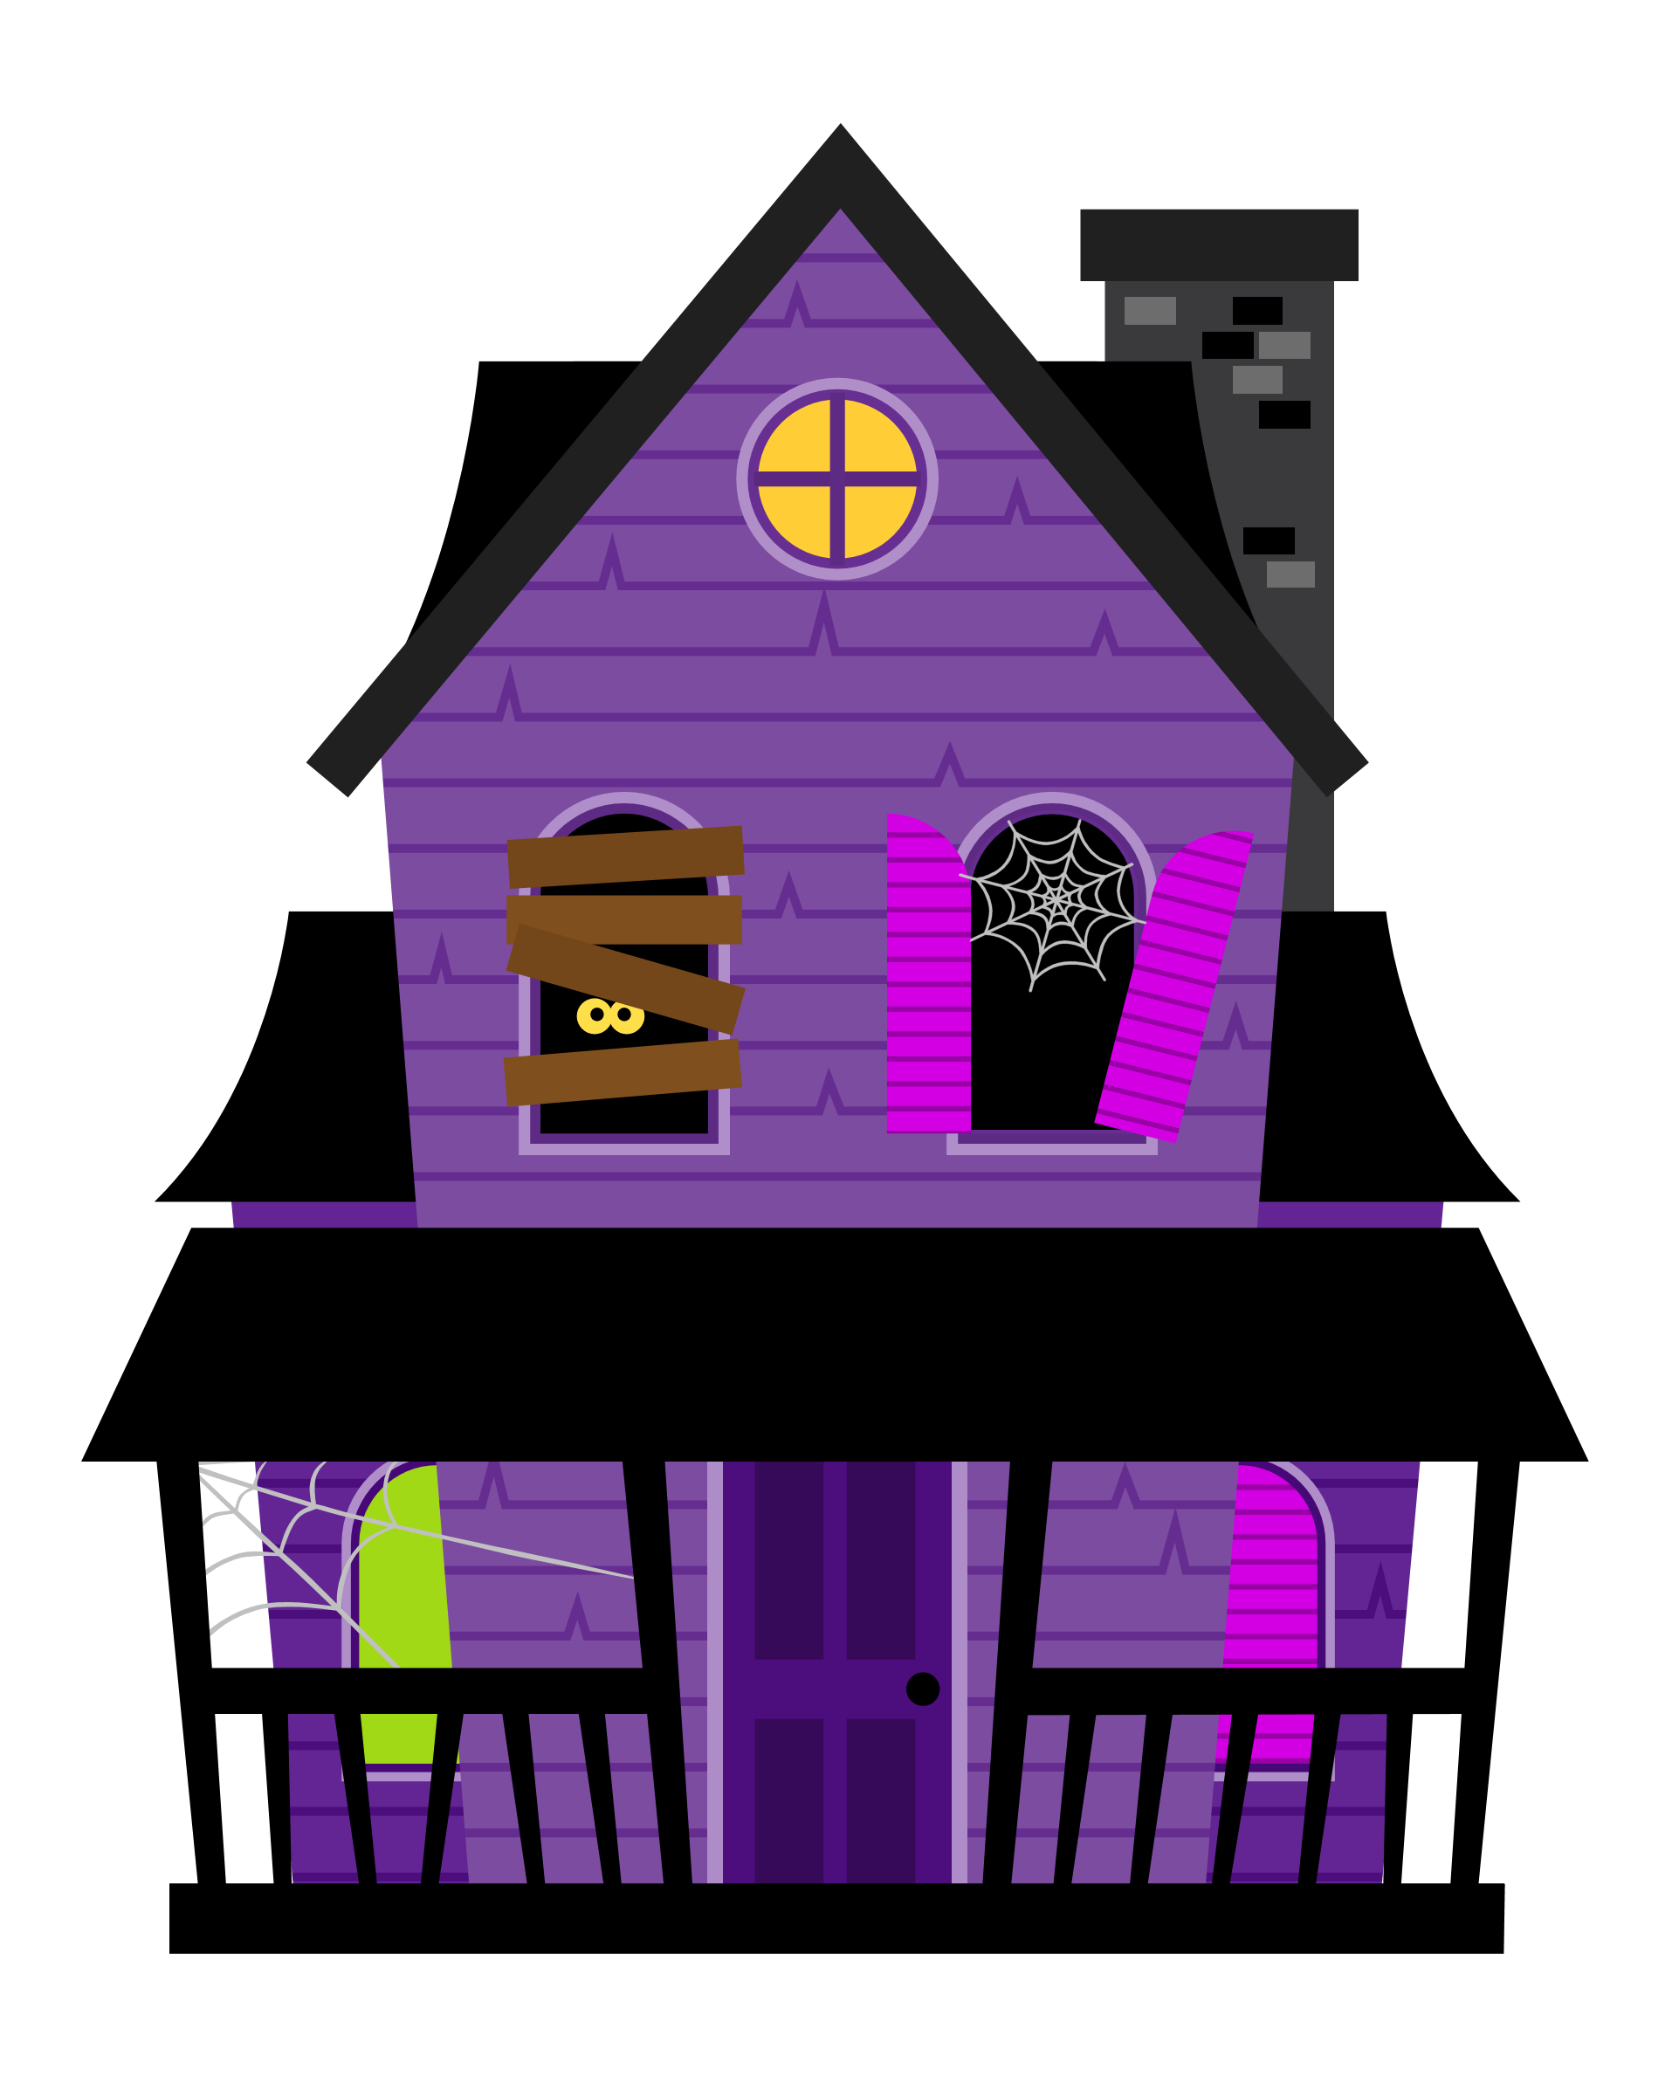
2. Haunted Houses
Use this house if you have a costume picked out.
Use this house if you do not have a costume picked out.

Slide 6
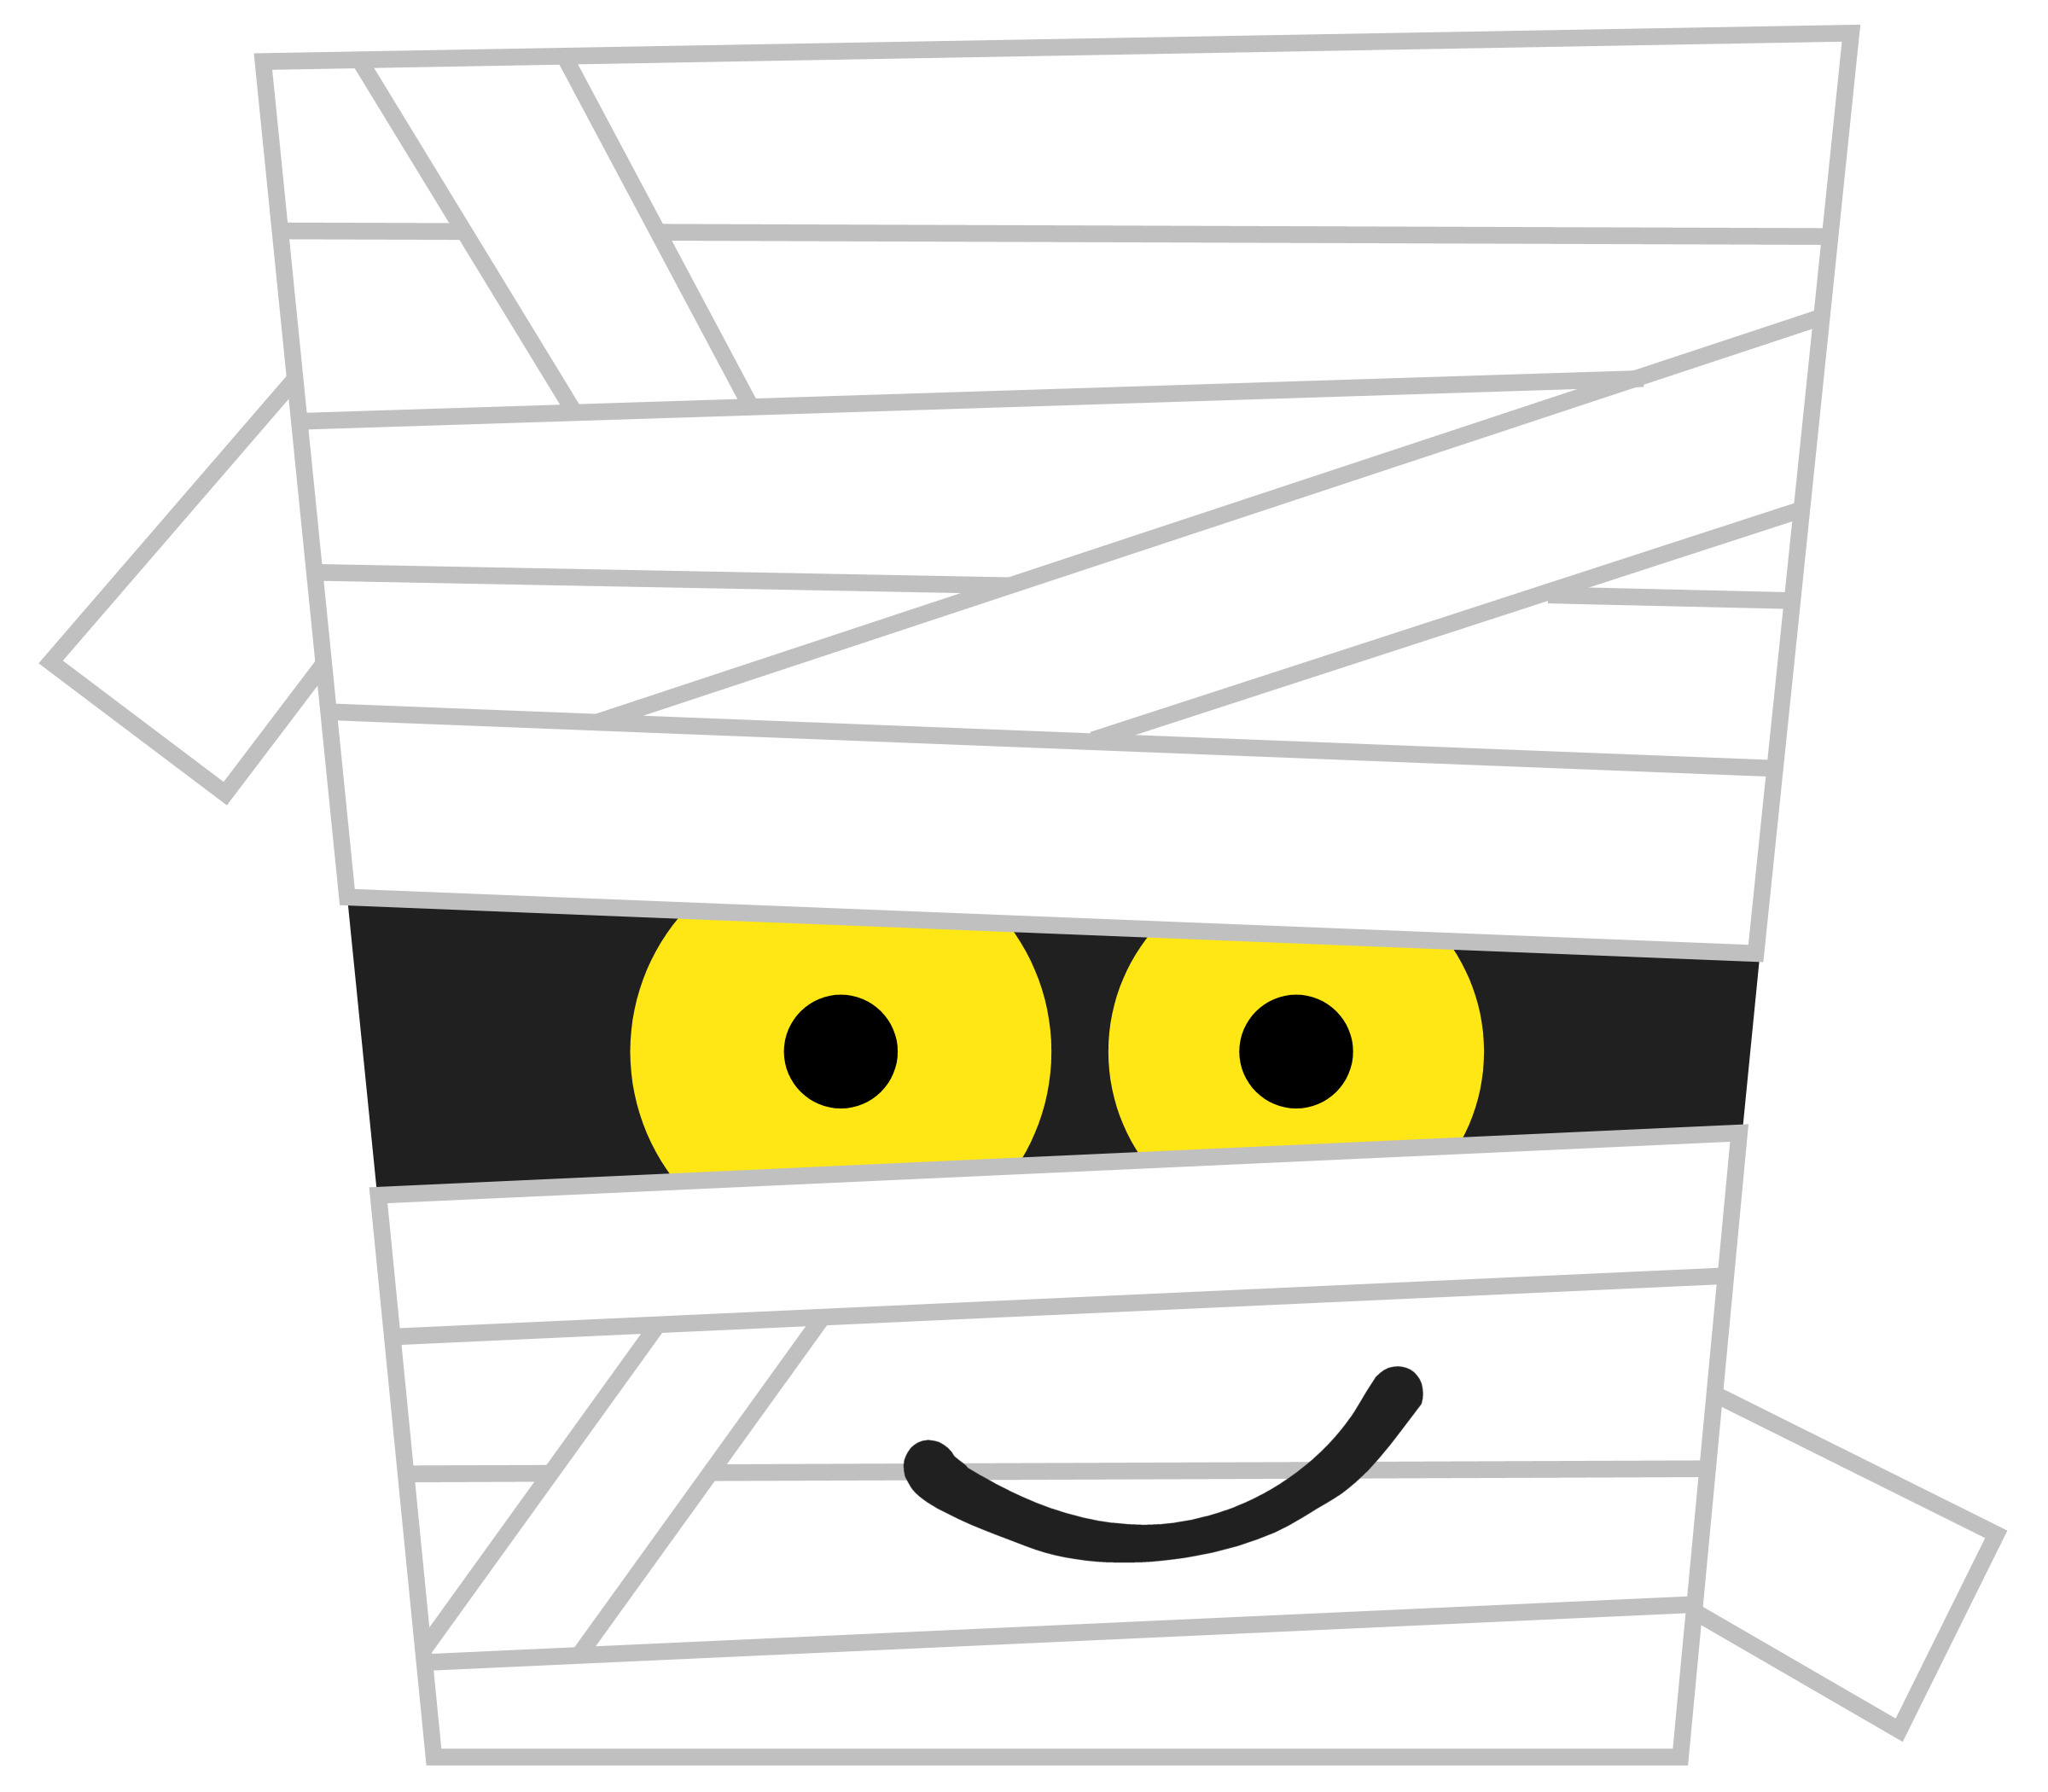
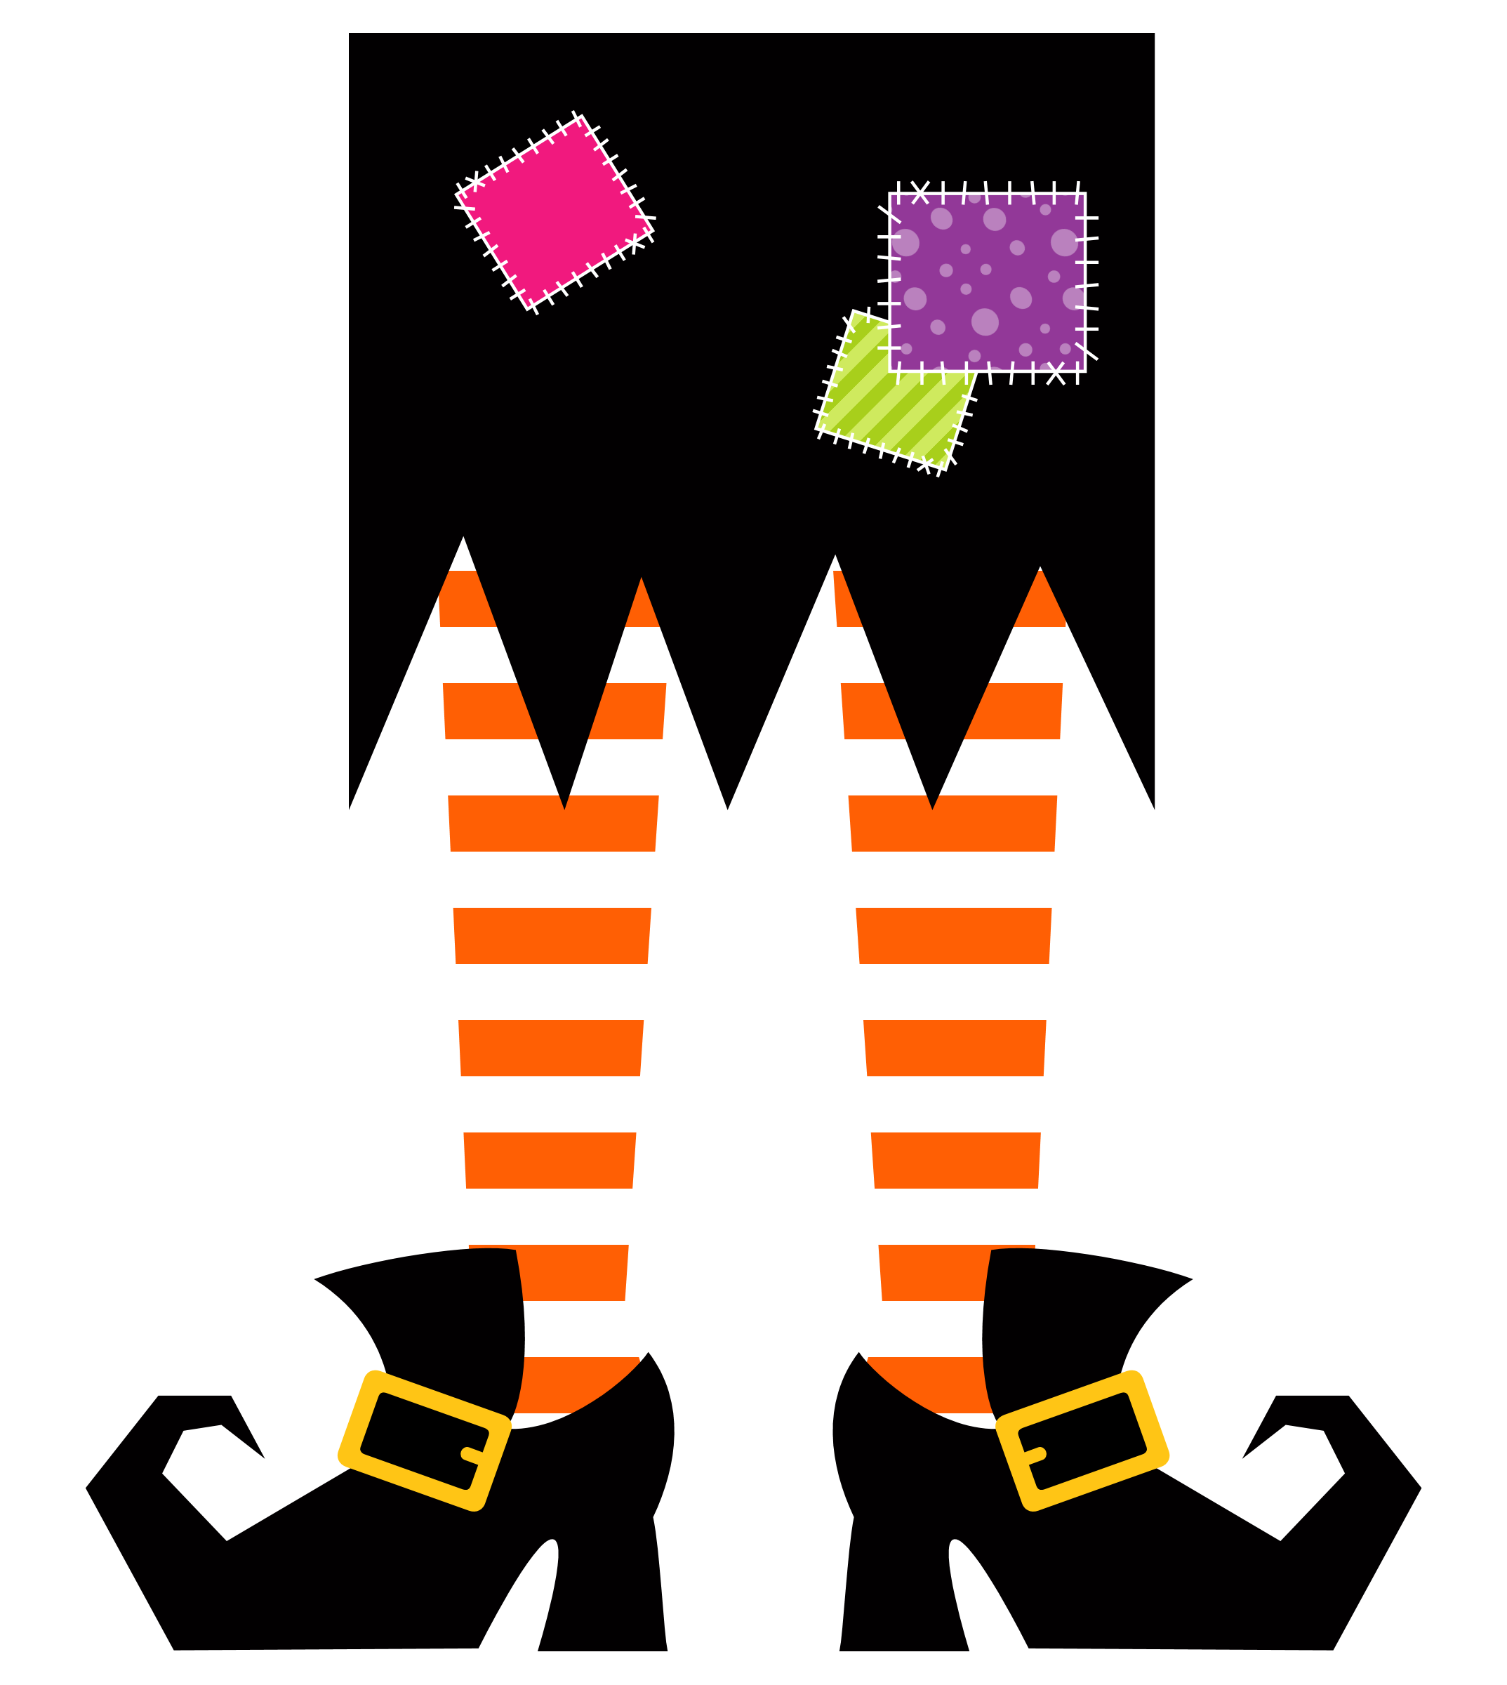
3. Characters and Accents
Choose from this column if you like to play outside.
Choose from this column if you like to play inside.
Choose from this column if you like to play inside and outside.

Slide 7
4. Spooky Cats
Add as many cat silhouettes as you want.
Add glowing eyes to each cat.

Slide 8
OPTIONAL - CANDY AND BAG
Add your candy pail/bag.
Add candy to the bag.

Slide 9
Type your story here.

