Slide 1
DIGITAL CITIZENSHIP | GRADE 2
That's Private!

Slide 2
What kinds of information should I keep to myself when I use the internet?

Slide 3
WARM UP
What kinds of things should we not tell a stranger?

Slide 4
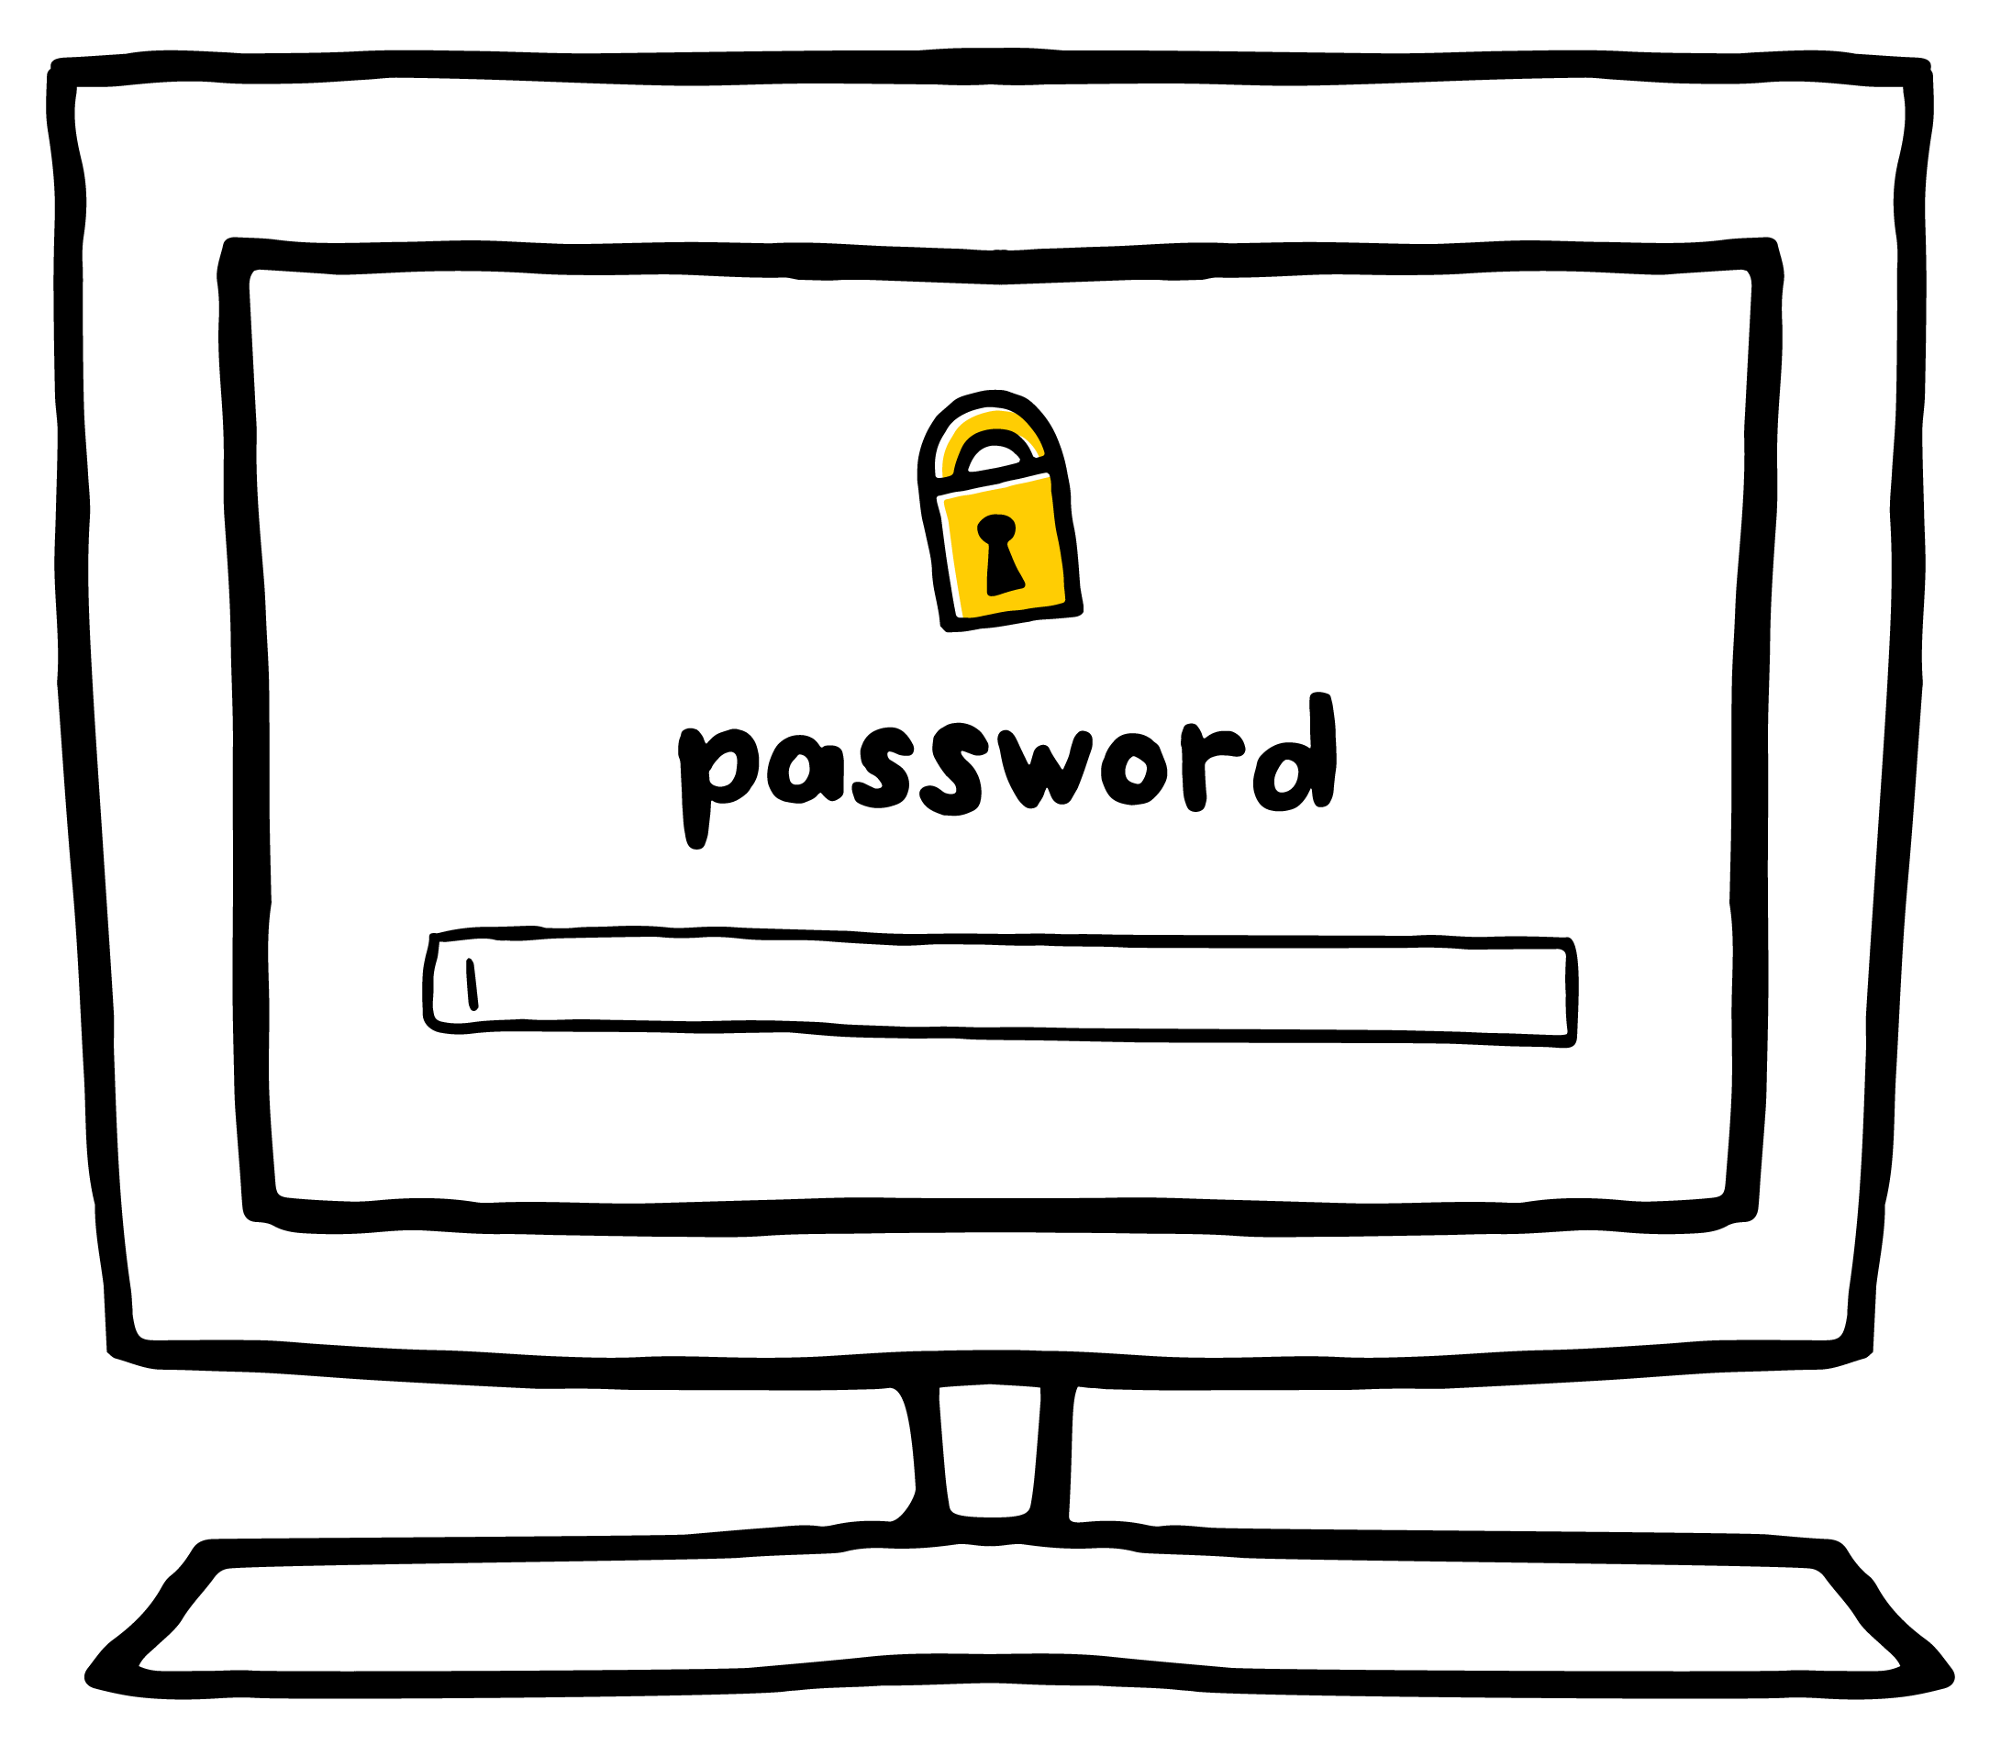
KEY VOCABULARY
Private
Something that you should keep to yourself

Slide 5
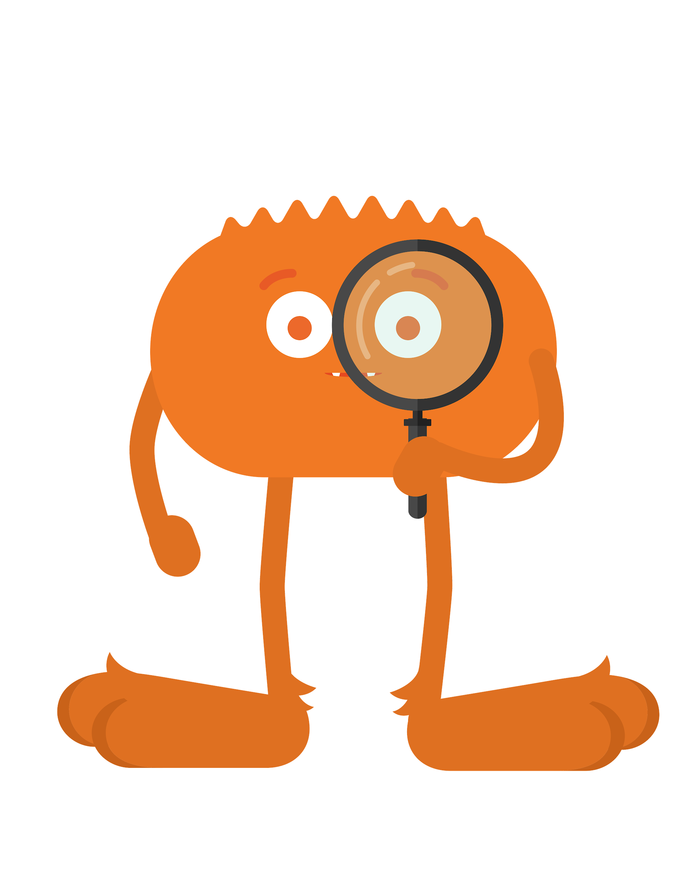
REVIEW
Private Information
[Capture student responses here.]

Slide 6
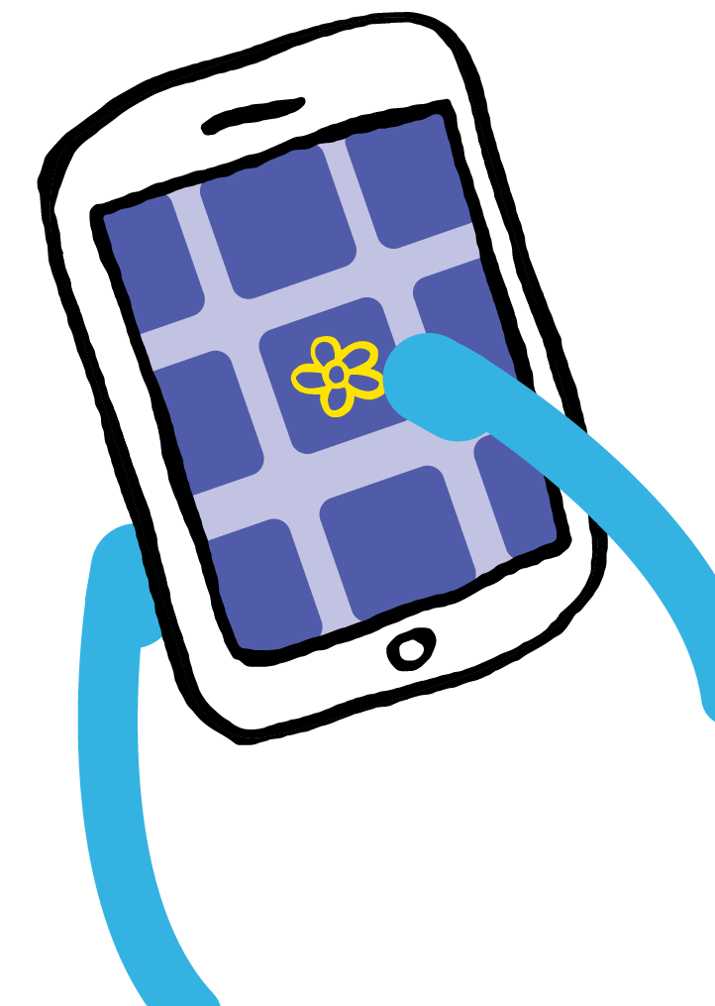
KEY VOCABULARY
Online
Using a computer, phone, or tablet to visit a website or app

Slide 7
GAME
Thumbs Up, Thumbs Down
OK to share
NOT OK to share

Slide 8
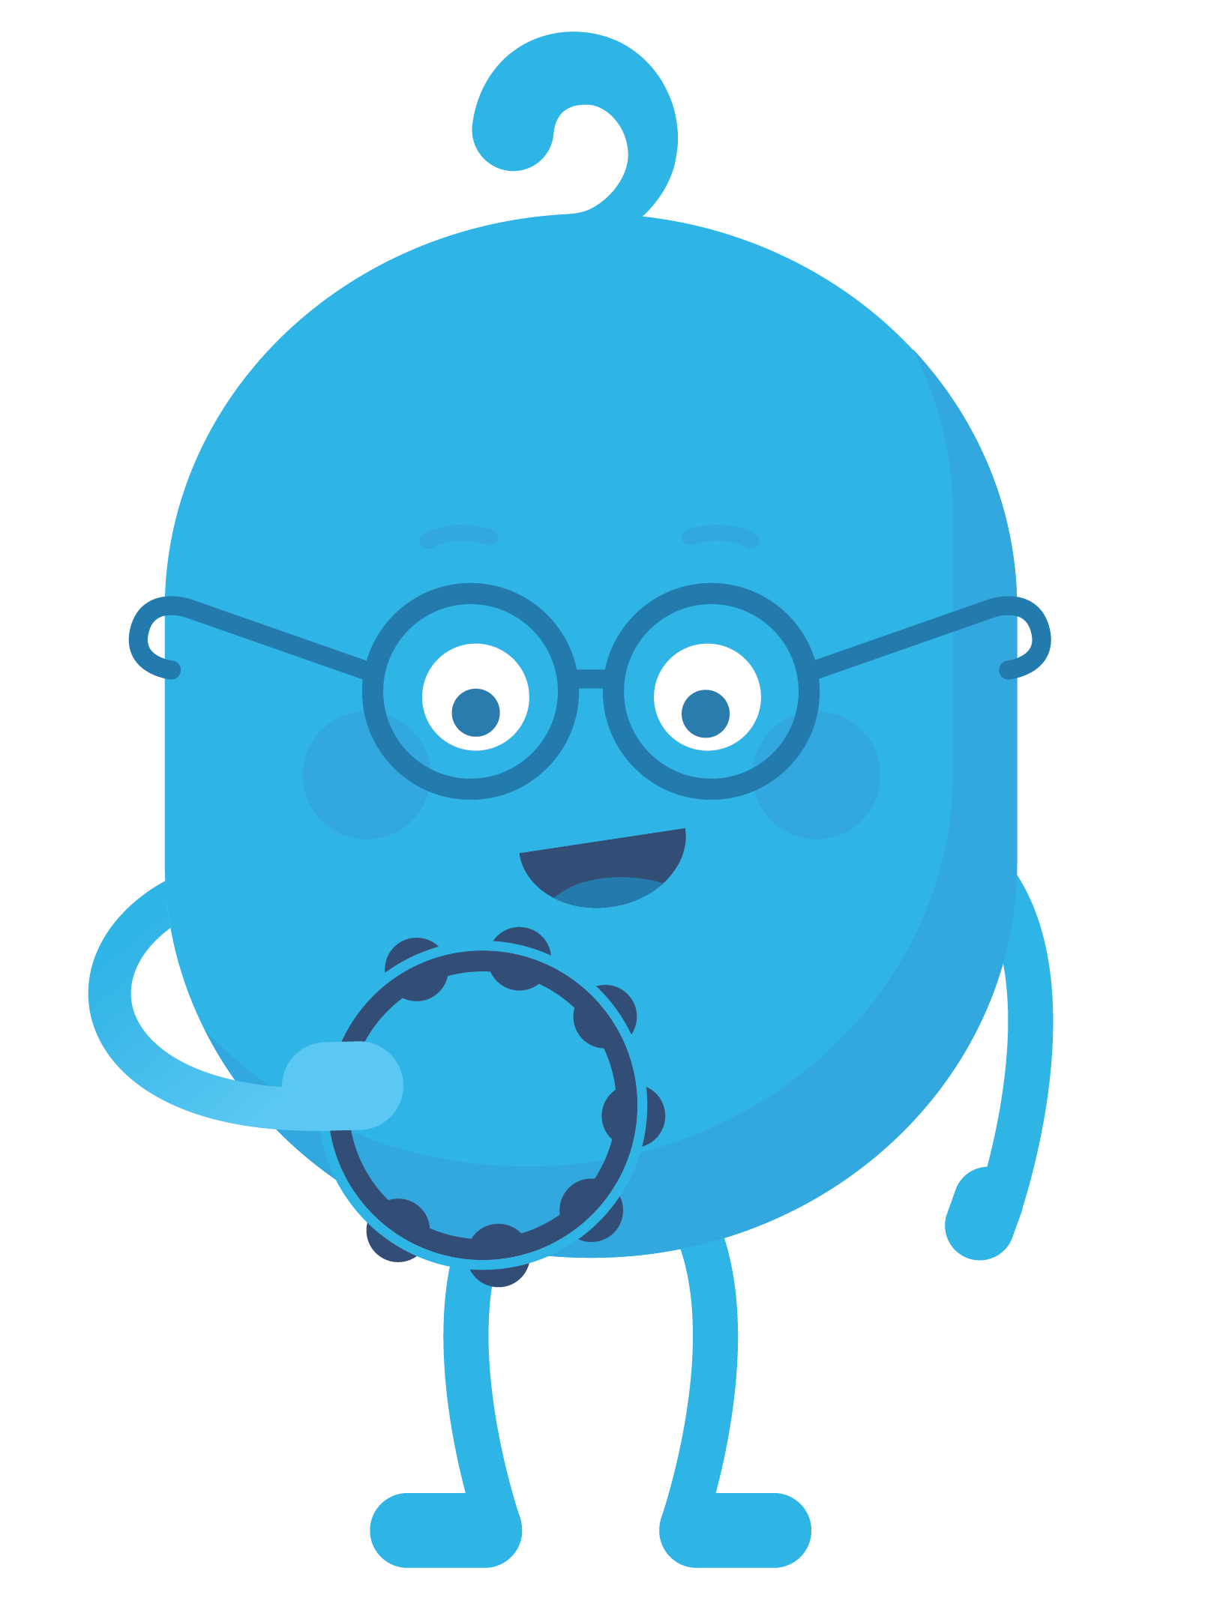
ACTIVITY
SongTube Sign-Up!
Draw an X through the sections that ask for private information.
Complete the rest of the form.

Slide 9
REFLECT HANDOUT
Pause & Think Moment
Draw.
What is an example of something that is OK to share online?
and
Write.
Explain why it is important to not share private information online.

Slide 10
