Slide 1


Slide 2
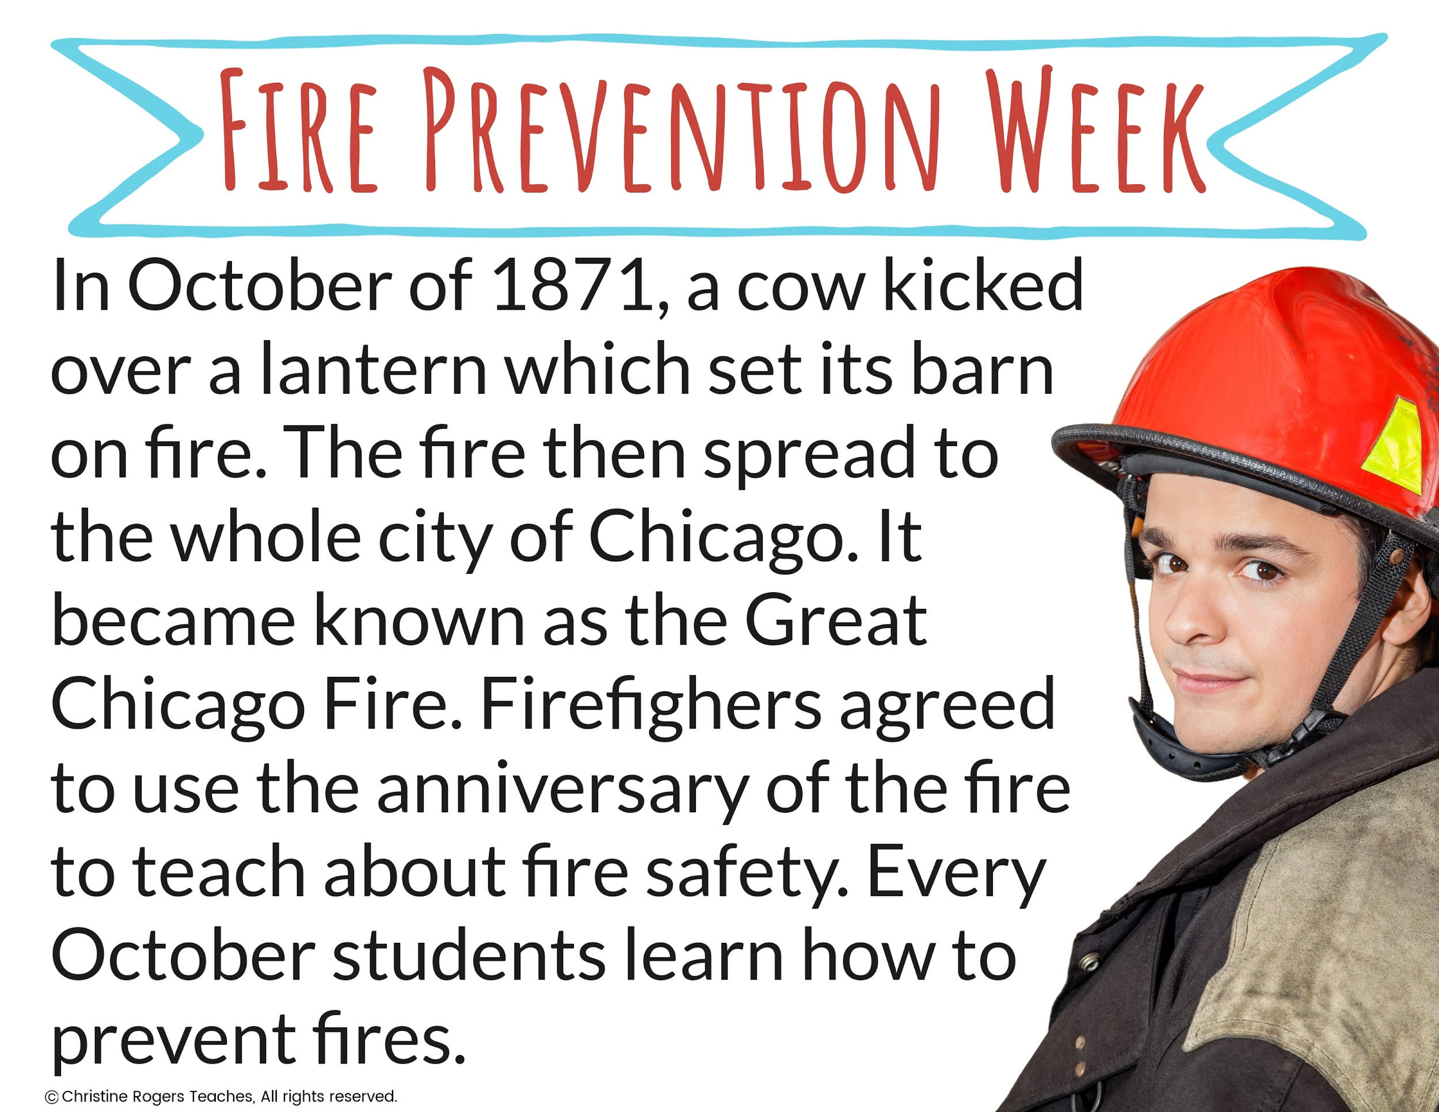

Slide 3
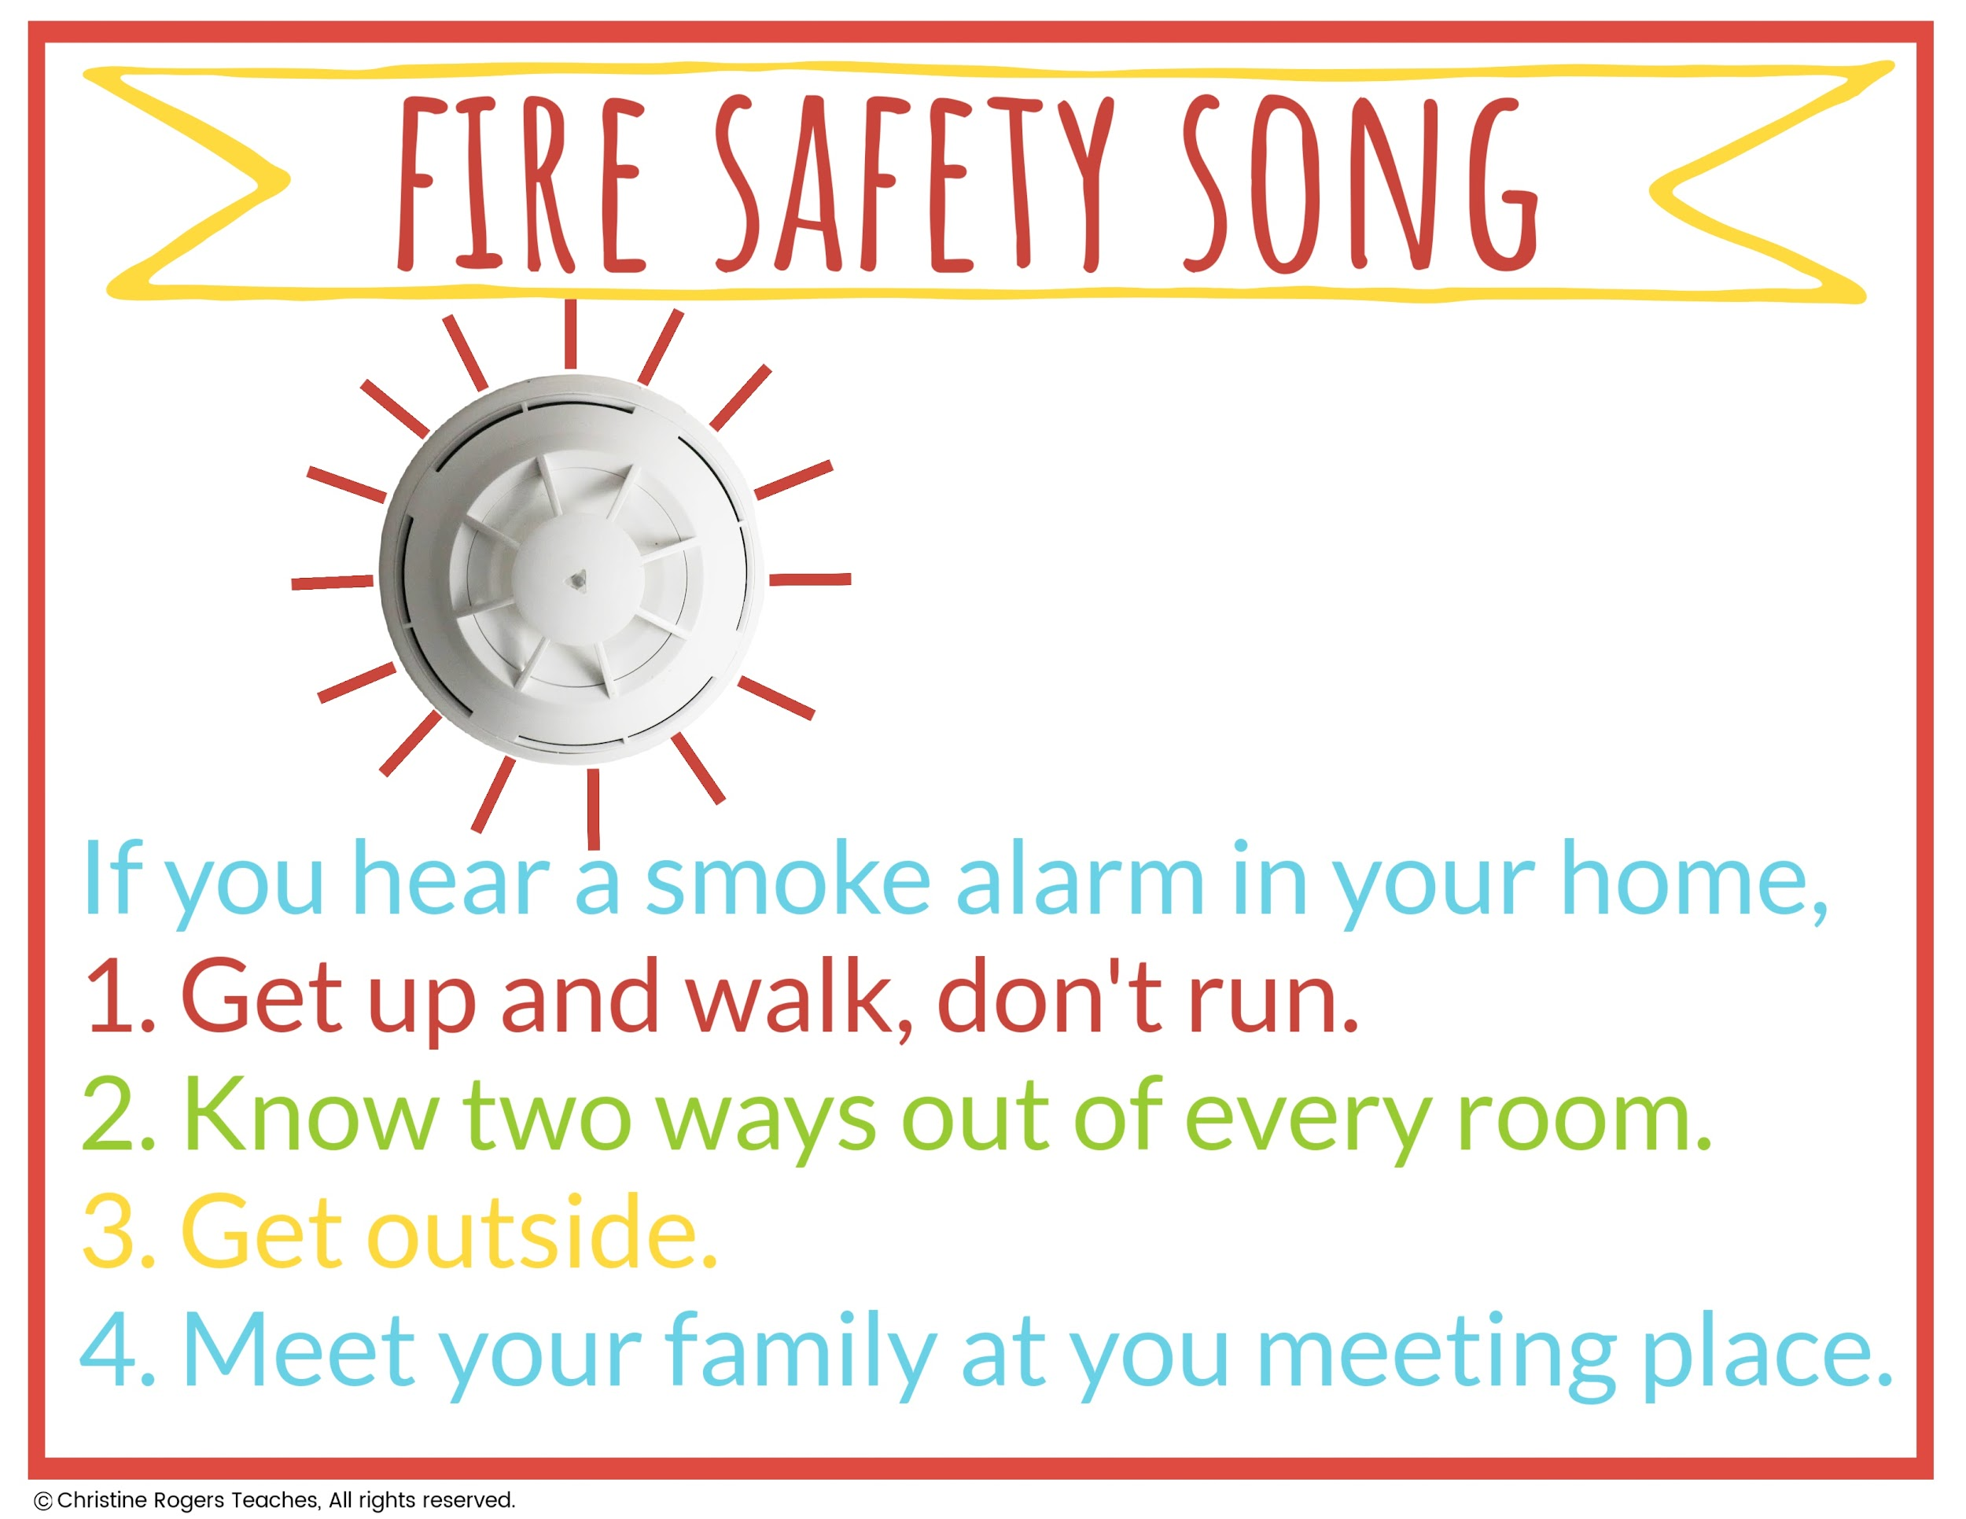
Click here to watch the Fire Safety Song.

Slide 4
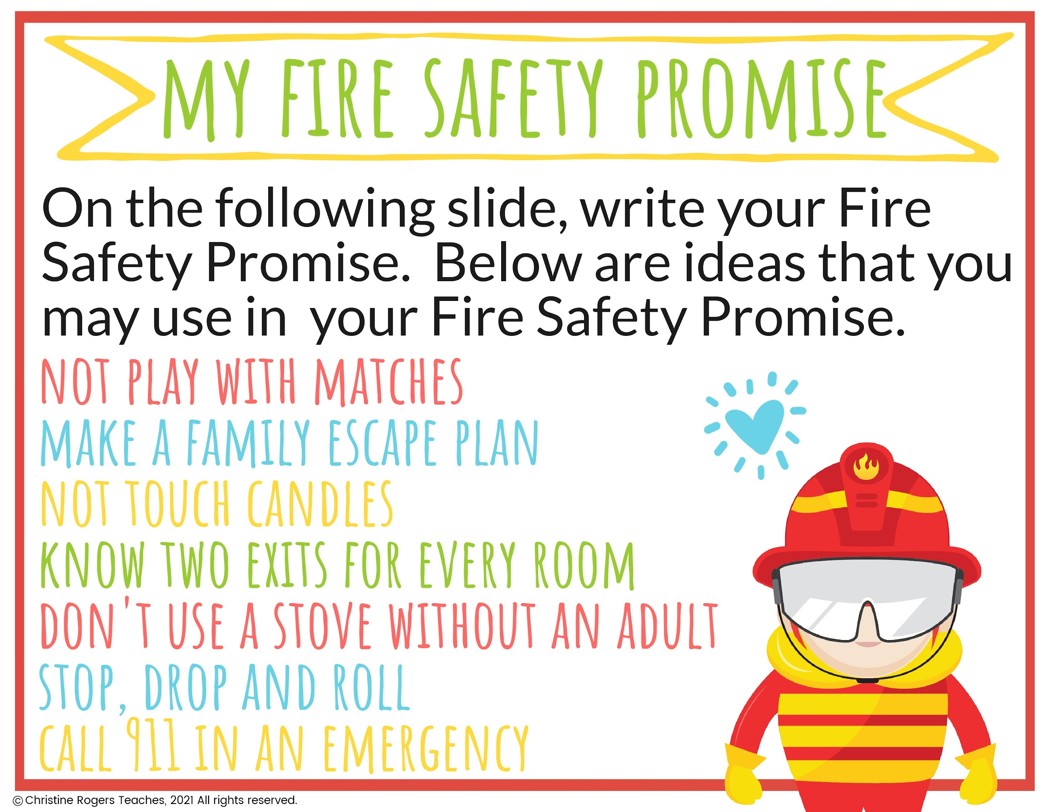

Slide 5
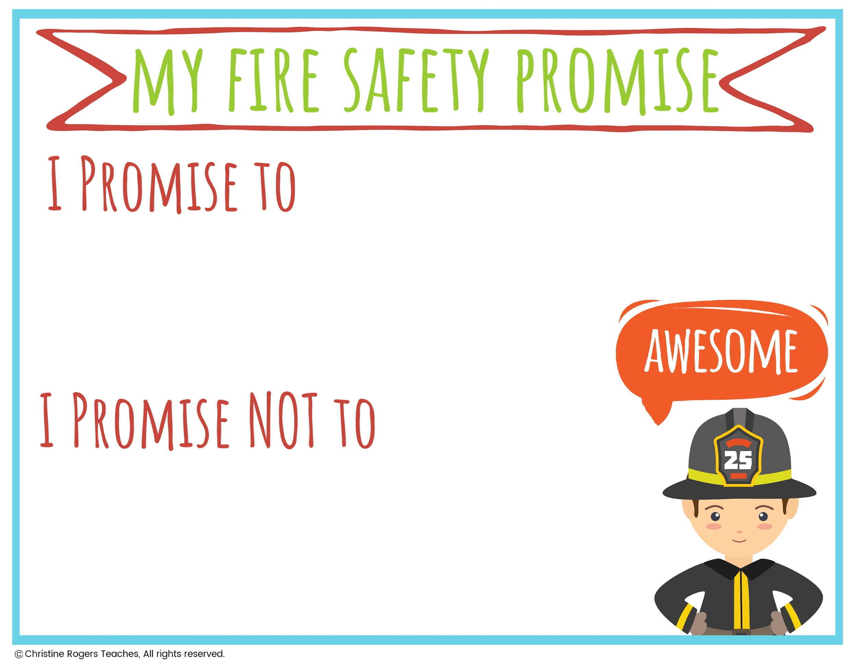
Type Here
Type Here

Slide 6
Fire Safety Poster

Slide 7
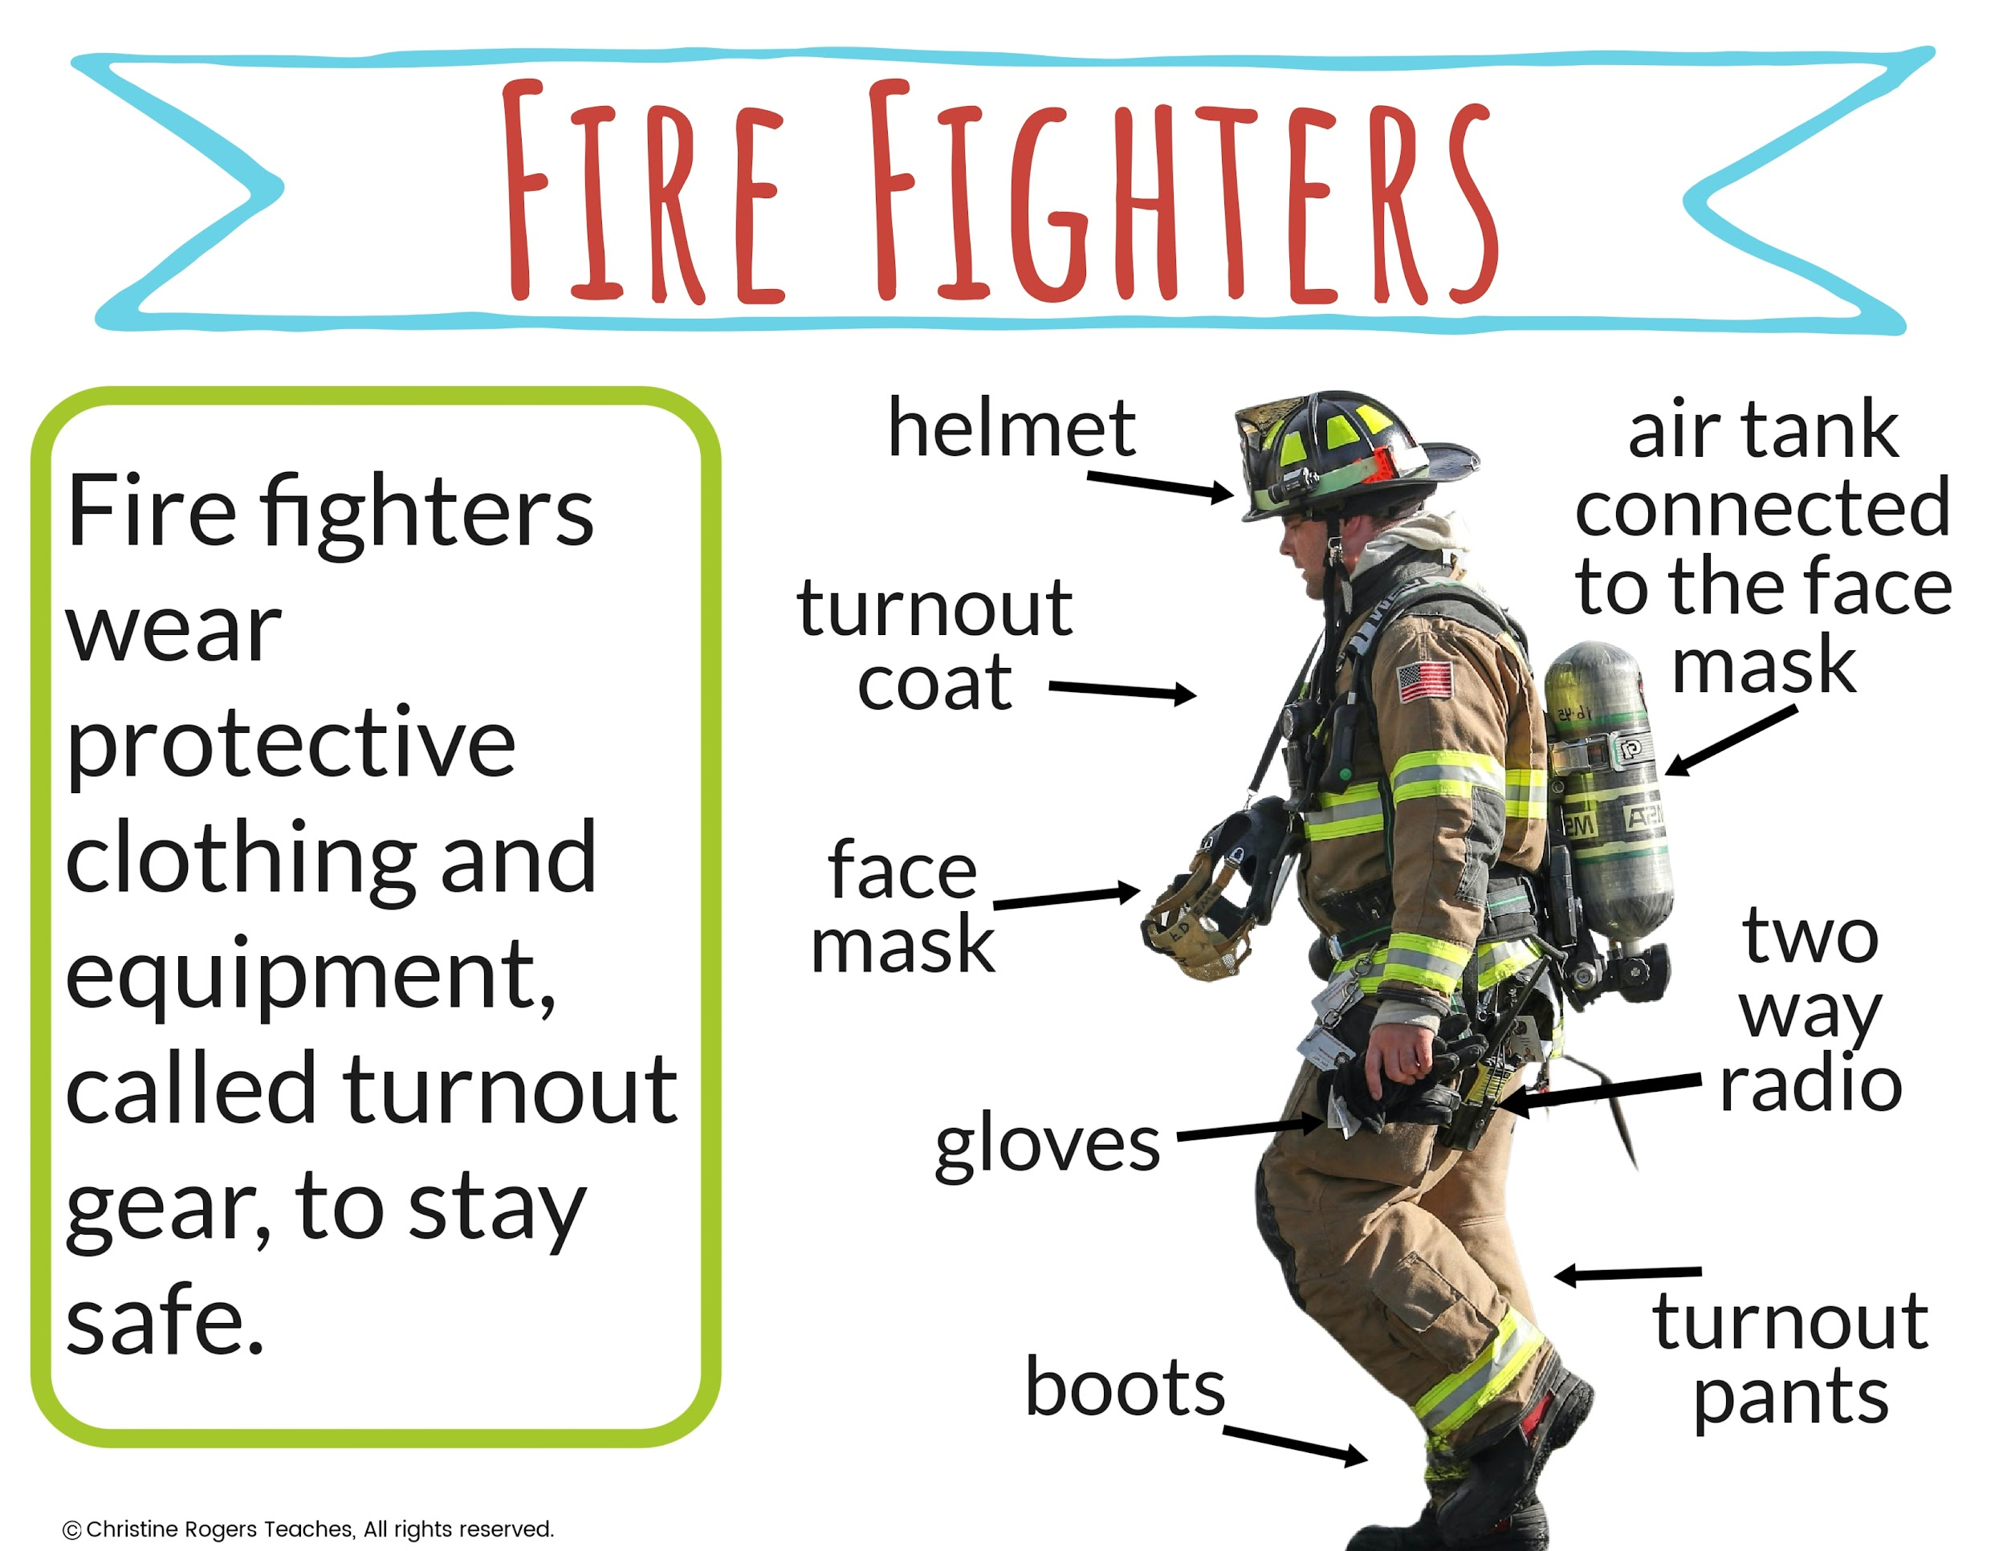

Slide 8
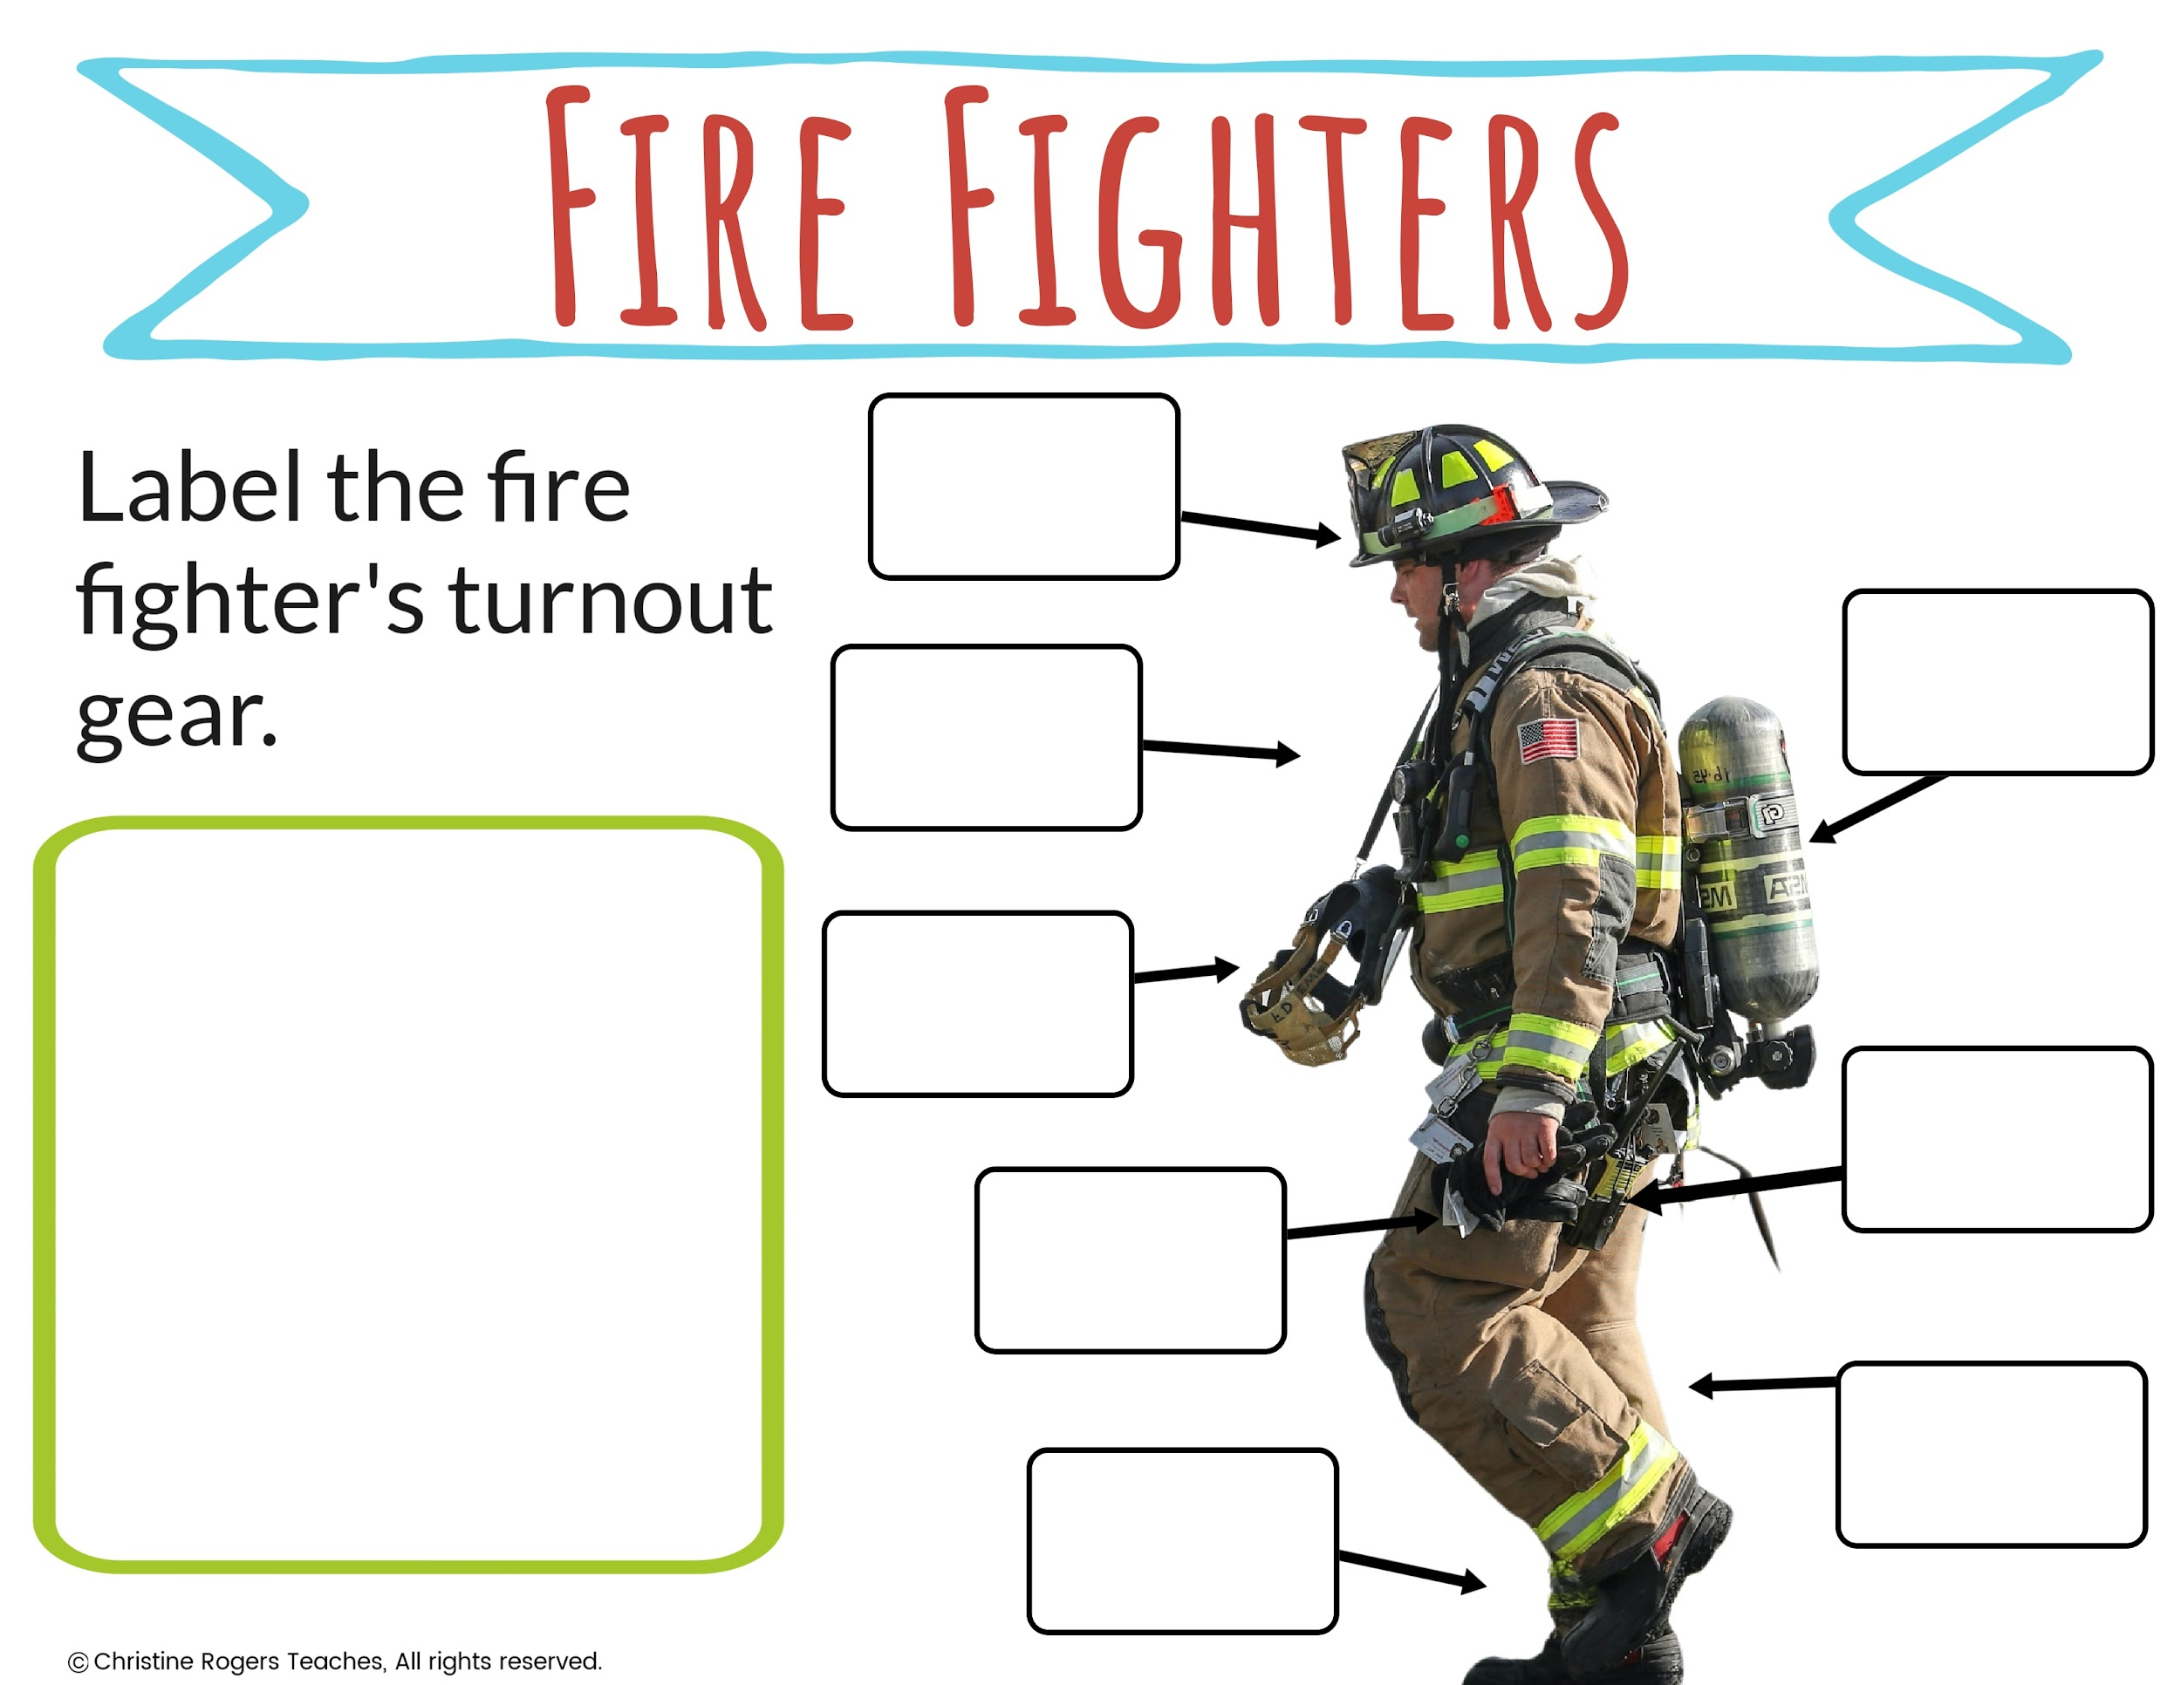
boots
air tank
face mask
gloves
turnout coat
two way radio
turnout pants
helmet

Slide 9
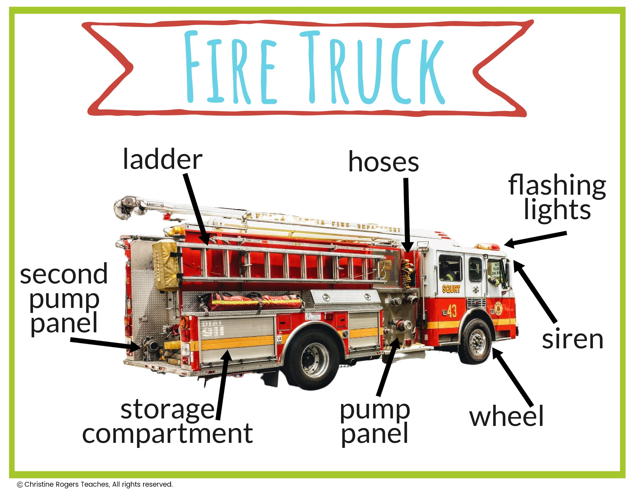

Slide 10
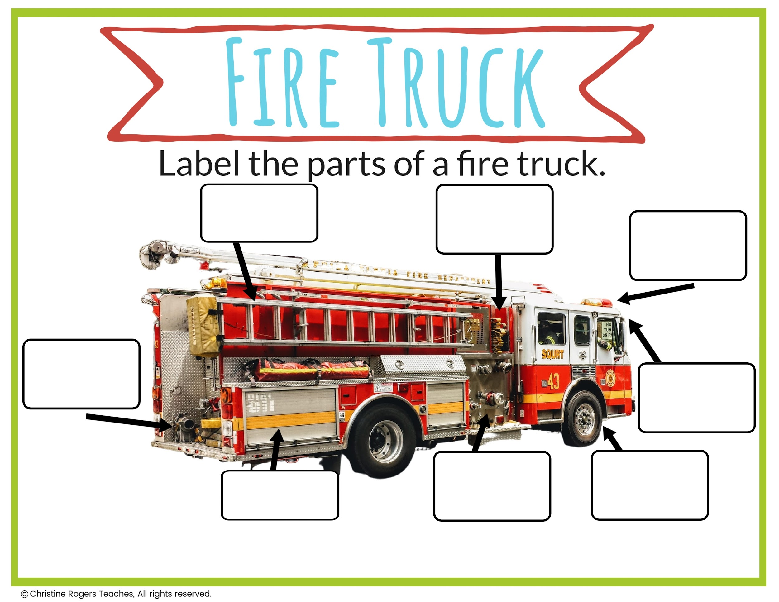
second pump
panel
pump
panel
hoses
storage
wheel
lights
ladder
siren

Slide 11
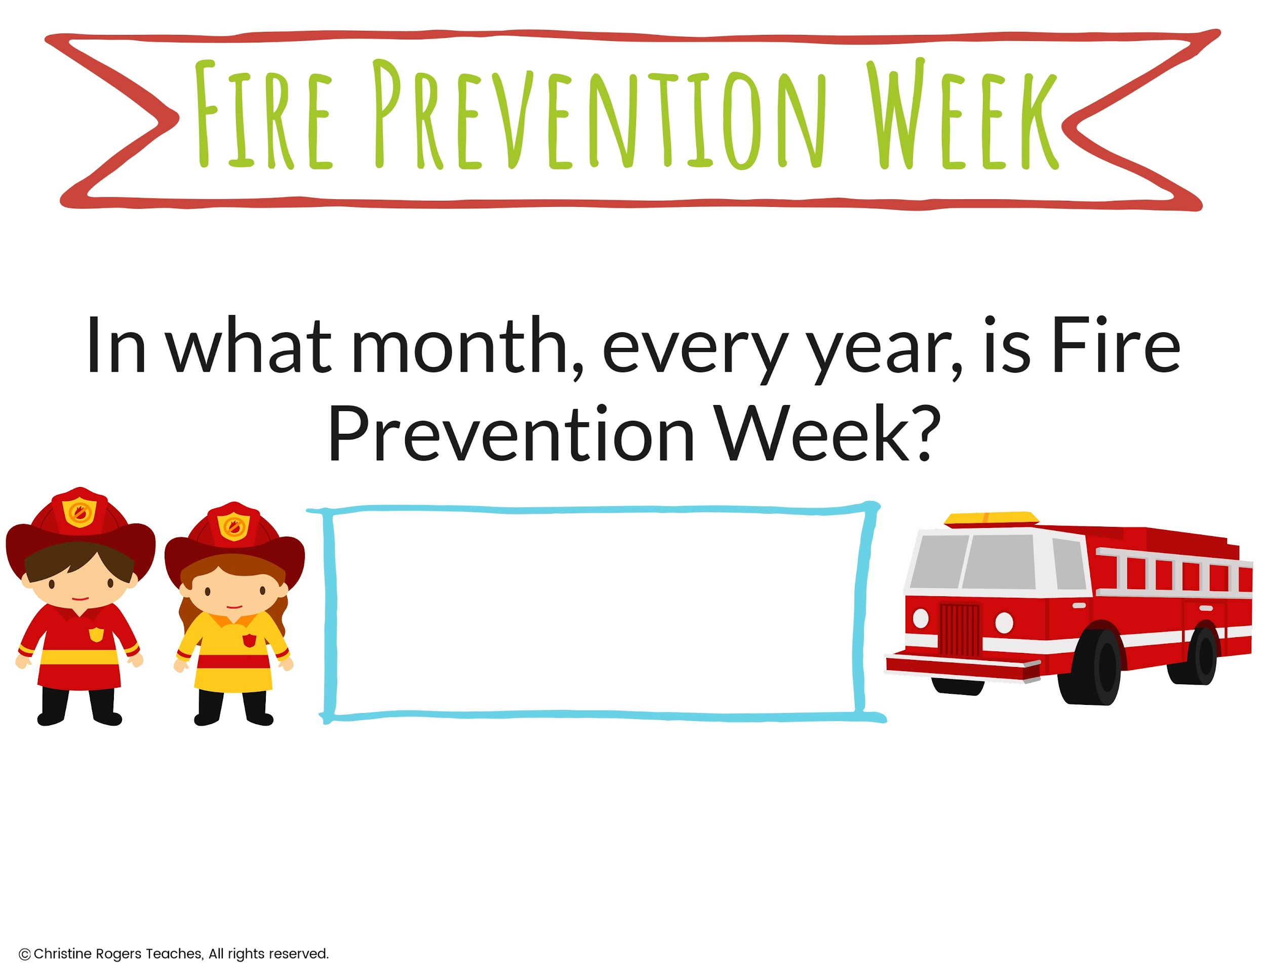
March
July
October

