Slide 2
Copy-

Slide 4
Paste-

Slide 7
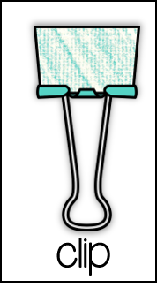

Slide 9
The sun is in the center of our solar system. | The sun is in the center
There are fifty states in the USA. | states in the USA.
Every wave has a crest and trough | Every wave and trough
Sometimes I wonder | Sometimes I wonder how wifi works
security software. | A computer needs security software
Never share online | Never share private information online
Type your answer here

