Slide 3
*Copy and Paste a question from Slide 2 and answer it on the next slide.

Slide 4
Question:
Source 1: | URL | Website Publisher or Author
Confirmed by: | URL | Website Publisher or Author
Answer:

Slide 5
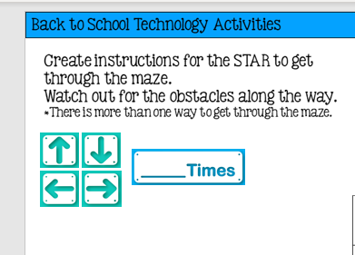
To Complete the next THREE slides, you will need to copy and paste the ARROWS and the blue TIMES boxes.

Slide 10
https://toytheater.com/geoboard/

