Slide 1
Fonts and Text
Author’s Name Goes Here

Slide 2
Sweet Lion

Slide 3
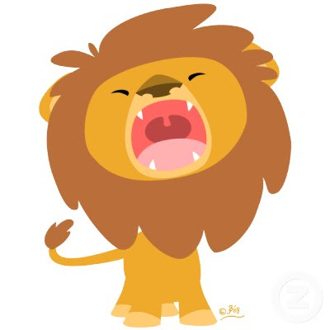
Loud Lion

Slide 4
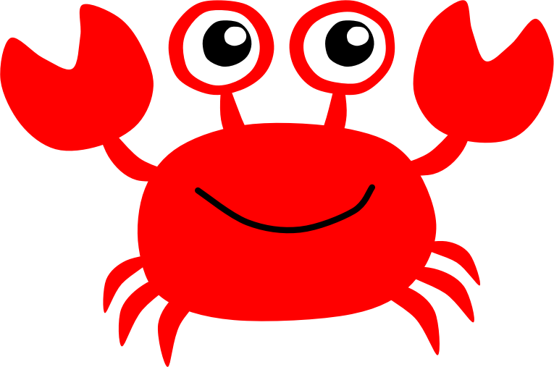
Happy Crab

Slide 5
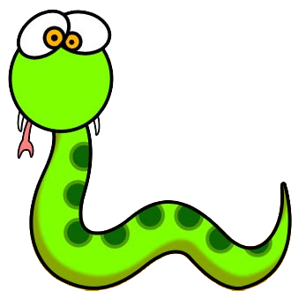
Silly Snake

Slide 6
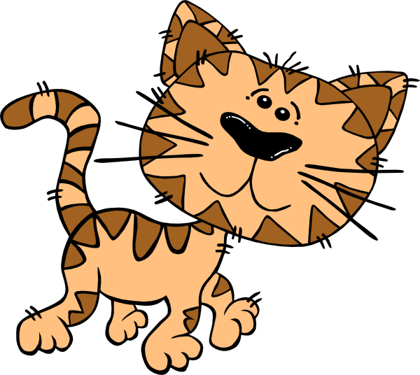
Tired Cat

Slide 7
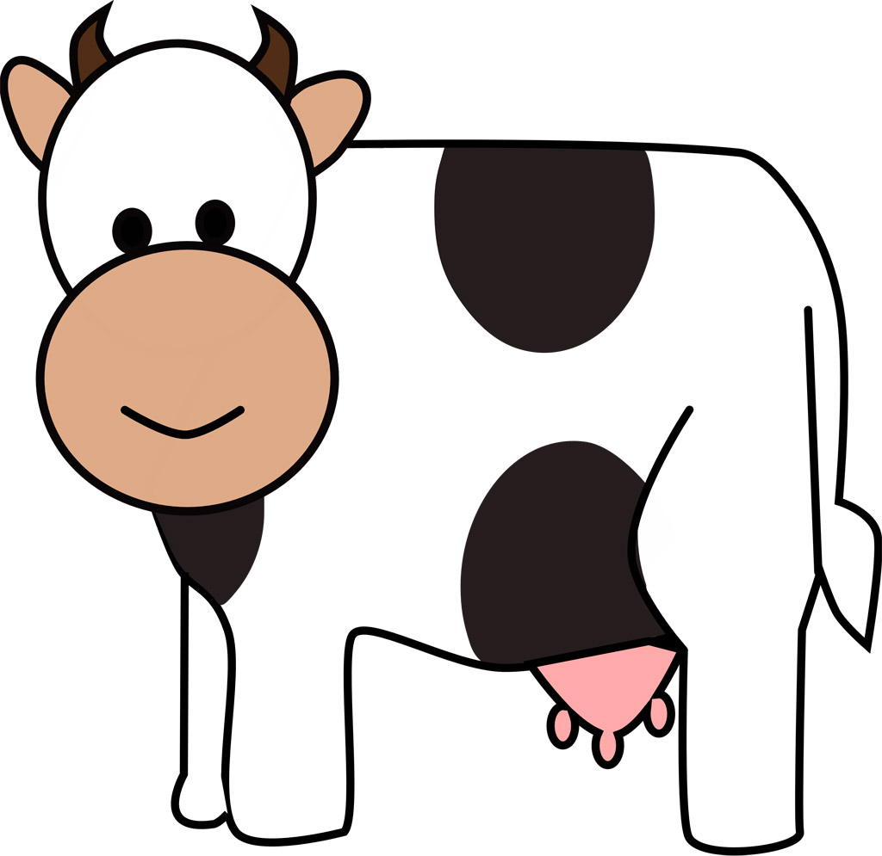
Calm Cow

Slide 8
Colorful Fish

Slide 9
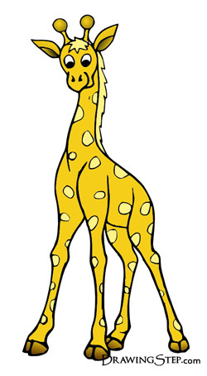
Tall Giraffe

Slide 10
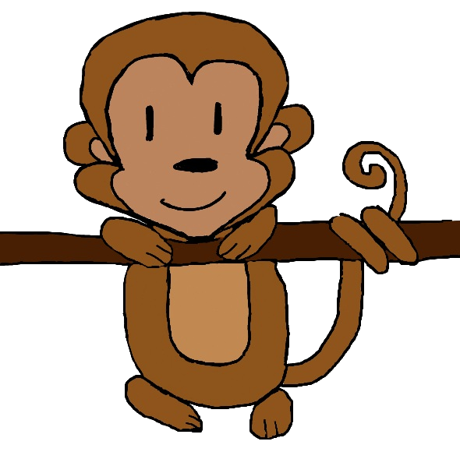
Hanging Monkey

