Slide 1
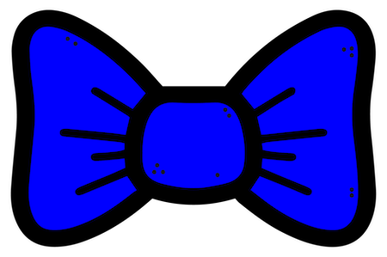
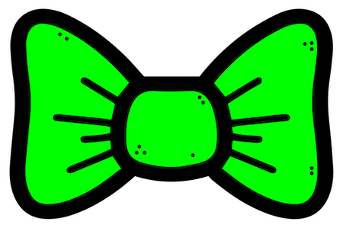
Add one bowtie
If you added the blue bowtie then add a button, else add gloves.

Slide 2
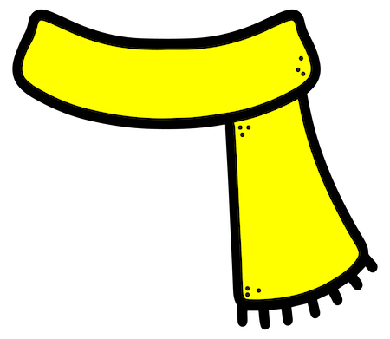
Add one scarf
If you added the red scarf then add the top hat, else add the soft hat.

Slide 3
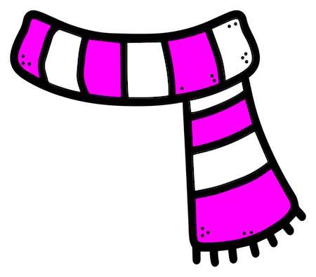
Add one button
If you added the blue button then add a smiley face, else add gloves.

Slide 4
Add one hat
If you added the yellow hat then add the scarf, else add the bowtie.

Slide 5
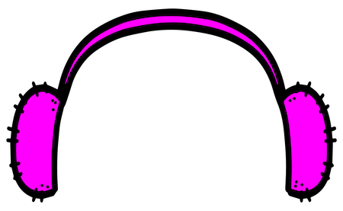
Add one face
If you added the sad face then add the bowtie, else add a button.

Slide 6
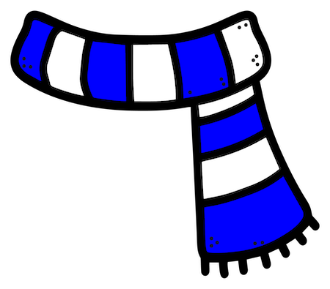
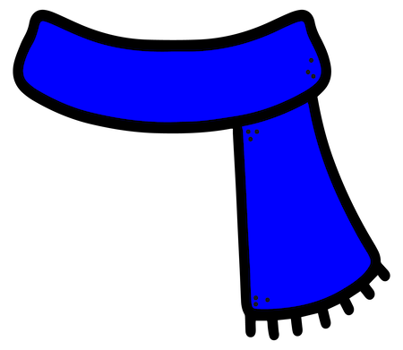
Add one scarf
If you added the striped scarf then add the hat, else add the earmuffs.

Slide 7
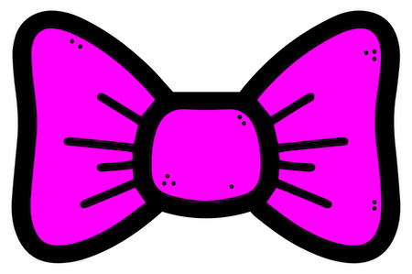
Add one bowtie
If you added the pink bowtie then add the pink button, else add the green button.

Slide 8
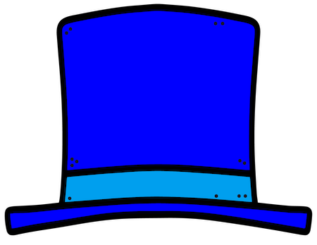
Add one hat
If you added the green hat then add the striped scarf, else add the solid scarf.

Slide 9
Add one button
If you added the red button then add the pink bowtie, else add the green bowtie.

Slide 10
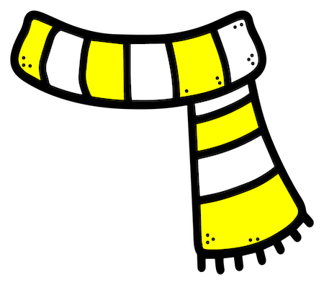
Add one set of buttons
If you added the green buttons then add the striped scarf, else add the solid scarf.

