Slide 1
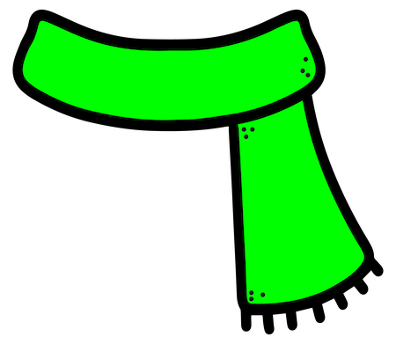
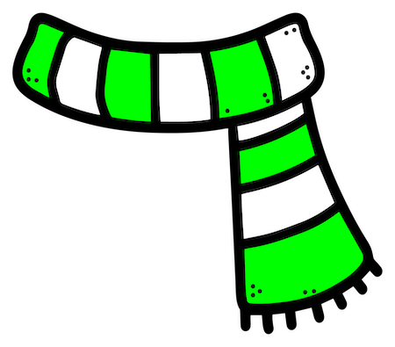
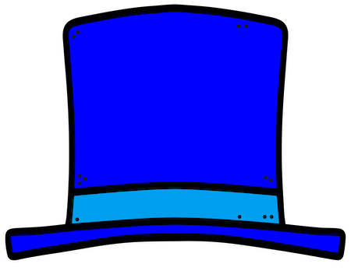
Green scarf
Blue hat
Yellow button

Slide 2
Green scarf
Yellow hat
Blue button

Slide 3
Red scarf
Blue hat
Red button

Slide 4
Yellow scarf
Yellow hat
Yellow button

Slide 5
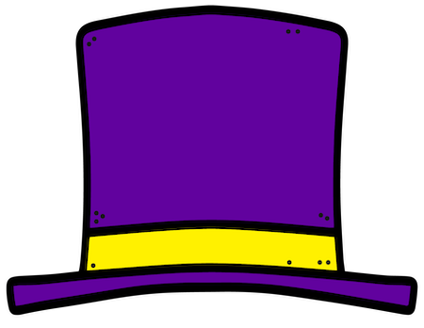
Red scarf
Green hat
Blue button

Slide 6
Two blue buttons
Green hat
Yellow scarf

Slide 7
Two red buttons
Purple hat
Green scarf

Slide 8
Two yellow buttons
Yellow hat
Green scarf

Slide 9
Red button
Red hat
Blue scarf

Slide 10
Blue button
Yellow hat
Blue scarf

