Slide 1
Adding, Deleting, Copying, and Changing Slide Layouts
Author’s Name Goes Here

Slide 2
Title and Content Slide Layout
The content box gives you a place to type or add graphics (pictures, videos, charts, and more).

Slide 3
This is the Section Header Layout
Use this for a long presentation or to start a new topic

Slide 4

Two Content Layout
Two boxes to type in
Great for text and a picture

Slide 5


Two Content with Captions
Give your picture
A heading or caption

Slide 6
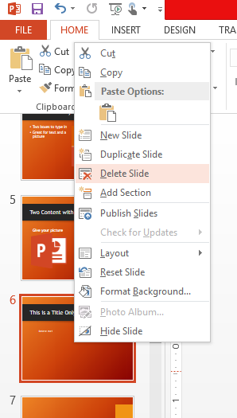
This is a Title Only Slide
Delete me!
Right-click on the slide and choose Delete Slide
Choose me
Right-click

Slide 7
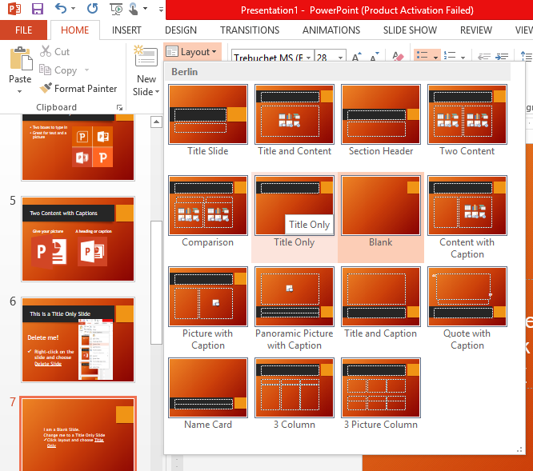
I am a Blank Slide.
Change me to a Title Only Slide
Click layout and choose Title Only
Slides box

Slide 8
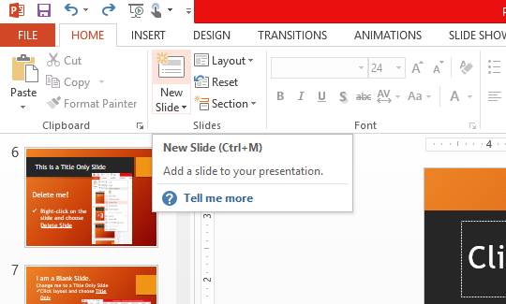
This is a Content with Caption Layout
Click New Slide to add another slide after me
Click me

Slide 9
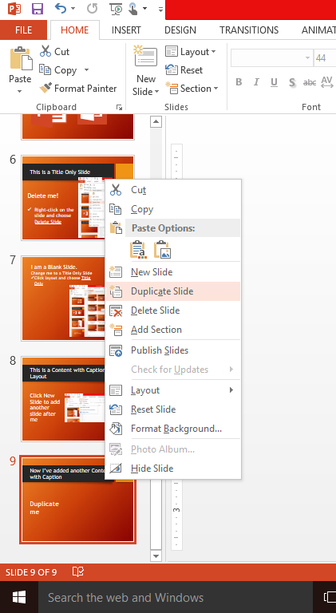
Now I’ve added another Content with Caption
Duplicate me
Right-click on the slide and choose Duplicate Slide
Choose me
Right-click

