Slide 2
7
1
4
9
2
6
Practice Copy and Pasting each picture.
CTRL and C = Copy CTRL and V = Paste

Slide 3
8
3
0
7
5
10
Practice Copy and Pasting each picture.
CTRL and C = Copy CTRL and V = Paste

Slide 6
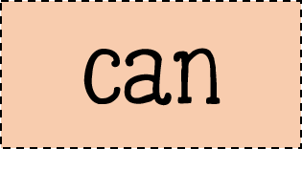
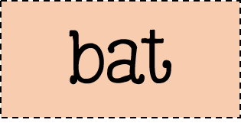
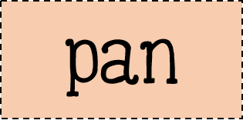
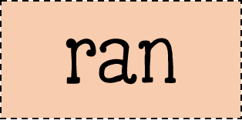

Slide 8
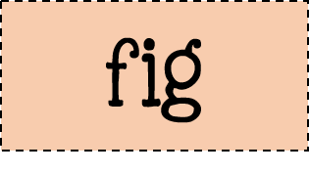

Slide 10
