Slide 2
Type here
Notes:
Teacher records class discussion responses.

Slide 3
Type here
Notes:
Teacher records class discussion responses.

Slide 4
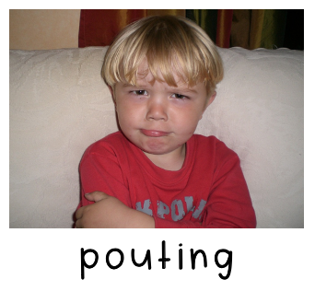
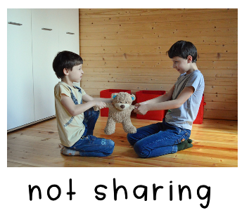
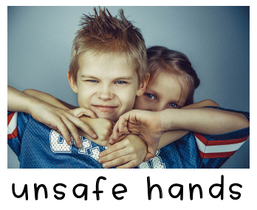
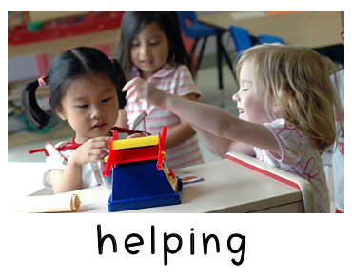
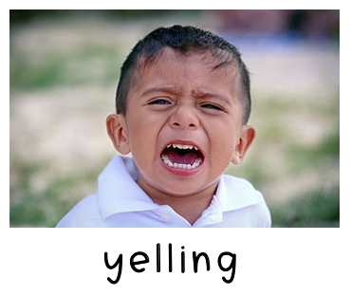
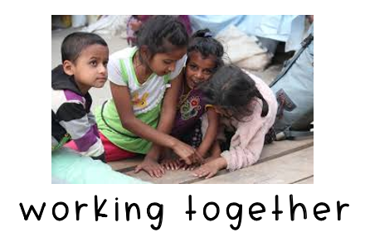
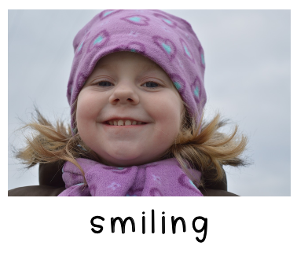
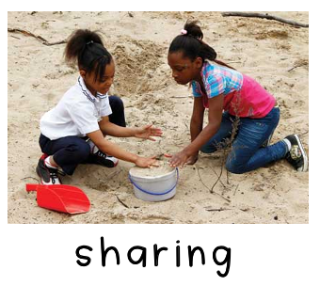
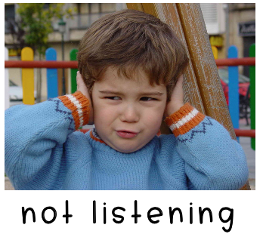

Slide 5
Type here

Slide 6
Type here
Type here
Type here
Type here
Notes:
DIRECTIONS: 1. Type your responses into the text boxes.
2. Take a photo of yourself with the camera on your computer. (Insert--Image--Camera) Then insert the photo into the box that says “I am kind.”

