Slide 1
PROBLEM TILES
SOLUTION TILES
Row | Type the word you made in each row
1 | lip
2
3
4
l
n
b
e
a
i
p
g
d
PICTURE KEY
o
t
h

Slide 2
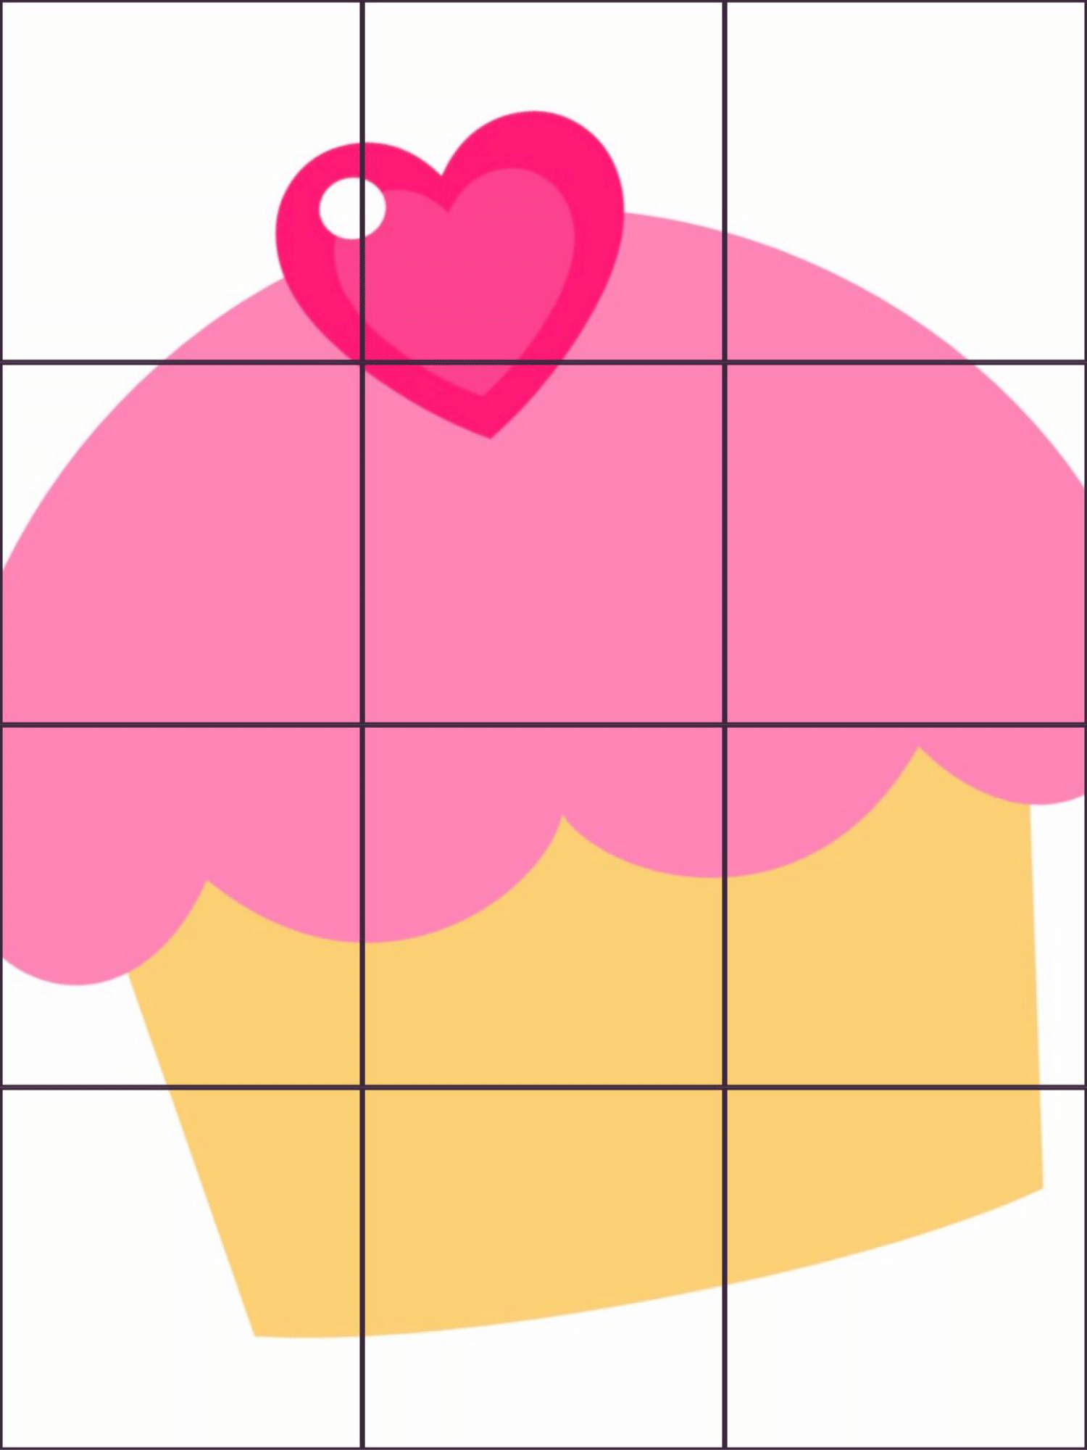
PROBLEM TILES
SOLUTION TILES
Row | Type the word you made in each row
1 | cab
2
3
4
p
g
o
c
e
b
t
h
u
PICTURE KEY
a
n
d
Notes:
Addition Regrouping

Slide 3
PROBLEM TILES
SOLUTION TILES
Row | Type the word you made in each row
1 | bug
2
3
4
i
d
a
b
o
n
g
t
l
PICTURE KEY
c
u
f
Notes:
Addition Regrouping

Slide 4
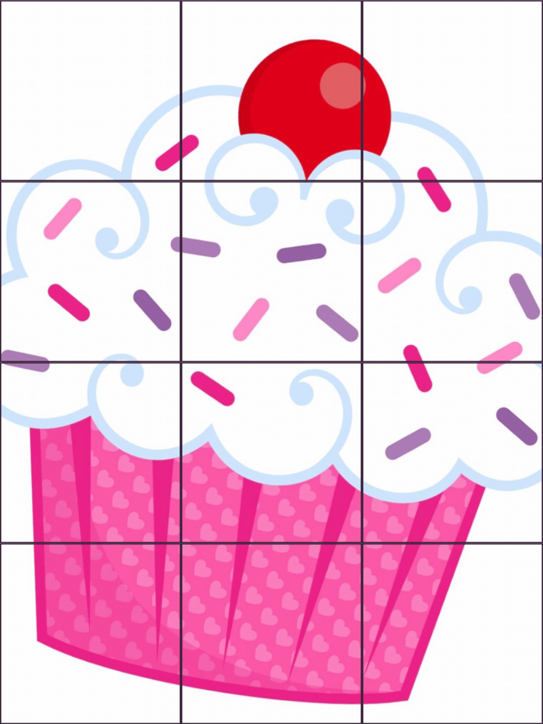
PROBLEM TILES
SOLUTION TILES
Row | Type the word you made in each row
1 | bag
2
3
4
r
t
p
n
g
u
i
a
d
PICTURE KEY
b
h
e
Notes:
Addition Regrouping

Slide 5
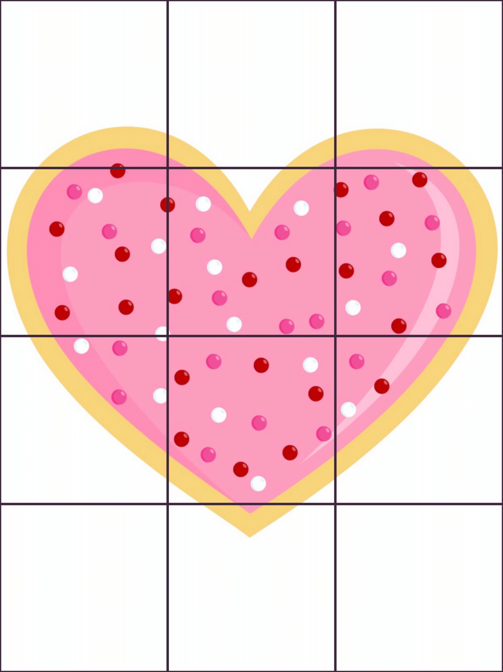
PROBLEM TILES
SOLUTION TILES
Row | Type the word you made in each row
1 | cap
2
3
4
c
t
g
d
j
a
h
e
l
PICTURE KEY
p
o
i
Notes:
Addition Regrouping

