Slide 1
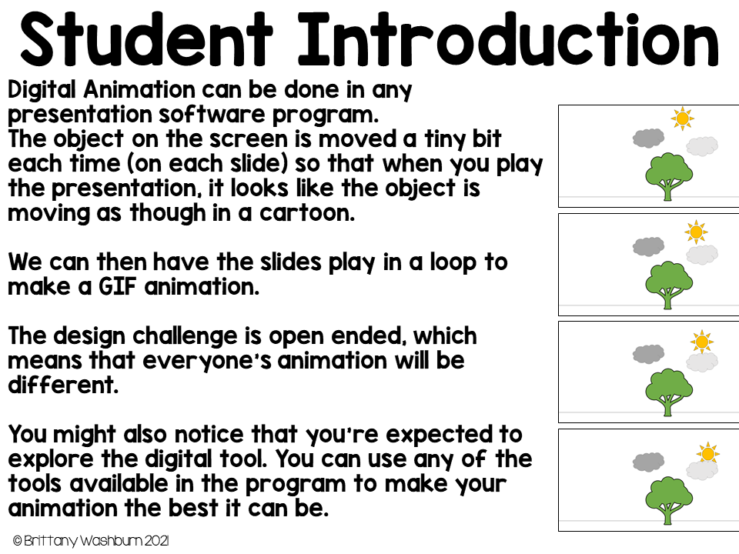

Slide 2
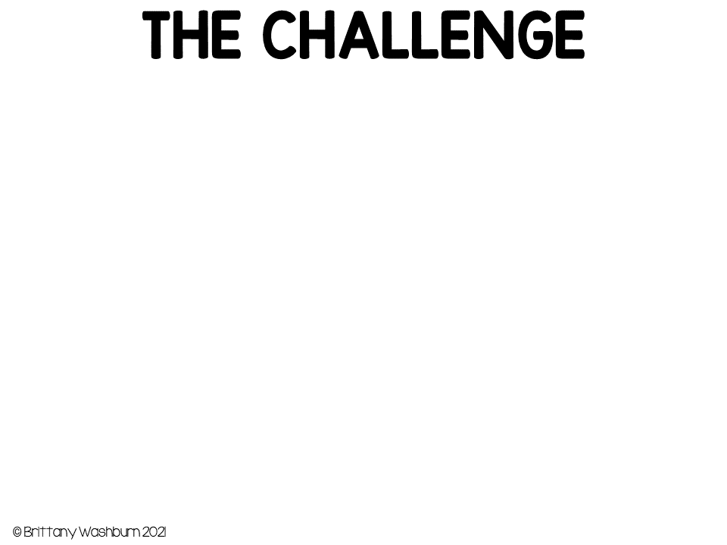
Create a Halloween scene animation with at least 2 clip art pieces and at least 1 line of text.

Slide 3
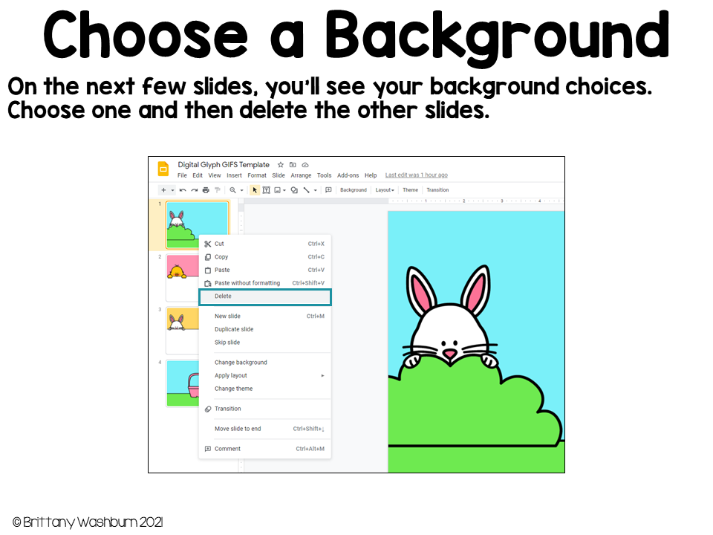

Slide 4
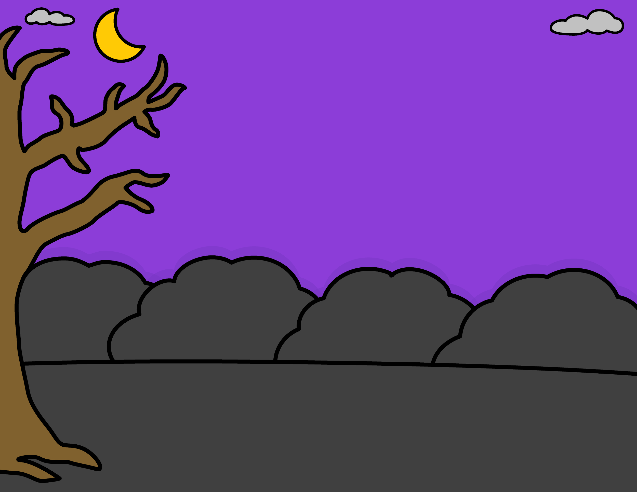

Slide 5
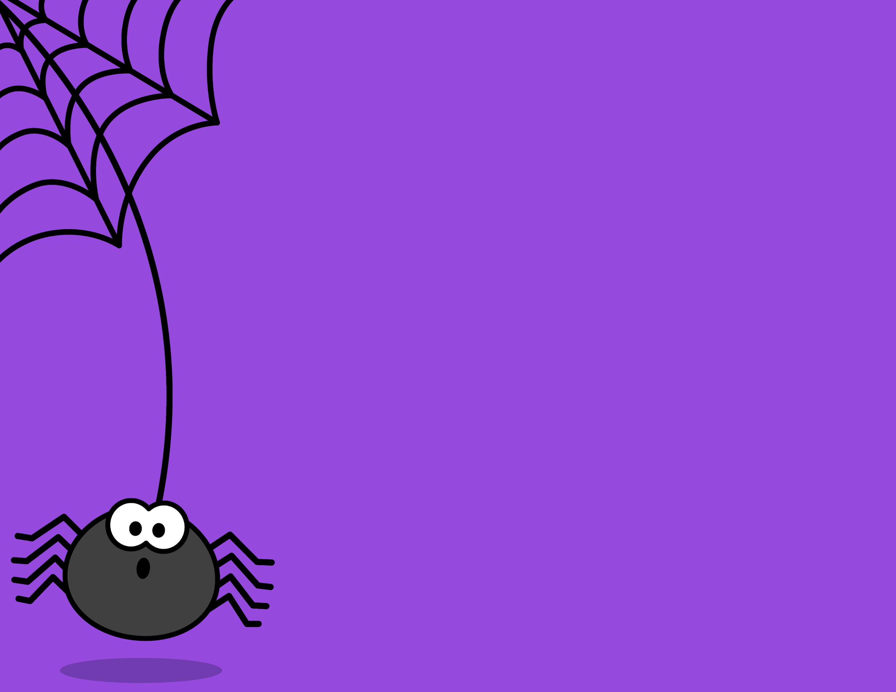

Slide 6
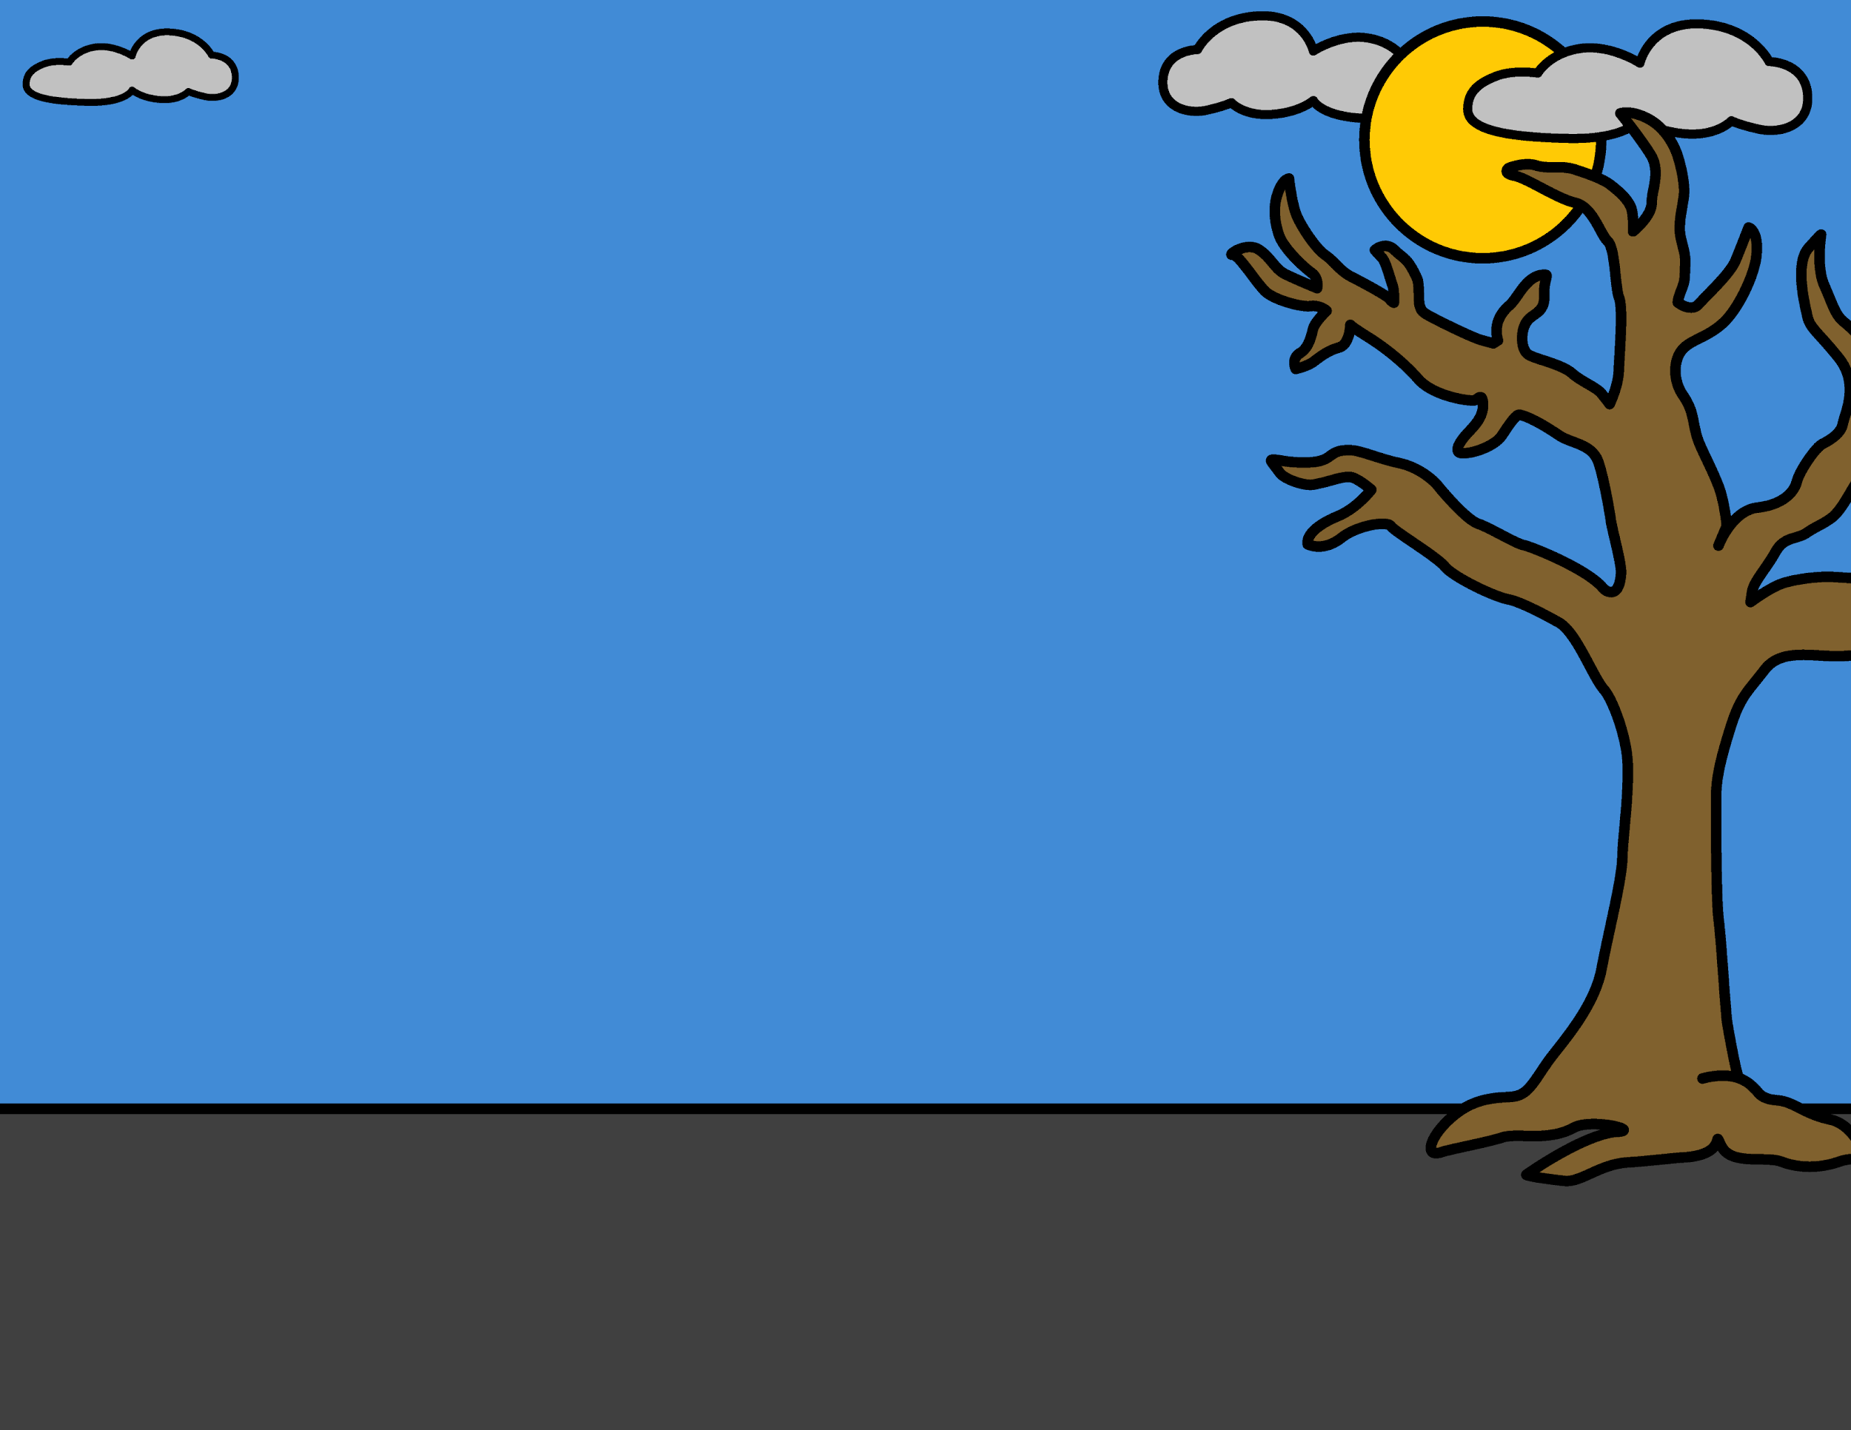

Slide 7
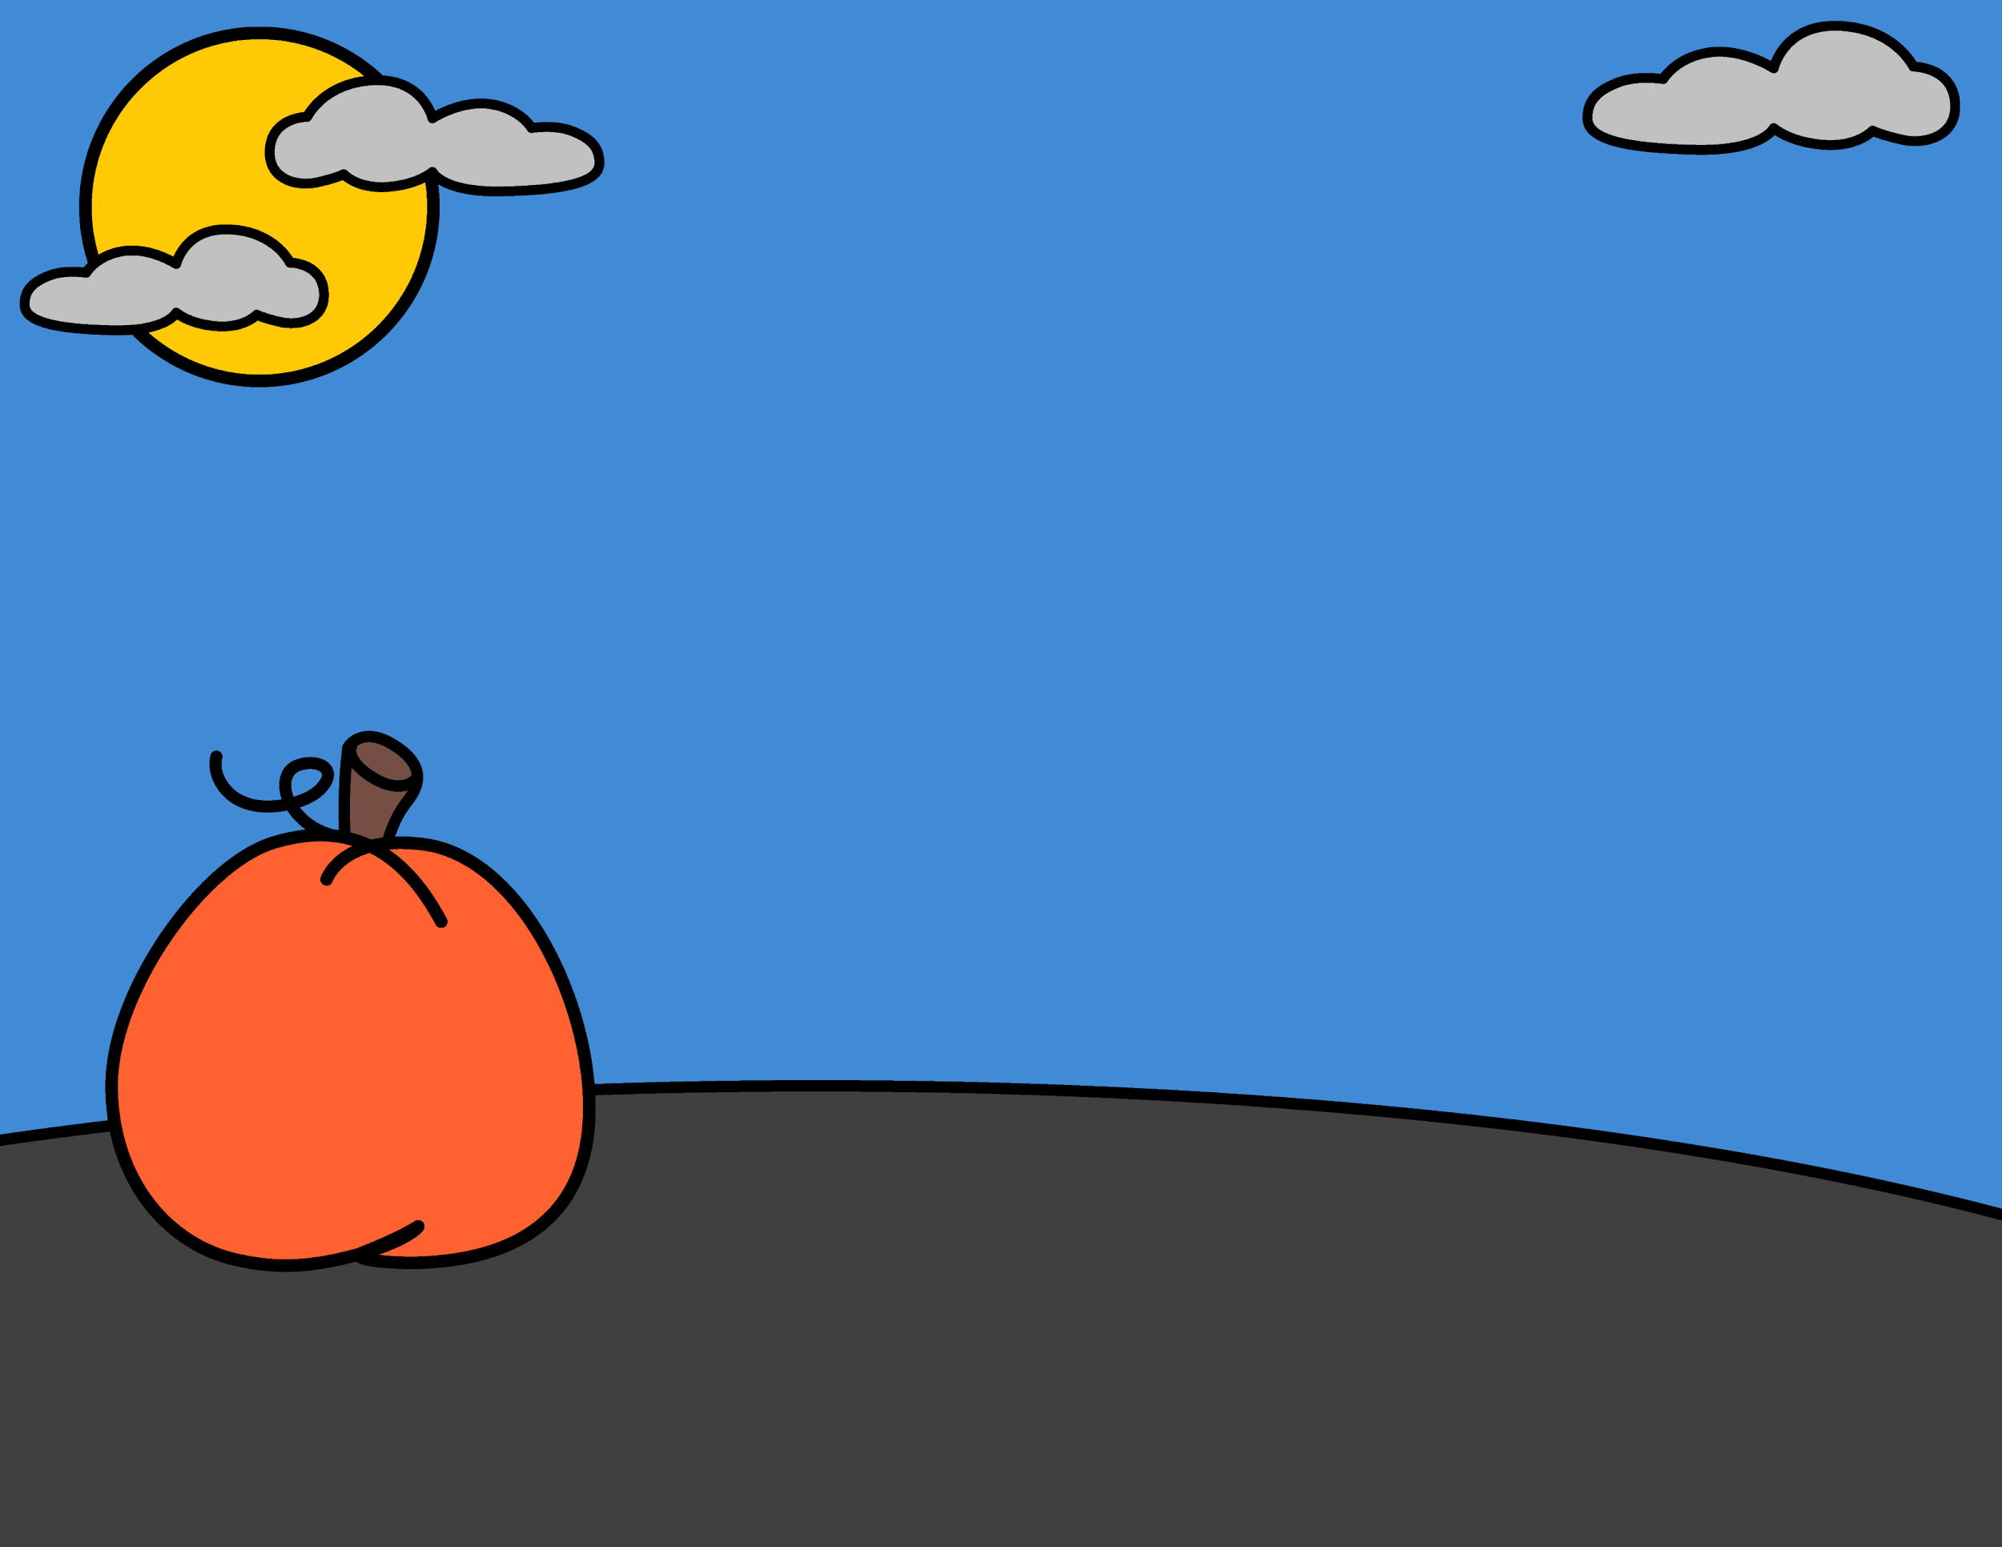

Slide 8
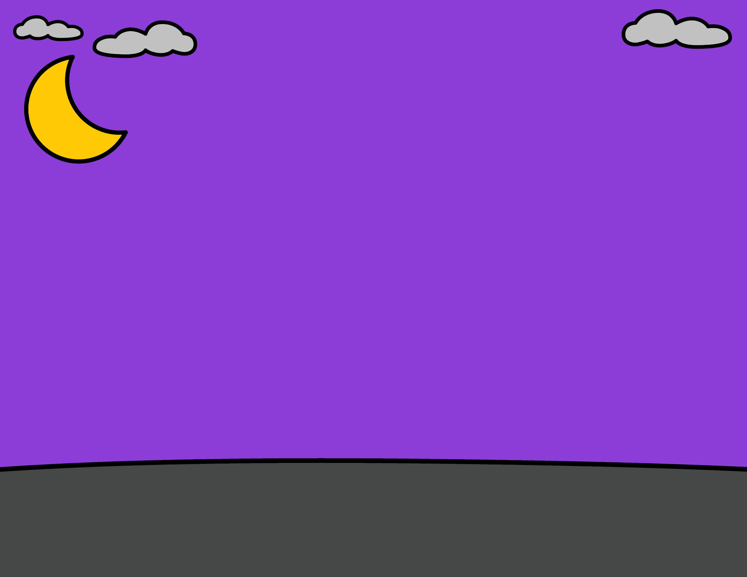

Slide 9
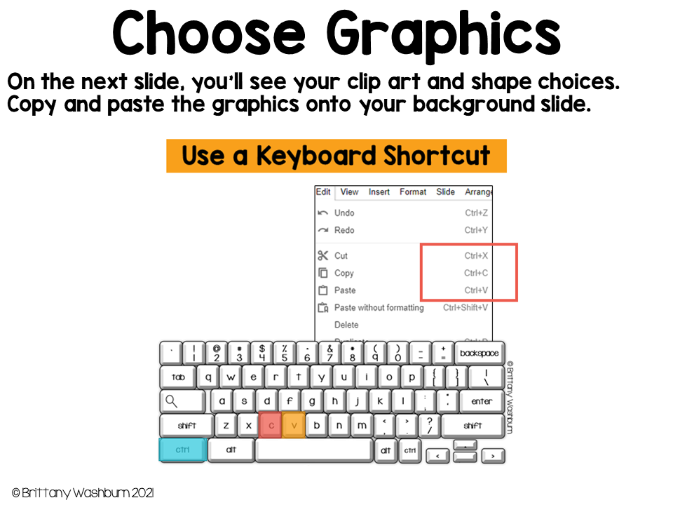

Slide 10
These graphics are layered shapes, which means they are grouped together. To color the graphics, use the fill color bucket tool. Be precise by clicking the part of the shape you want to color twice to select it.
To resize grouped shapes, hold down the shift key on your keyboard while you pull the corner handle. This will keep the aspect ratio (proportions) from distorting.

Slide 11
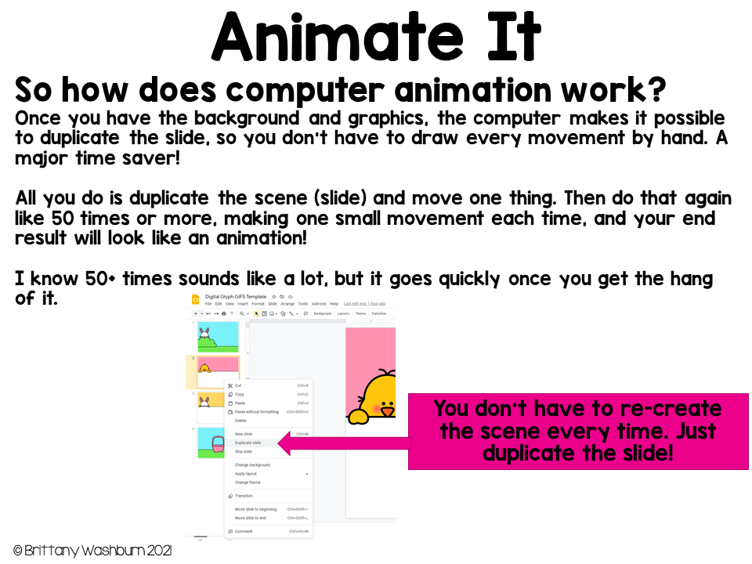

Slide 12
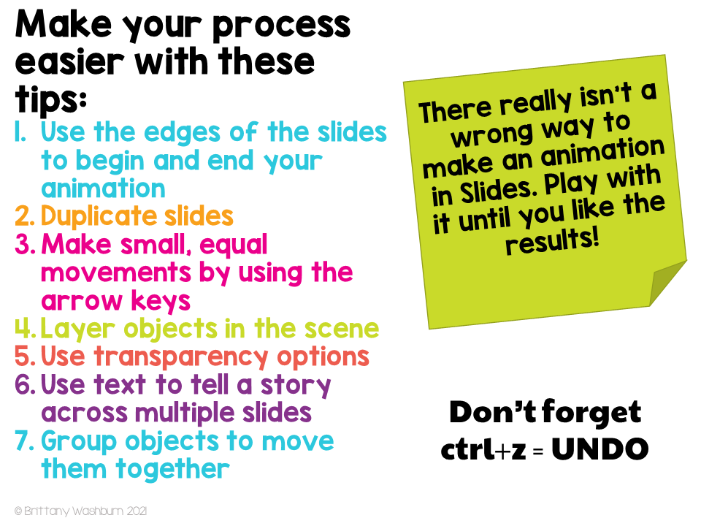

Slide 13
