Slide 1
Your Rings of Responsibly Review Questions
How could throwing a bottle out of your window be similar to something you do online?
What are the Rings of Responsibility?
Have you ever heard the term "digital citizen"? What comes to mind when you hear that term?

Slide 2
The Power of Words- Review Questions
Why do you think the other player made those comments to Guts?
What did Guts do in response to the mean words?
How is getting called names online similar to getting called names in person?
What are the rules of S.T.O.P.? What can you do if someone is mean to you online?

Slide 3
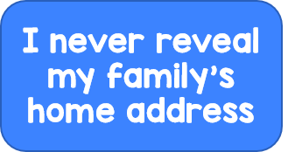
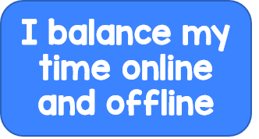
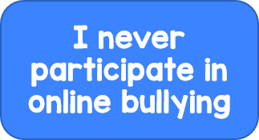
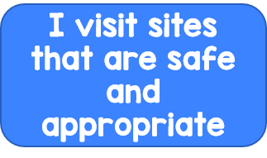
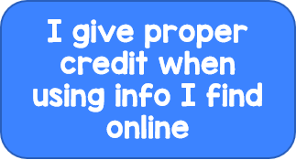
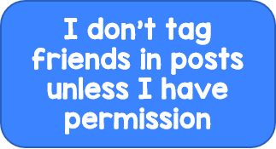

Slide 4
