Slide 1
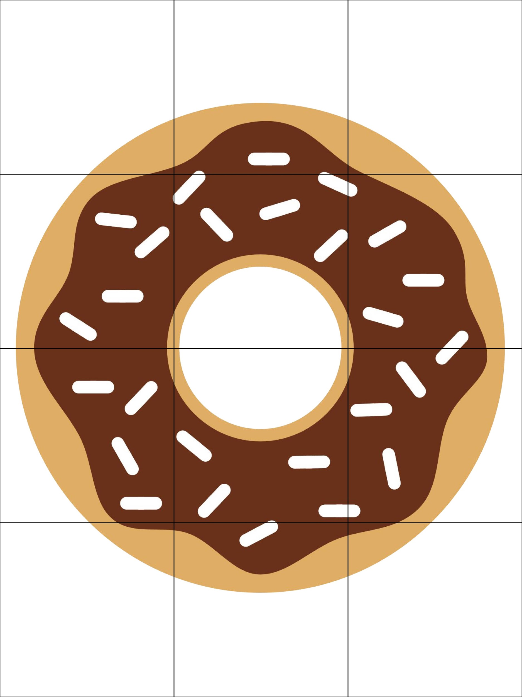
PROBLEM TILES
SOLUTION TILES
When you’re finished, move this rectangle to reveal the picture and check your work.
© Brittany Washburn
PICTURE KEY

